Slide 1
Parkinson’s disease and anaesthesia
Dr. S. Parthasarathy
MD., DA., DNB, MD (Acu),
Dip. Diab. DCA, Dip. Software statistics
PhD (physio)

Slide 2
My salute !!
Legendary teacher of two centuries--
Dr. M.Ravishankar

Slide 3
What is it ??
Parkinson's disease is a neurodegenerative disorder of unknown cause. (James Parkinson, 1817)
One of the most common neurodegenerative disease, affecting
2% of persons, age of 65 years
3 % in 80 years of age
Factors
Increasing age ,manganese exposure , genetic associations

Slide 4
Basic symptoms
tremor at rest,
rigidity,
bradykinesia,
postural instability
Shaking palsy
The turn after walking is difficult
They cannot walk but they can run

Slide 5
Non Motor Symtoms
urinary dysfunctions (82.6%),
sleep (80.6%),
gastrointestinal (80%) disorders.
autonomic dysfunctions were also frequent:
thermoregulatory dysfunctions 58.6%,
cardiovascular 50.9%,
sexual dysfunctions 47.9%. Depression was present in 47.9%
fatigue symptoms in 23.1%.

Slide 6
Causes IM DVT
Drugs --phenothiazines,
butyrophenones, metoclopramide
post encephalitis, AIDS
Vascular- arteriosclerosis,
multi- infarct disease,· Tumour
· Post trauma eg repeated head injury
·Toxicity eg Wilson’s disease, heavy metals, carbon monoxide poisoning
· Metabolic eg hypoparathyroidism

Slide 7
Other systems with anaesthesia significance
Respiratory dysfunction results from the uncoordinated involuntary movement as a result of rigidity and muscle weakness.
Also pharyngeal muscle weakness leads to increased retention and improper impaired expulsion of respiratory secretions and can cause perioperative aspiration pneumonia

Slide 8
Other signs- Autonomic dysfunction
orthostatic hypotension, sialorrhea, constipation, incontinence, and frequency, excessive sweating, and seborrhea
Autonomic instability can lead to sudden, exaggerate or uncertain response to central neuraxial blockade.

Slide 9
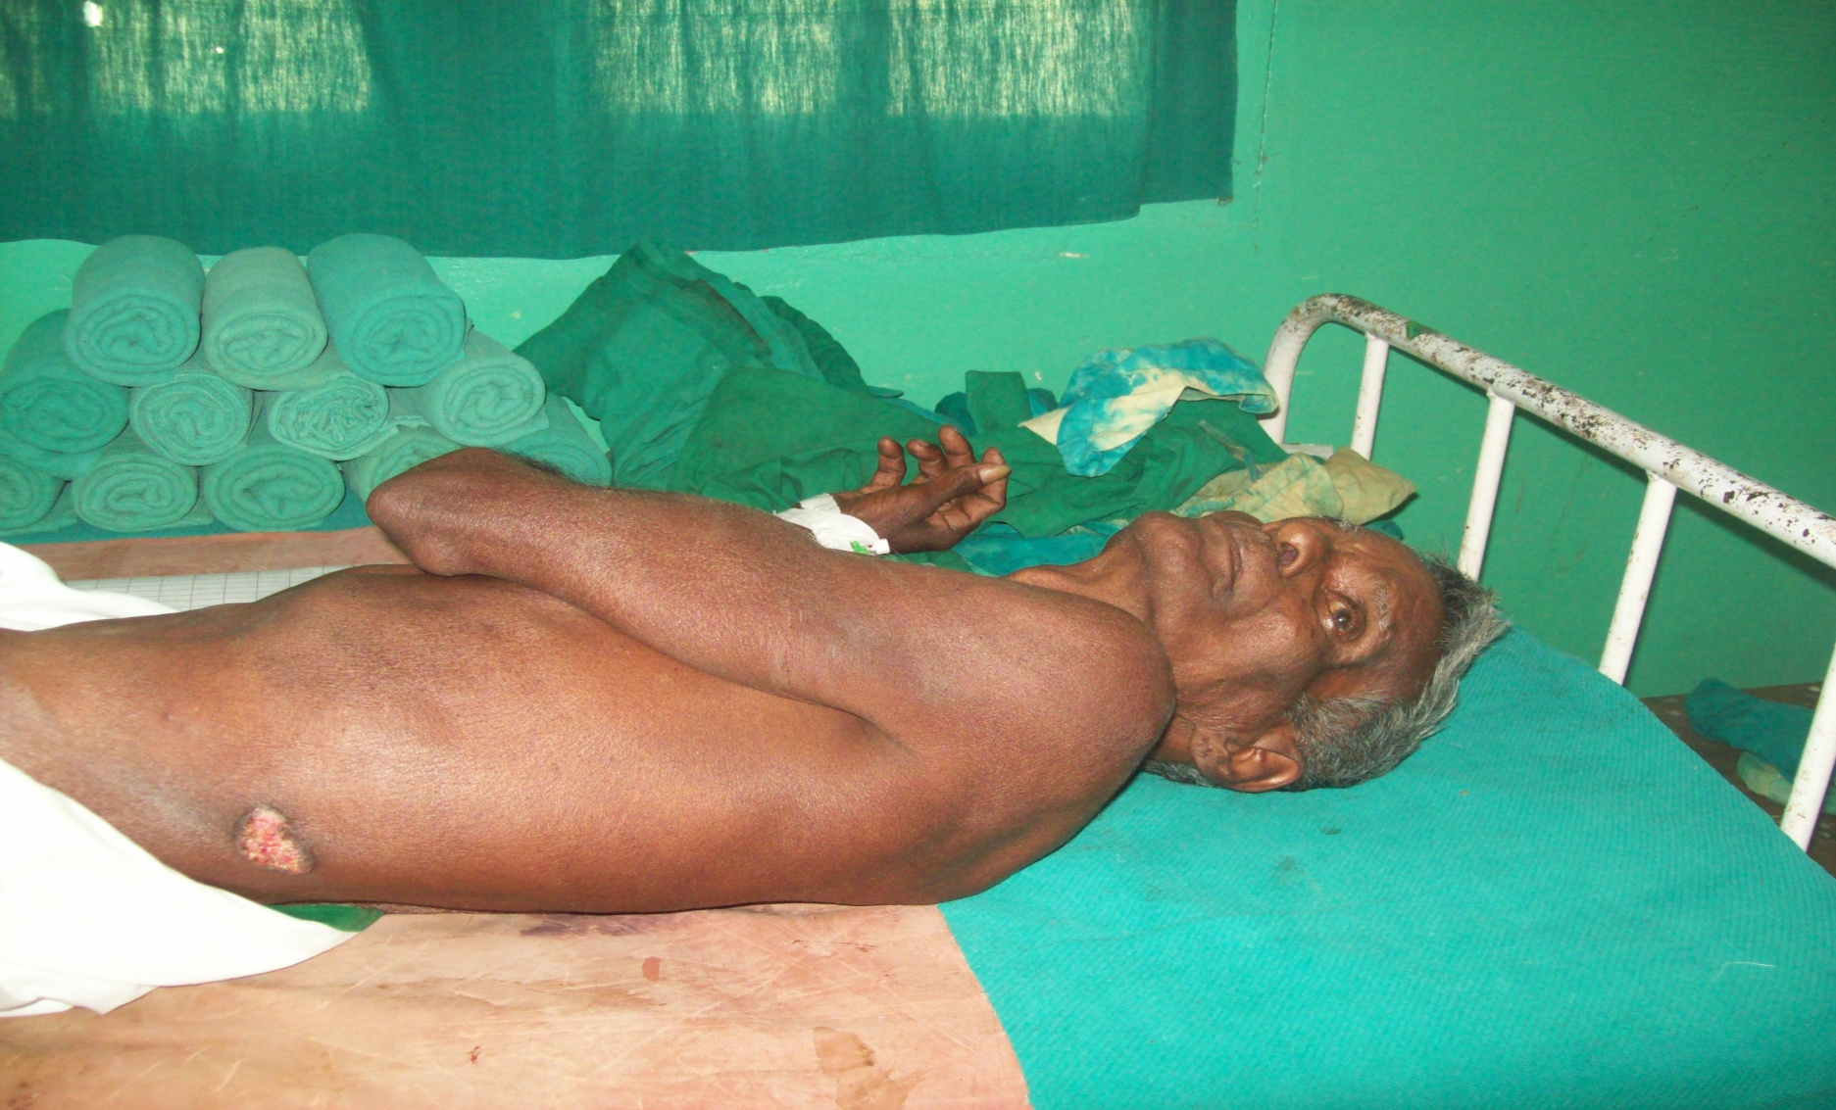
Diagnosis
There is no specific test to confirm Parkinson's disease, the diagnosis is made mainly on clinical grounds.
MRI - normal in Parkinson's disease but may be useful in demonstrating cerebrovascular disease or widespread brainstem atrophy in other neurodegenerative disorders

Slide 10
Basal ganglion – striatal fibres
ach
DA

Slide 11
Drugs
Increase dopamine or decrease Ach
benzhexol
L dopa + DDI
MAO inhibitors
Selegeline , rasageline
COMT inhibitors
Tolcapone ,entacapone
Apomorphine, amantadine,
Pramipexole , ropinirole
Accurate reconciliation and timely administration of home medications

Slide 12
Why We should know ?
patients with PD undergoing non-neurological surgeries have higher 30-day mortality and have a greater risk of having postoperative major complications including pulmonary embolism, stroke, pneumonia, septicemia, acute renal failure, and urinary tract infection

Slide 13
Drugs
Oral levodopa.with DDI-- Treatment should continue until the morning of surgery.
orthostatic hypotension, dyskinesia, NMS (neuroleptic malignancy syndrome).
the high dopamine levels ? can predispose to arrhythmias under general anaesthesia
patients should resume treatment as soon as possible

Slide 14
Levo dopa –tips
Patients on levodopa treatment will have severe nausea and vomiting, are more prone to be dehydrated and hypovolemic.
Levodopa acting through a central mechanism contributes to hypotensive effect.
In patients on levodopa therapy, mono amino oxide (MAO) inhibitors are contraindicated and sympathomimetics should be used with caution as these can cause an acute rise in blood pressure.

Slide 15
Other drugs
The COMT inhibitors in common clinical use are tolcapone and entacapone.
Tolcapone – liver damage
Anticholinergic drugs such as orphenadrine benzhexol have limited efficacy and many side-effects, which limit their tolerability.
They may be useful in early disease to treat tremor (where bradykinesia is not a major problem)

Slide 16
Periop use ?
Apomorphine is a short-acting dopamine agonist that is administered subcutaneously, or sometimes sublingually or intranasally.
An important side-effect is nausea and vomiting, but with the concurrent use of domperidone it may be well tolerated

Slide 17
MAO- B inhibitors – selegeline
inhibit the metabolism of narcotics in the liver, so 20%–25% of the usual dose is advised.
Serotonin syndrome (autonomic instability with hypertension, tachycardia, hyperthermia, hyper-reflexia, confusion, agitation, and diaphoresis) occurs when meperidine is given to patients receiving antidepressants
RASALECT , syndopa plus , entocom, neupro patch – beta blockers ?

Slide 18
Rivastigmine and muscle relaxants
If they have dementia ?
Acetylcholinesterase inhibitors for PD dementia (rivastigmine, donepezil, and galantamine) are commonly prescribed,
Sensitive to succinylcholine (up to 50 minutes) increased resistance to neuromuscular blocking drugs.

Slide 19
Other treatment options
Surgical procedures comprise deep brain stimulation, ablative lesions and cell transplantation.
Deep brain stimulation has the advantage
that it is reversible and adjustable.

Slide 20
For what they can come for ??
for prostrate,
incidental general surgical procedures, cataract,
gynecological surgeries,
Orthopaedic ( HIP) and so on.

Slide 21
Anaesthetic considerations –preanaes check up.
Routine + type of surgery
Head and neck – rigidity, pharyngeal muscles
Resp. impairment ,larynx, postop etc
CVS –hypertension orthostatic hypo -check BP in two positions , arrhythmias –
check pulse for one minute
GI – reflux, nutrition
Musculoskeletal and CNS
use of antimuscarinic drugs increases viscosity of saliva and further impairs swallowing

Slide 22
Periop drugs
All drugs to continue except
Anticholinergics and MAO inhibitors
If a patient is taking a monoamine oxidase-B inhibitor,
such as rasagiline or selegiline, it is recommended to discontinue it 1 to 2 weeks before surgery.
Immediate post op -- drugs to continue
rotigotine patches are an ideal choice in the perioperative management of PD.
Fasting guidelines and scheduling of drugs

Slide 23
Perioperative drugs
300 mg of levodopa could be equivalent to 8 mg of rotigotine.
If the patient was already receiving rotigotine, then the same dose could be maintained or even increased to 24 mg/day
Subcutaneous apomorphine can be used every 3—4 h with ondansetron

Slide 24
INTRAOPERATIVE CONSIDERATIONS
general anesthesia would temporarily suppress the parkinsonian symptoms, those under regional anesthesia may have persistence of rigidity in the neck or in the extremities and tremor of several parts of the body.
Musculoskeletal abnormalities
Proper positioning is essential

Slide 25
Which monitoring !
thermoregulatory dysfunction is common in PD.
Spontaneous periodic hypothermia
Parkinson hyperpyrexia syndrome if we stop drugs

Slide 26
presence of tremor can result in artifacts in the EKG
Excess sweats may remove the ECG electrodes

Slide 27
Prone for aspiration pneumonia
impaired cough reflex ,
defective motor control for cough ,
and dysphagia in elderly PD population
PPI like intravenous pantoprazole

Slide 28
GA – induction
Propofol ok but cautious in stereotactic procedures – abolishes signs
Thiopental reduces the release of dopamine at a striatal level
Ketamine would be contraindicated as it may cause an exaggerated sympathetic response.
Ophthal - GA

Slide 29
Tips
consider low-dose ketamine (0.1–0.2 mg/kg IV) as a safe, novel, and useful temporary adjunct to long-term treatment when doses of dopamine-based medications are missed within the perioperative setting.
Sialorrhoea and dystonic neck – difficult airway

Slide 30
Agents – inhalational
No halo
But others ok
Think of exaggerated hypotension

Slide 31
Neuromuscular blockers
Non-depolarising muscle relaxants are safe;
rocuronium would be the main choice in PD.
Succinylcholine may be safe, although there have been reports of hyperkalemia being induced in PD patients.

Slide 32
Phenothiazines, butyrophenones (including droperidol) and metoclopramide may worsen PD and, therefore, would be contraindicated
No Phenergan
Opioids may induce rigidity and should be employed with caution. Fentanyl –ok
No to pethidine

Slide 33
Dysautonomia
Dysautonomia is common in elderly PD patients, more so in those with advanced PD.
The wide fluctuation of blood pressure during anesthesia should be quickly recognized
persistent hypotension in PD can be managed with the α1-adrenoreceptor agonist phenylephrine
Intraoperative hypertension – better to use labetolol – does not cause blood brain barrier

Slide 34
Intra op tips
Harmonic scalpel – Ok
Prefer bipolar diathermy
Intravenous fluids to avoid dehydration
Rotigotine patch can be initiated and continued after neurology consult
Dexmedetomidine is an α2-agonist recently proposed as a potentially ideal drug for sedation during the surgical treatment of Parkinson's disease (PD

Slide 35
Emergence from anaesthesia
pathological neurological reflexes, including hyperreactive stretch reflexes, ankle clonus, the Babinski reflex, and decerebrate posturing.
Shivering is common after general anaesthesia
Rigidity after both high-dose and lower-dose fentanyl is also well described in normal patients.
Adequate tidal volume !??
Patients with Parkinson‘s disease are more prone to postoperative confusion and hallucinations
Same risk of aspiration

Slide 36
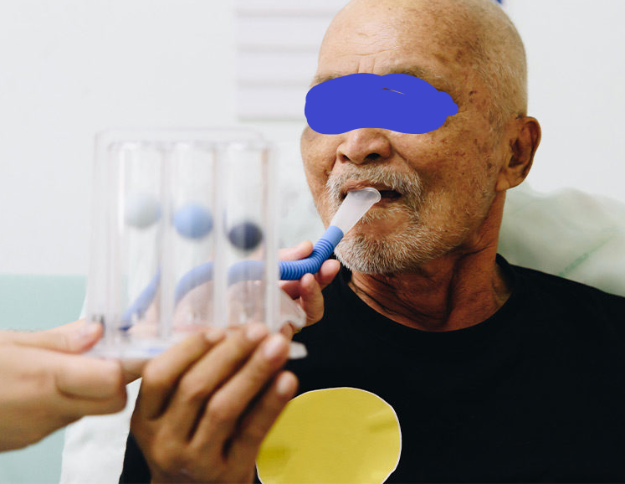
Chest physiotherapy and breathing exercises for all the thoracic and upper abdominal surgeries should be instituted to avoid respiratory infections

Slide 37
Regional
It avoids the effects of general anaesthetics and neuromuscular blocking drugs, which may
mask tremor.
Aspiration - less
If sedation is required, diphenhydramine-ok
postoperative nausea and vomiting is less
Drug continuation easy
post op atelectasis – less

Slide 38
Mechanical problems
Excessive movement can be a problem for surgeries performed with local or regional anaesthesia.
Tremors – regional – can affect procedure , monitoring – still patient ??
Can give oral syndopa – twenty minutes to act

Slide 39
Post op considerations
Strict vigilance of the hemodynamic and respiratory parameters in the immediate postoperative period
Care must be taken to start antiparkinsonian drugs as soon as possible, - ileus – small bowel absorbtion
Proper postoperative analgesia with multimodal analgesics or with strong NSAIDs should be provided according to the type of surgery.
Chest physiotherapy and breathing exercises for all the thoracic and upper abdominal surgeries should be instituted to avoid respiratory infections.

Slide 40
Tremors !! ??

Slide 41
Mobilize early
But beware of falls
Immobile - think of heparin !

Slide 42
Post op fever

Slide 43
Think of old age and other comorbid illness

Slide 45
Long live the ISA - Thank you all
Usually I get hip/ortho/cataract - rarely Ca stomach
Continue all drugs stop rasalect
Good block ( PENG or IPACK )
Spinal fentanyl with bupivacaine – SCBPB – IV clonidine
Creatinine and ketorolac
Oral para and flupirtine – oral tramadol ?? !
Immediately continue the drugs or benzodiazepines for hallucinations
No haloperidol !

