Slide 1
Peripartum cardiomyopathy
Dr. S. Parthasarathy
MD., DA., DNB, MD (Acu),
Dip. Diab.DCA, Dip. Software statistics
PhD (physio), IDRA FICA CUGRA

Slide 2
What is it ?
Dilated cardiomyopathy
Systolic dysfunction decreased EF <45 %
Idiopathic
Late pregnancy or postpartum
Some presented at 36 weeks and hence the definition did not have weeks
A majority may present postpartum !!

Slide 3
History
1800 – Virchow defined heart failure with pregnancy
1930 s – more awareness
1990s echo development

Slide 4
Increased airway pressure is increase seal pressure
The surrounding pressure never exceeds

Slide 5
Incidence
1 in 4000 to 1 in 1000 live births
Why an increase ?
Advancing maternal age
Preeclampsia
Better diagnosis
Asthma
Substance abuse
Smoking
Deficient micronutrition
Tocolytics

Slide 6
Late pregnancy – postpartum
Why should the time be like that ??
Maximal hemodynamic changes and stress

Slide 7
Etiopathogenesis
Viral myocarditis
Hormonal (prolactin insult)placental angiogenic factors to the heart when the female is genetically predetermined
Older age
Blacks

Slide 8
Clinical features
dyspnea on exertion,
orthopnea, paroxysmal nocturnal dyspnea,
edema of the lower extremities.
Rarely with severe systolic failure and shock needing ICU care and mechanical ventilation
Both RV and LV failure dysfunction may present …

Slide 9
Hidden symptoms
Normal pregnancy – dyspnea ??

Slide 10
ECG -
No use
Usually normal
May be STT changes –
Arrythmias
Biomarkers
Pro BNp
Cathepsin
Interferons
Soluble fms-like tyrosine
kinase-1 (sFlt-1)

Slide 11
ECHO- the standard test
Dilated cardiomyopathy
No RWMA
EF < 45 %
BOTH right and left heart dilation
No other valvular lesions
Look for clots
Cardiac magnetic resonance imaging provides more accurate measurement of cardiac dimensions and functions and can also be used to guide the site of myocardial biopsy if required

Slide 12
Not so good indicators
EF <35 %
Frank failure
Hypertension
Raised troponins

Slide 13
Differential diagnosis
myocardial infarction,
amniotic fluid embolism,
severe pre-eclampsia,
pericarditis,
pulmonary thrombo-embolism,
myocarditis,
sepsis

Slide 14
Complications
Thrombo embolism
Both sides cardiac chambers found
Procoagulant pregnancy increases the risk
Sudden death from ventricular arrythmias
Heparin and LMWX heparin are safe during pregnancy, and the former is preferred near term because of its shorter half-life

Slide 15
Arrythmias
Big Dilated LV
Clots
EF < 35
Think of anticoagulants
Warfarin is teratogenic

Slide 16
Treatment
Refractory cases
Assist devices and ECMO
Diuretics
Go to loop later
Beta 1 selective metoprolol
Flecainide in arrythmias – being used
No ACE inhibitors or sartans in pregnancy
?? In breastfeeding
Oxygen NIV ventilation --- digoxin – ok
Levosimendan infusions – proved benefit in failure cases

Slide 17
Newer treatment
Prolactin surge - ? Mechanism
Bromocryptine dosage
5 mg tds up to 8 weeks
No major side effects but a few gains
Amlodipine in BP is OK !!
Nitrates and hydralazine
Are also OK

Slide 18
Other emerging trends
Apheresis of angiogenic factors
Serelaxin is a recombinant form of relaxin-2 that showed some evidence of benefit in alleviating dyspnea in acute heart failure
Serelaxin is administered as a continuous intravenous (IV) infusion over a period of 24 to 48 hours. At doses of less than 200 mcg/kg/day,
Pentoxifylline is a xanthine derivative with phosphodiesterase inhibiting and anti-inflammatory properties

Slide 19
Obstetrics
Stable cases – allow up to 38-40 weeks
But early removal of the fetus is ideal
Heart failure cases – LSCS
Other cases – obstetric indications
Epidural analgesia with assisted second stage is better
Breast feeds normal

Slide 20
Prognosis
70 – 75 % get back to EF >50 % in 6 months
13 % decrease less than 35 % remain symptomatic for further management
The rest remain as such - continue the drugs and remain asymptomatic
Need 6 months follow up
1.3 % mortality -
a lot of new studies a mortality rate of 7 – 12 %

Slide 21
Anesthetic concerns
RA – CSEA CSA = allowed
Titratable
GA – sympathetic surge and myocardial depression
Propofol fentanyl – RSI described
After delivery – diuretics
Oxytocin – OK
No ergots
Intraop TEE – described by a few – monitoring – case to case basis

Slide 22
Next pregnancy ?? Allow ??
Immediate treatment with bromocryptine – better results postpartum but think of breast feeds
Heart function should become normal without drugs
Exercise echo should be normal
Think of allowing the next pregnancy
But with dysfunction and drugs especially EF <35 %
25 % increased chances of even mortality
IUCD only – no hormones

Slide 23
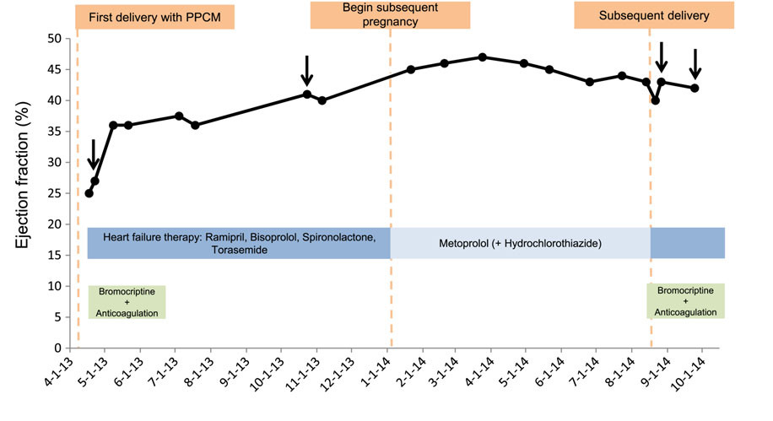

Slide 24
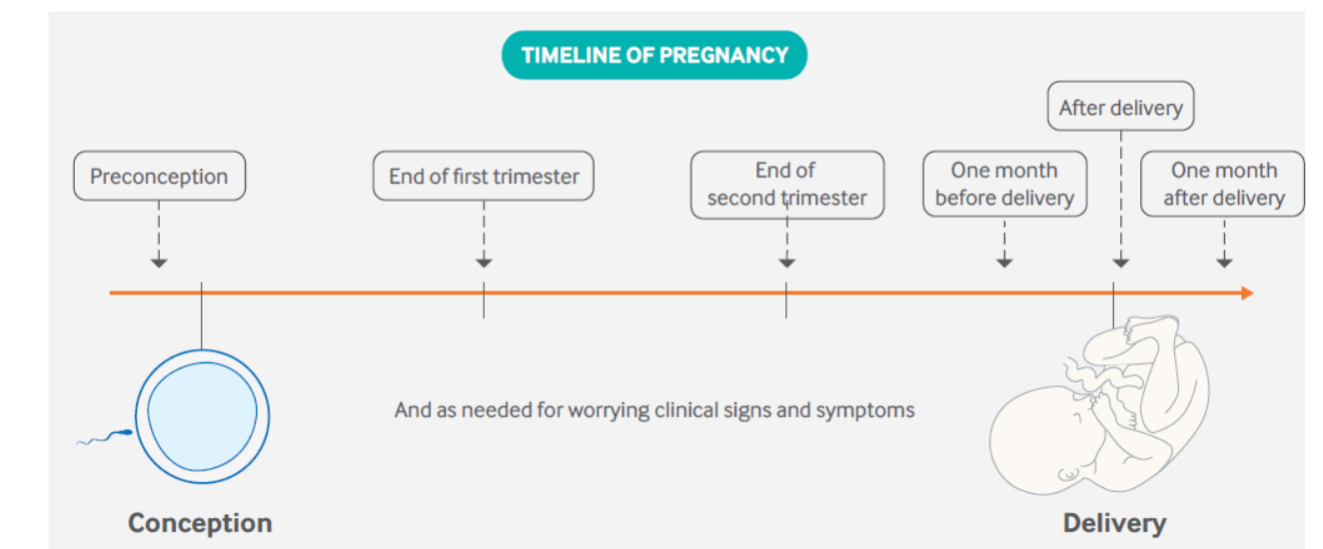
Screening ECHOs – timing

Slide 25
????????
Which women need bromocriptine
Anticoagulants
Pathogenesis
Failure management
OBG
Next pregnancy

Slide 26
Summary
Definition
Incidence
Clinical features
Pathophysiology
Diagnosis
Treatment
Obstetrics
Anesthesia
Unexplored areas

