Slide 1
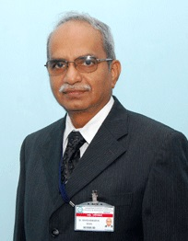
“High Fives” 5 best publications in Anaesthesiology & Critical Care in the recent past that can influence Practice of Anaesthesiology in India
“Regional Anesthesia”
Dr S.Parthasarathy MD DA DNB. PhD FICA IDRA
Diploma in software based statistics
Associate Editor, IJA ---- Professor
Mahatma Gandhi Medical college and research institute Pondicherry – India

Slide 2
How to choose !!
Simple
Really useful
Easy to administer
Less complications

Slide 3
Indian journal of anesthesia – 2018 – article from canada

Slide 4
Previously for thoracic surgeries and pain relief !
11 cases - GA for cases –
laparoscopic nephrectomy
Renal transplantation
cephalic pancreatectomy
Unilateral or Bilateral ESP block T8 or T9 given
Excellent pain relief for 16 hours
No opioids – only para

Slide 5
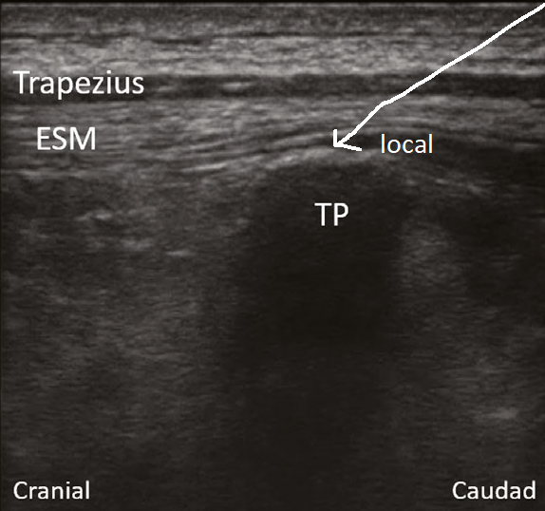
We have started using for post op,acute and chronic pain relief – even ESP catheters !!
Don’t worry about the pleura as in PVB
No worry about neuraxial block or vessels
No hemodynamic disturbance
Any position
Abdominal or thoracic
Results satisfactory

Slide 6
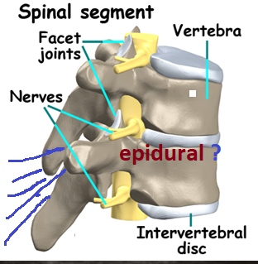
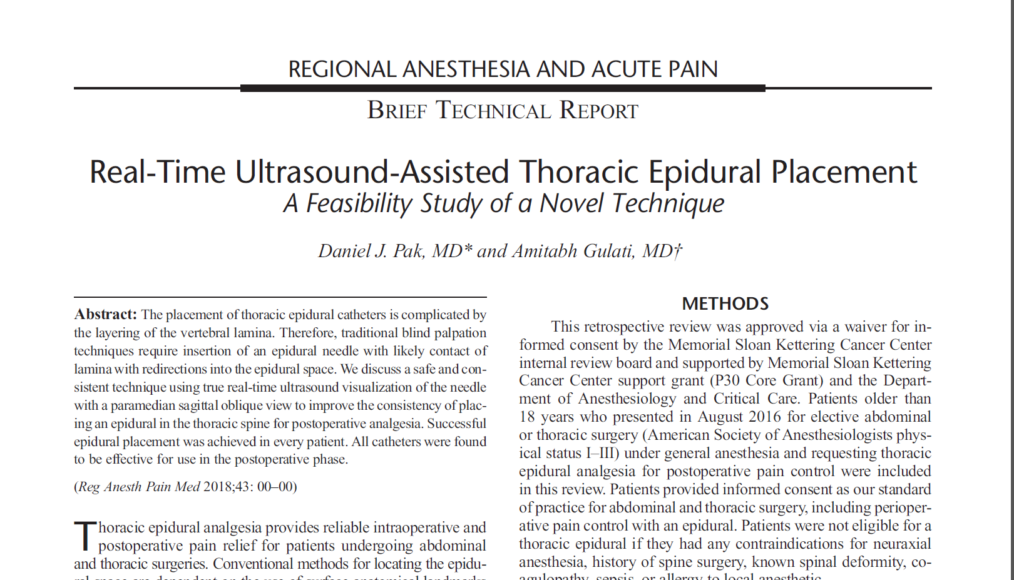
Always worried about thoracic epidurals
Regional Anesthesia and Pain Medicine • Volume 43, Number 5, July 2018

Slide 7
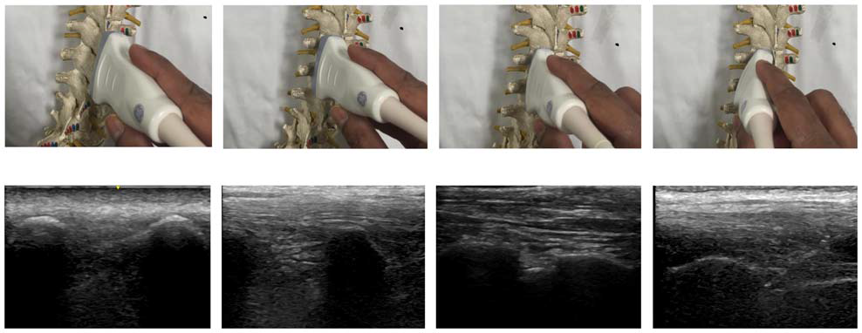
15 cases – all successful 11 first attempt –
no laminar contact –
No passes in thirteen !!
Abdominal thoracic surgeries
Effective in all patients
Side effects nil - A very small study- no scoliosis
We have started using in many cases !!

Slide 8
Azeddine Taleb et al Regional Anesthesia and Pain Medicine • Volume 43, Number 6, August 2018

Slide 9
What they showed !!
Lap colonic surgery three cases – ASA III
Difficult airway with multiple systemic illness
Age 60, 70 and 80
Parietal anesthesia with bilateral subcostal TAP block- Midaz with 10 mg ketamine for block
20 mL of a mixture containing ropivacaine 5 mg/mL, dexamethasone 2 mg, and clonidine 30 μg injected on each side
USG guided celiac plexus block with 20 ml 1 % ligno
Propofol for sedation
NO intubation – no opioids !! But only three cases !!

Slide 10
Regional Anesthesia and Pain Medicine • Volume 43, Number 8, November 2018
Retrospective review of 17 years
Accidental dural puncture with 17 G touhy
81 cases two groups
SPG- or EBP – classical technique
Possible cerebral vasodilation has synapse with SPG !!

Slide 11
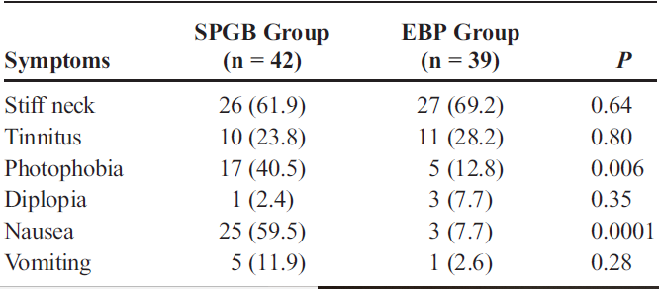
Look what they showed !!
No repeat epidural
5 patients requested and got 2nd SPG block while 4 received EBP again !!

Slide 12
Can we block the sciatic and saphenous in one injection in front of thigh !!

Slide 13
What they showed
100 cases of knee surgeries under spinal
Post analgesia with 4 in one block
Scan knee in medial and front and go proximal till Sup. Femoral artery appears in hiatus and inj. 30 - 35 ml of local
Targets for knee !! - nerve to vastus medialis, saphenous nerve, posterior division of obturator nerve and the sciatic nerve
Satisfactory analgesia in all the cases – sciatic component was blocked in almost all cases - No complications
What mattered ?? 35 ml ?

Slide 14
Inject in the front of thigh but see in prone in popliteal fossa !!
The problem is ----- near the vessels – depositing large volume ??

Slide 15
Thank you all

