Slide 1
Making the surgical journey safe
Dr S.Parthasarathy MD DA DNB. PhD FICA IDRA
Diploma in software based statistics
Associate Editor, IJA ---- Professor
Mahatma Gandhi Medical college and research institute Pondicherry – India

Slide 2
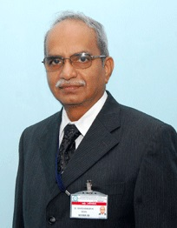
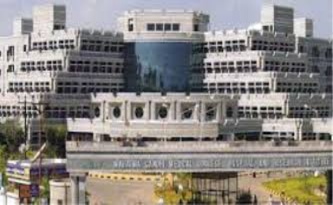
The legendary teacher of the century

Slide 3
The topic – google search
According to WHO, surgical complications harm about seven million patients each year. At least one million of these patients could be at risk of death during or immediately following a procedure. ...
“Surgery should be safe. This is the operative environment that patients deserve.
300 million operations !!

Slide 4
Preop
Necessity for a journey
Pilot has to set everything in order
The pathway is smooth
Climate in between
Landing smooth
Intraop
Post op

Slide 5
Is there a need for surgery ??
a 90 year old male with cholelithiasis with minimal symptoms
Lap chole done
10th day he died of pneumonia
Talk to patient and attendants

Slide 6
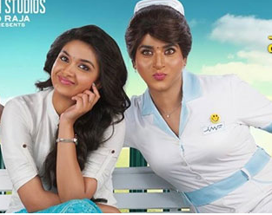
Preoperative
Talks to the patient
Relieves anxiety – fasting
Tells about the cost
Prepares - Enema ??
Administers antibiotic
Other drugs !!
Artificial dentures
Contact lenses !!
Hearing aids – can keep
Changes dress !!

Slide 7
OT technician !!
Wash hands and feet and enter
The process of autoclave
Carbolize
Formalin
Microbiology certificate
Emergency drugs and equipment
Burst !!
AMBU bag !!
Boyles machine
Oxygen and keys
Suction – preferably two

Slide 8
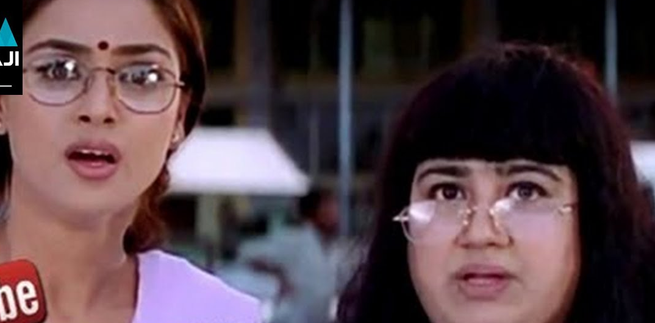
Theatre staff
Proper hand wash
Good rest and food
Area cleaning
Counts

Slide 9
Anesthesiologist
Preop check up
Can we train duty doctors to see charts and inform anesthesiologist
One good physician is enough in sick medical cases
Preop battery of consultation – worth it ?
Anesthesiologist to talk to surgeon

Slide 10
Investigations
For routine 25 years male - Hb and random sugar is enough
Just because he is coming for lap appendix ECG is never an indication.
Clear cut guidelines are there.
Not for all cases – Eg, GJ , insulin and diabetes
Rare blood groups!!
To take preoperative echo for all cases does not guarantee any safe journey

Slide 11
நாளைக்கு அஷ்டமி
அப்பறமா செவ்வாய் கிழமை
Elective becomes emergency !!
No time to stabilize sugar and BP !!
There is no safe anesthetic technique
There are only safe anesthesiologists !

Slide 12
Intraoperative
Don’t hesitate to call for help !!
Either anesthesia or surgical side !!
Confidence booster !!
Please Don’t pressurize anesthetist for extra comforts !
Safety first and surgeon comfort comes second

Slide 13
Preoperative
Before anesthesia
Surgical concerns

Slide 14
Key points in safety
Deep venous thromboembolism prophylaxis
Patient temperature and maintaining normothermia
Preventing operating room fires and electrosurgical safety
Body piercings
Laser safety
Tourniquet
Transport and hand over
New need not be good

Slide 15
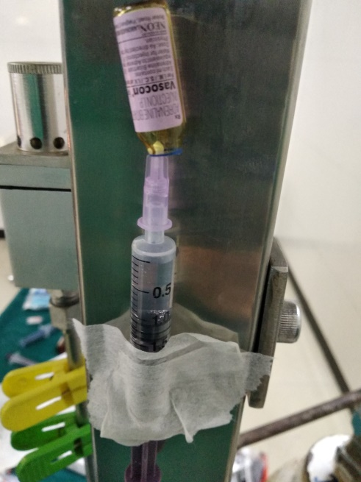
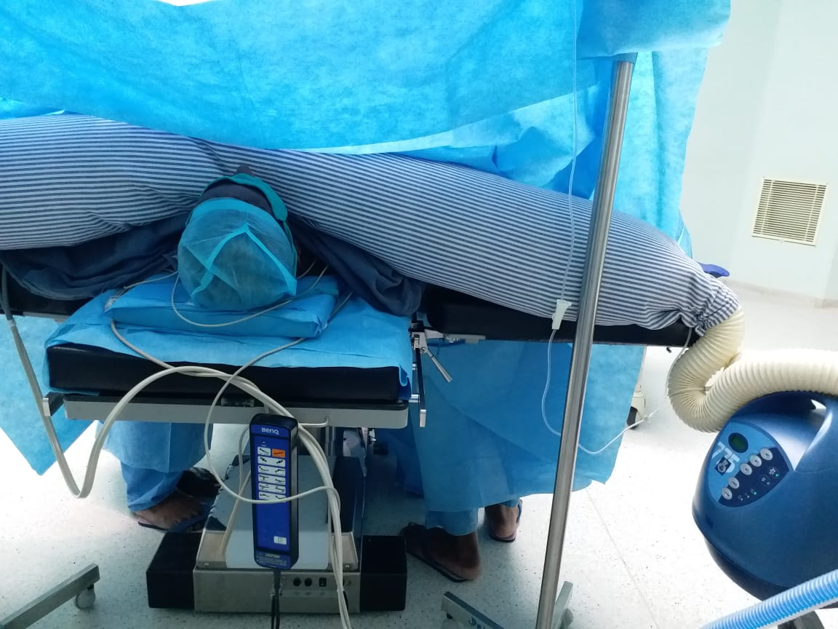
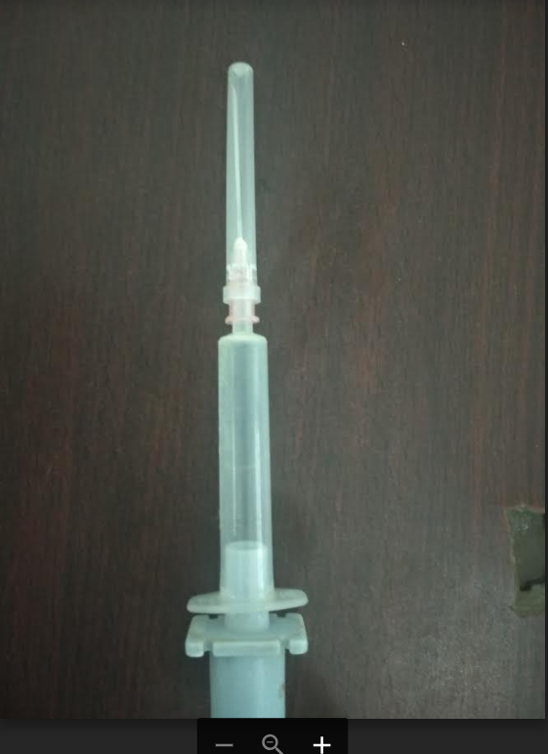
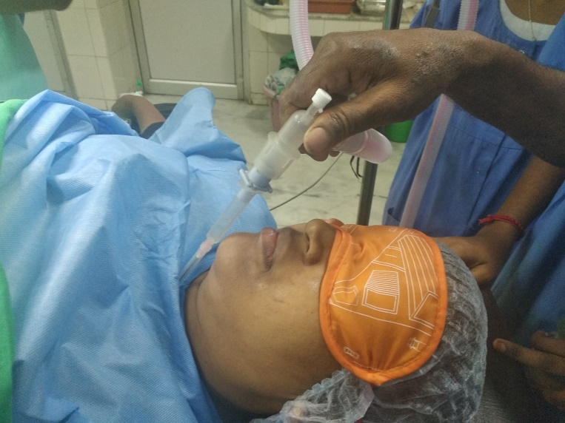

Slide 16
Table
Diathermy plate
OT lights

Slide 17
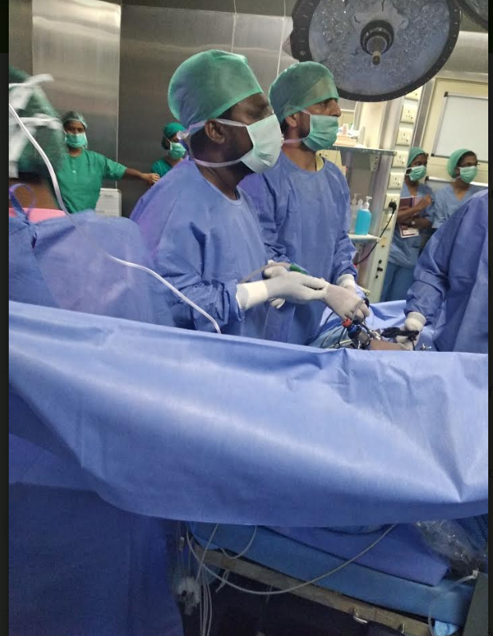
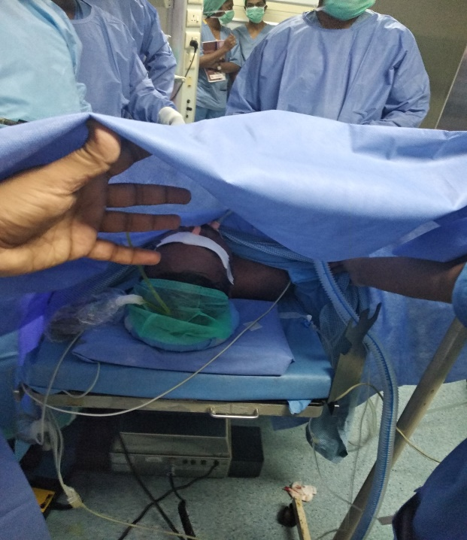
Surgeons pushing the hands
Extension tubing for IV access
Foleys clamped

Slide 18
Postoperative
Pain
Rigors
Hypoxemia
Bleeding
Drain – unclamp !

Slide 19
Specific surgeries
Tonsil
TURP
Emergencies
Onco surgeries
Thyroid
Plastic or CTVS

Slide 20
Pain if untreated
delayed wound healing
Anger, depression, anxiety
demoralization
CPSP
Discharge
Satisfaction

Slide 21
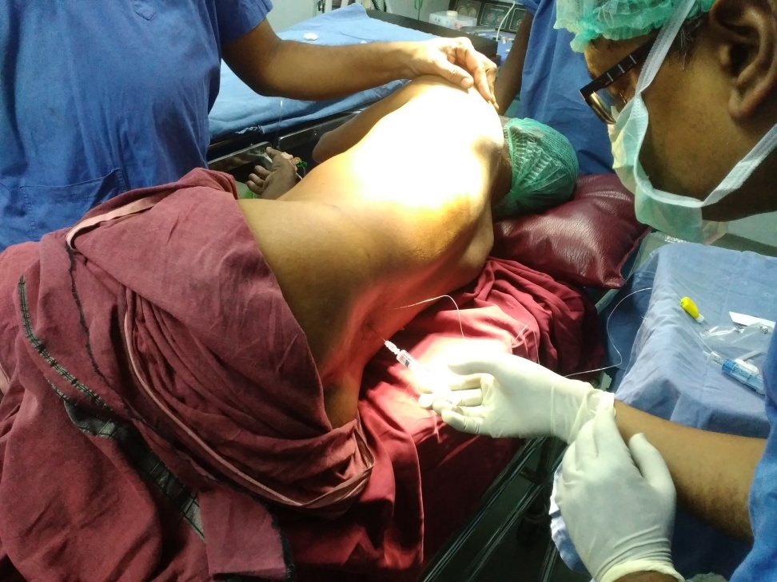
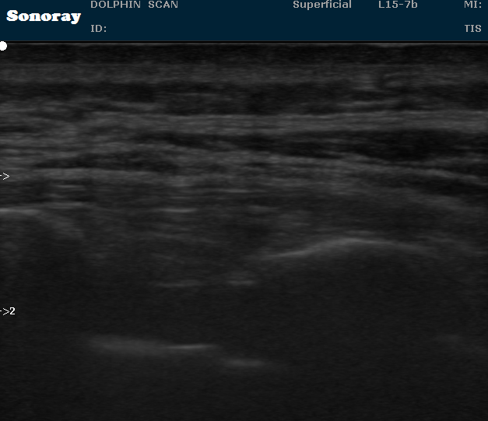
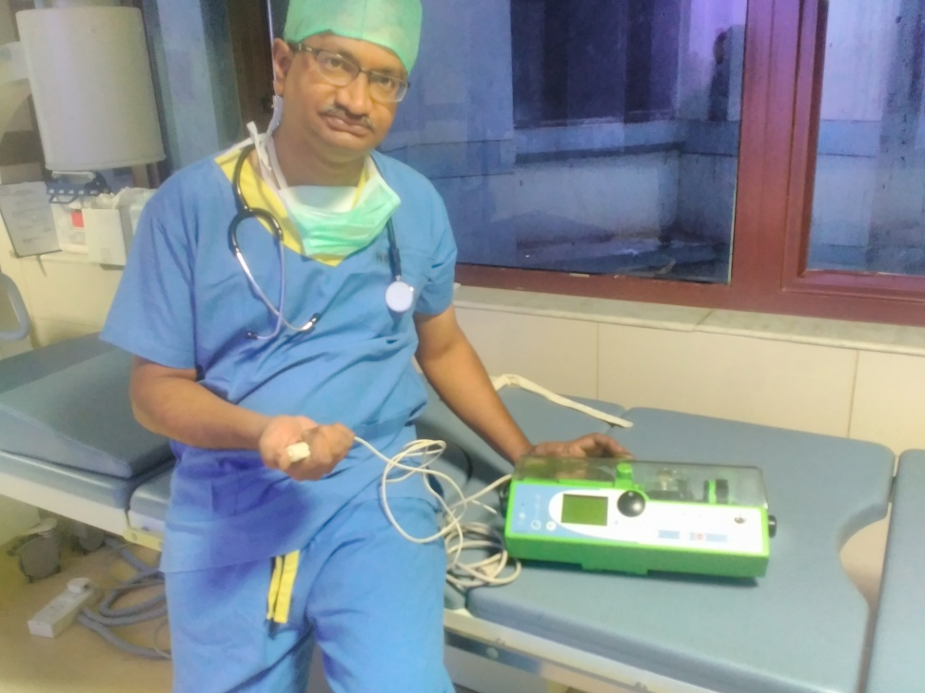
Parenteral drugs

Slide 22
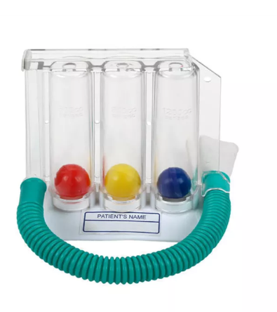
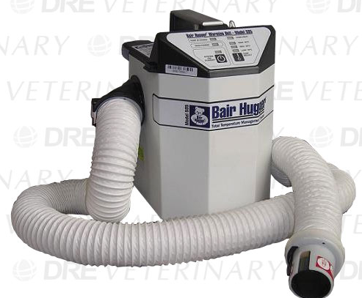
Use low dose tramadol, pethidine or ondansetron for rigors
No avil dexa please

Slide 23
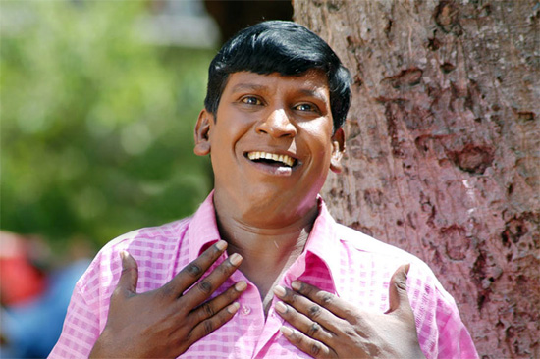
Be mentally prepared
Both the surgical team and the patient team

Slide 24
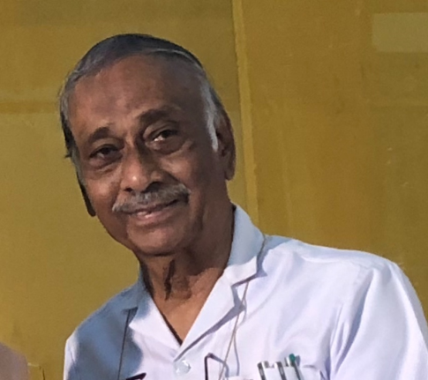
A famous quote from Dr. K. Sivaraman former emeritus professor surgery
There are no major or minor surgeries
There are only major and minor surgeons

Slide 25
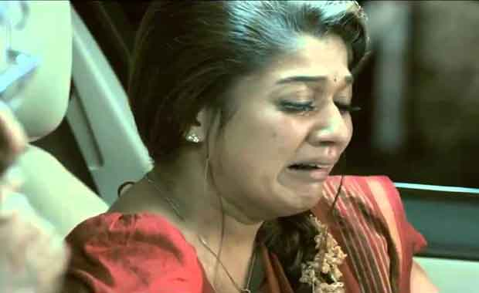
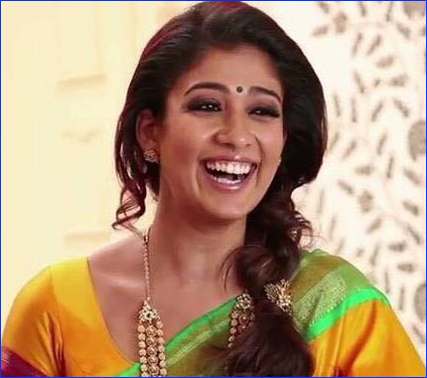
Patients relatives !!
Thank you all

