Slide 1
Neonatal resuscitation
Dr. S. Parthasarathy
MD., DA., DNB, MD (Acu), Dip. Diab.
DCA, Dip. Software statistics
PhD ( physiology) – IDRA, FICA

Slide 2
The need
Approximately 10% of newborns require some assistance to begin breathing at birth.
Less than 1% require extensive resuscitative measures
only 60% of asphyxiated newborns can be predicted antepartum.

Slide 3
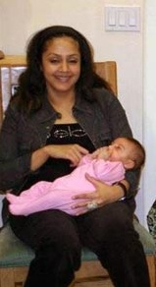
The need is continuous

Slide 4
Initial queries ??
Gestational age ?
Multiple or singleton,
Meconium ?
Maternal diseases
Fetal distress

Slide 5
How to be ready

Slide 6
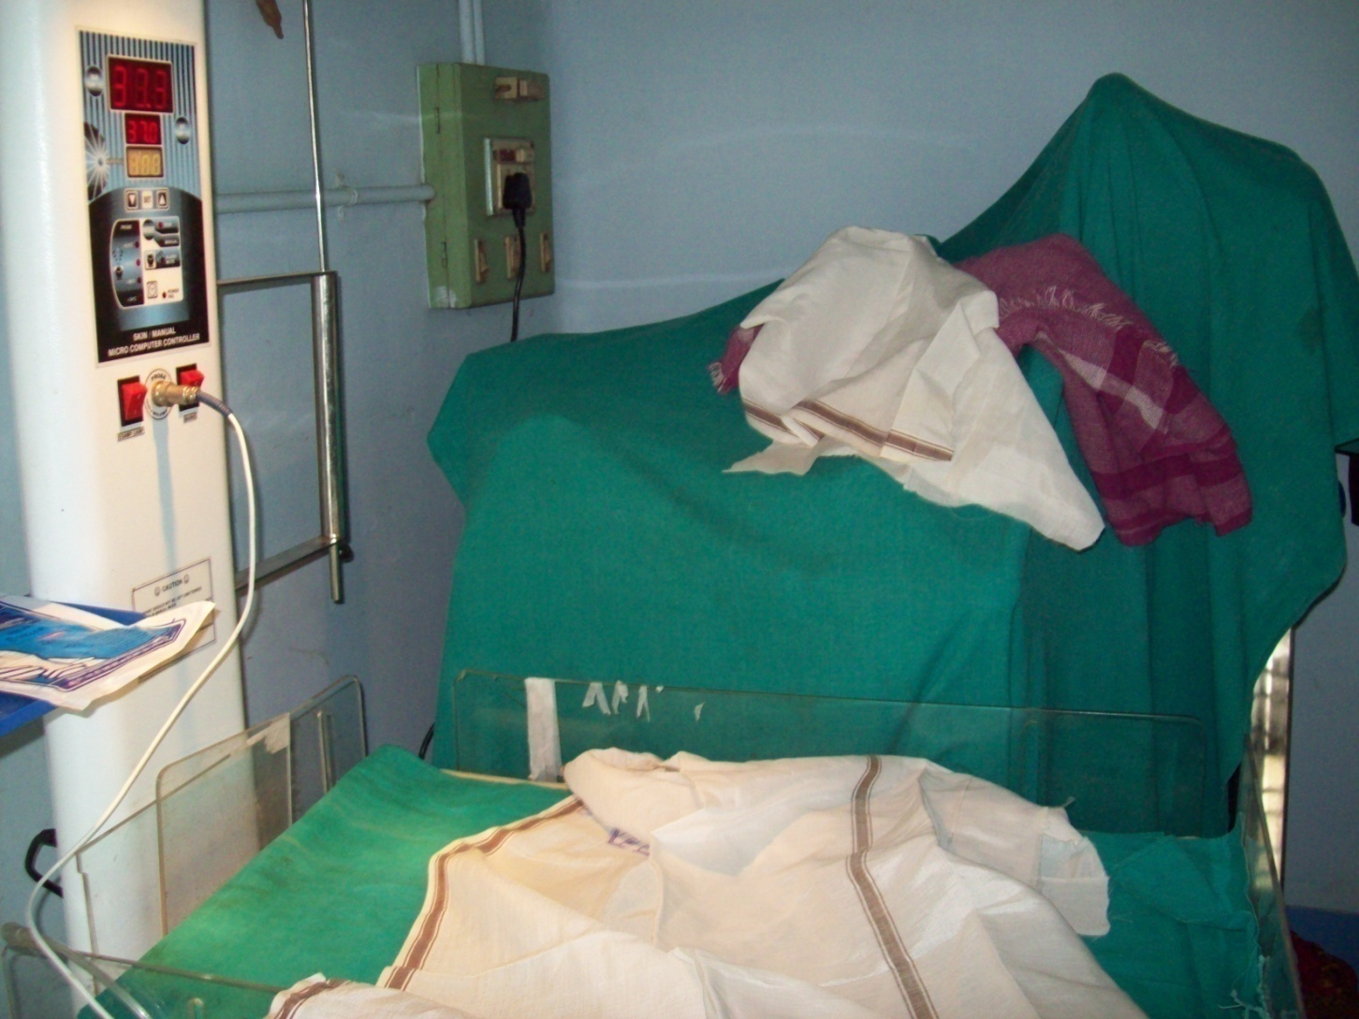
Prewarm clothes – 3 layers – manual mode maximum

Slide 7
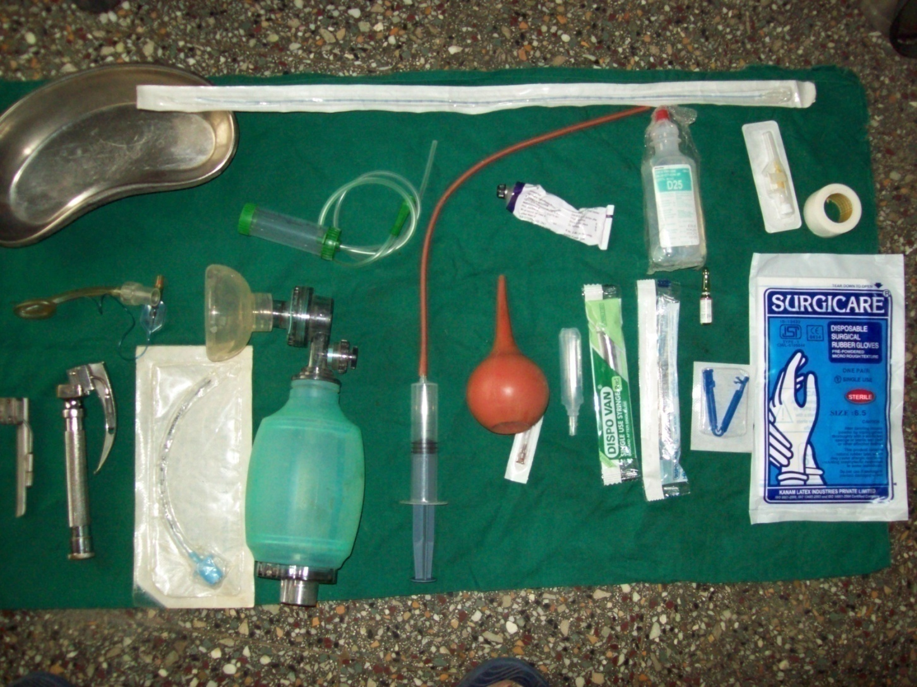
Equipment

Slide 8
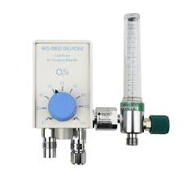
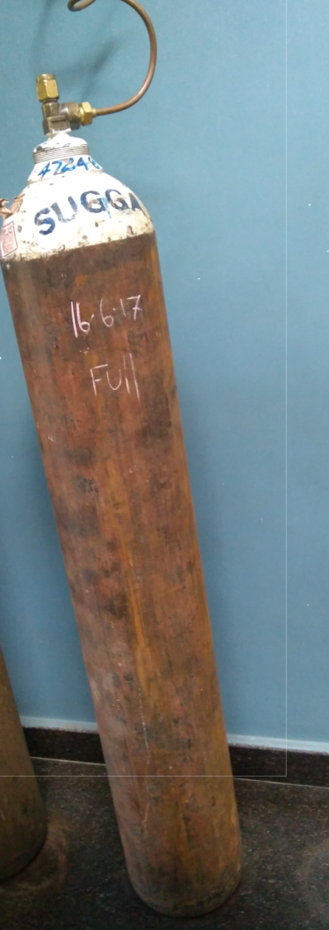
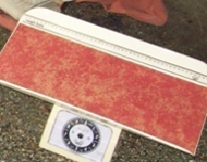
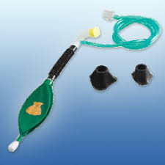

Slide 9
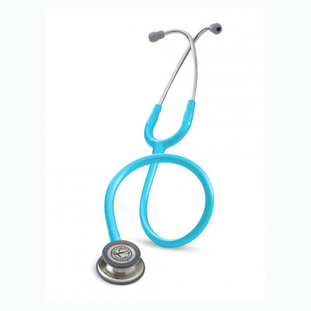
Equipment
Man power
Temperature
Airway
breathing
Oxygen
Drugs

Slide 10
Respiration equipment
Oxygen supply, Assorted masks
Neonatal bag and tubing to connect to an oxygen source
Manometer, Endotracheal tubes (2.5-4)
Tape and scissors
Laryngoscope (0 and 1 sized blades)
Extra bulbs and batteries
CO₂ detectors
Stylettes for endotracheal tubes
Laryngeal mask Airway (optional)

Slide 11
Fluid equipment
Intravenous catheters (22 g)
Tape and sterile dressing material
Dextrose 10% in water (D10W)
Isotonic saline solution
T-connectors
Syringes, assorted (1-20 mL)

Slide 12
Advanced procedure ready
Umbilical catheters (2.5F, 5F)
Chest tube (10F catheter)
Sterile procedure trays

Slide 13
Trained Personnel
One present
Two or more
-- problems
--- twins
Theatre warming

Slide 14
Breathing crying active baby - yes
the baby does not need resuscitation
should not be separated from the mother.
The baby should be dried, placed skin-to-skin with the mother, and covered with dry linen to maintain temperature.
Observation of breathing, activity, and color should be ongoing.
Cut the cord after one minute

Slide 15
If there is some problem
Cut the cord and shift to radiant warmer
Servo controlled 36 degrees
Attach probe after drying

Slide 16
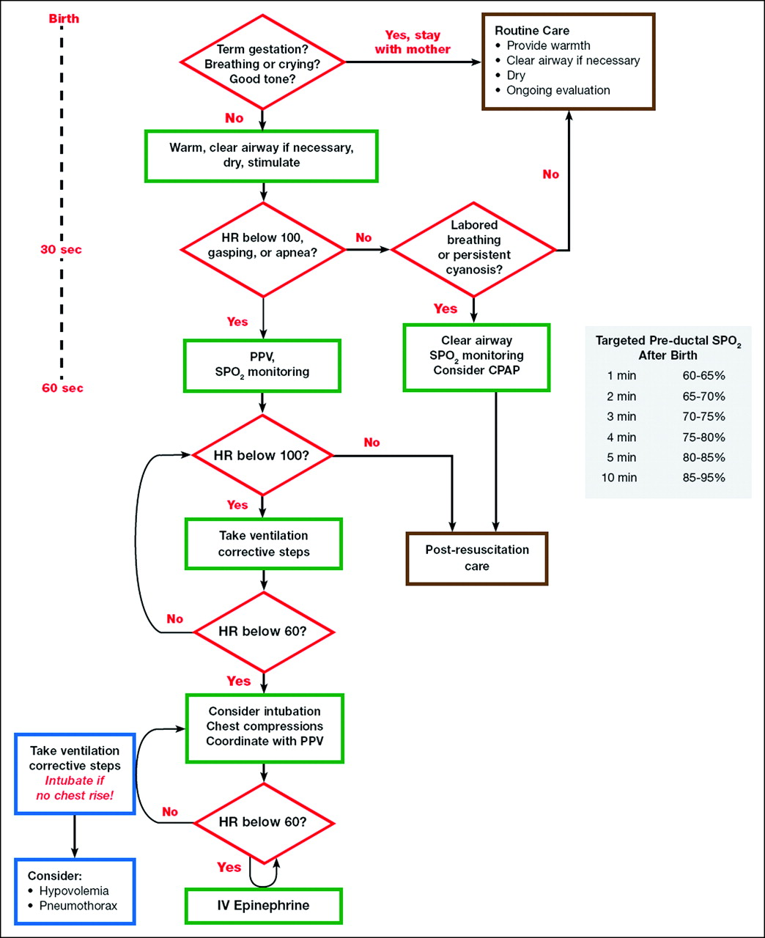

Slide 17
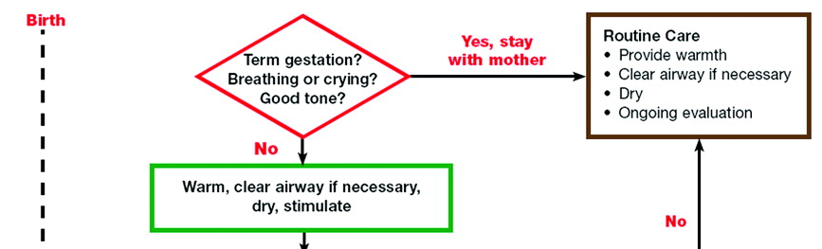
30 seconds
Dry, change linen,
position,
secretions - stimulus

Slide 18
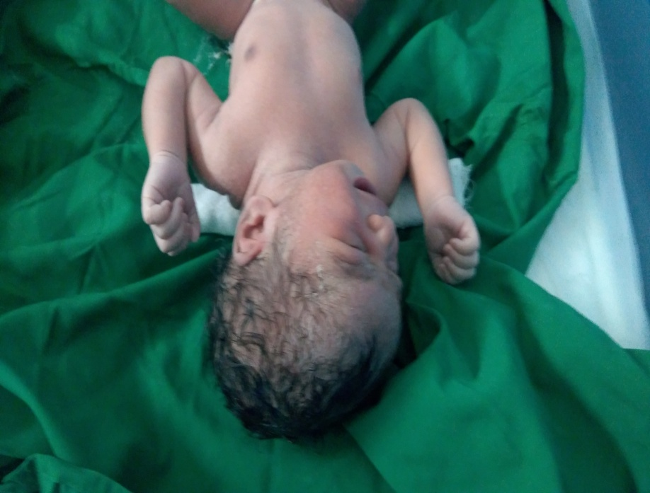
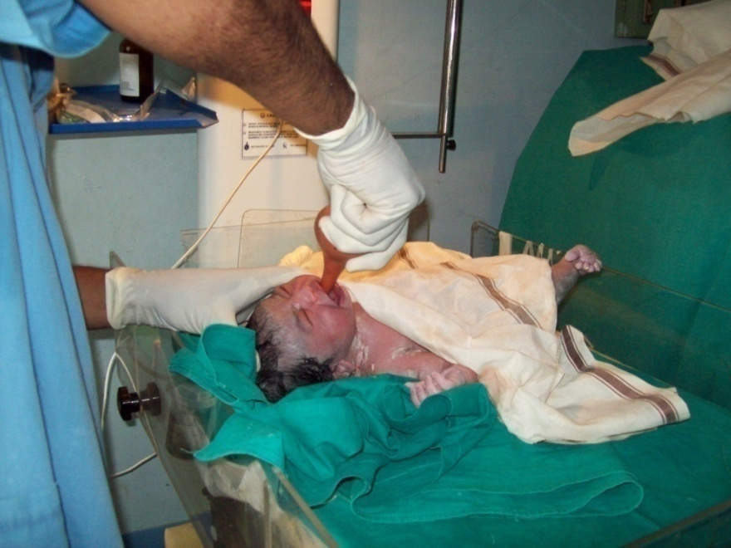
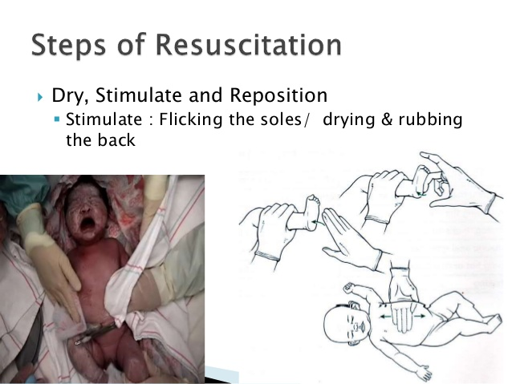
Don’t touch pharynx
DCPSS

Slide 19
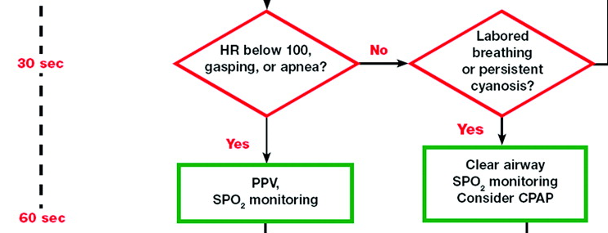
Room air
40 – 60 / minute
Breathe , two three
Five breaths
Assess
No chest rise
MSOPA
Mask seal, position, open mouth
Pressure
Alternate airway

Slide 20
Heart rate picks up !!
More than 100
Stop PPV
60 -100 – continue PPV for one more minute
Less than 60 – start chest compressions

Slide 21
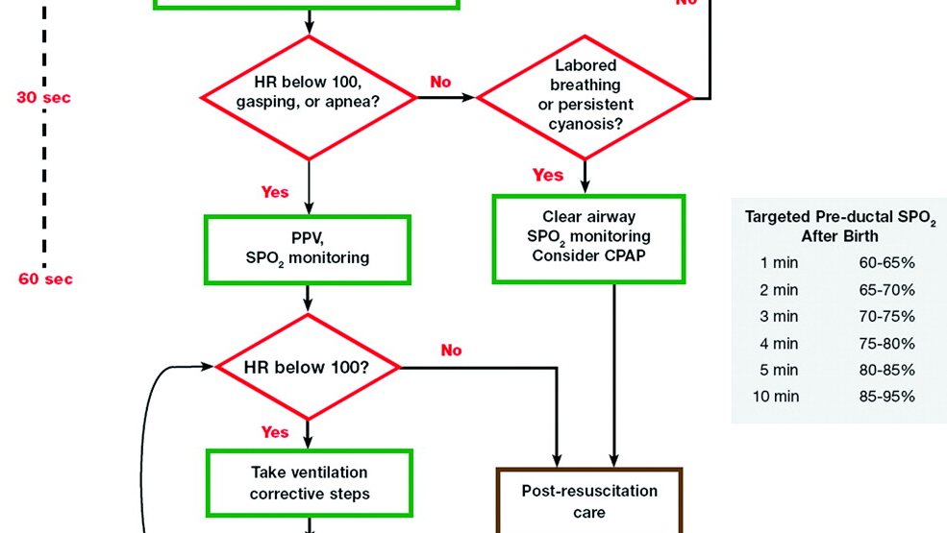

Slide 22
The golden minute
Approximately 60 seconds (“the Golden Minute”) are allotted for completing the initial steps, reevaluating, and beginning ventilation if required.

Slide 23
Observational care or resuscitation care
PPV for more than one minute
Resuscitation care
More than 2 minutes – insert orogastric tube !
Twenty minute watch for all the vitals of the baby even though with the mother
Other sick babies to go NICU

Slide 24
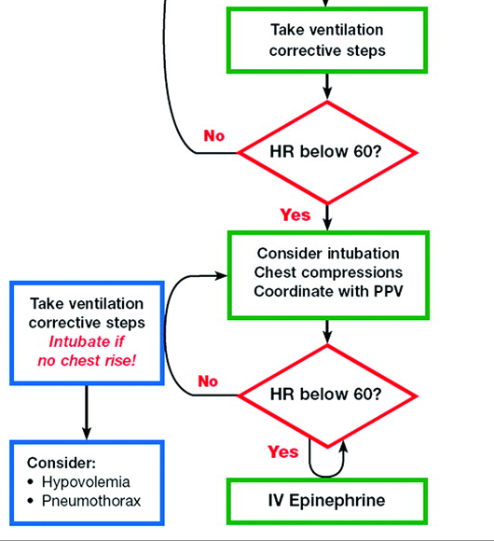

Slide 25
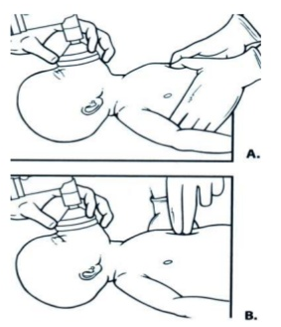
Chest compression
Two thumbs or Two fingers
Coordinated
3 :1
90 compressions – 30 breaths
120 events
100 % oxygen and intubation
One third the AP diameter

Slide 26
Stop chest compressions if HR > 60
Stop PPV if HR is > 100
60 and 100 are the benchmark heart rates

Slide 27
Meconium stained liqour
Vigorous babies
Muscle tone
HR > 100 and breathing normal
Non vigorous babies – suction the pharynx and trachea
Meconium aspirator ready

Slide 28
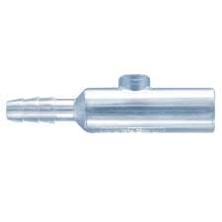
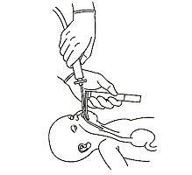
Meconium aspirator
If we cant intubate , don’t try again
Leave it , oral suction and PPV
Ventilate – better than vigorous unsuccessful intubation attempt

Slide 29
But heart rate is less than 60 still
Color of the baby
Saturation
Pallor ?
ET 0.5 – 1 ml/kg of 1:10000 adrenaline
Plan for UV catheter – 3 F
Intravenous – 0.3 ml/kg second dose

Slide 30
Then color again
Normal saline – 10 ml/ kg over 5 minutes
Can be repeated even 3 – 4 times
O negative RBCs - ? Abruption

Slide 31
Better ??
Continue resuscitation
Talk with parents
Talk with NICU
Shift with transport incubator if distant

Slide 32
In summary on Temperature control
Dry and keep warm
Others
prewarming the delivery room to 26°C
13 covering the baby in plastic wrapping
placing the baby on an exothermic mattress
the baby under radiant heat
prewarming the linen
The goal is to achieve normothermia and avoid iatrogenic hyperthermia

Slide 33
Temperature
unheated non humidified oxygen sources for the bag-valve-mask device
Intubated ventilated patient – humidified warmed ventilator circuits

Slide 34
Temperature range
Normal 36.5-37.5º C Continue
Potential cold stress 36-36.5º C concern
Moderate hypothermia 32-36º C Danger
Severe hypothermia < 32º C
Outlook grave, skilled care urgently needed

Slide 35
Administration of Oxygen
Oxyhemoglobin saturation may normally remain in the 70% to 80% range for several minutes following birth
clinical assessment of skin color is a very poor indicator of oxyhemoglobin saturation

Slide 36
SPO2 monitor
a preductal location (ie, the right upper extremity, usually the wrist or medial surface of the palm).
Term infants keep SaO2 – 90- 94%
Preterm – 88-92%
Monitor progress

Slide 37
CPAP
CPAP
recommend administration of continuous positive airway pressure (CPAP) to infants who are breathing spontaneously,
4 -6 cm
but with difficulty, following birth, although its use has been studied only in infants born preterm

Slide 38
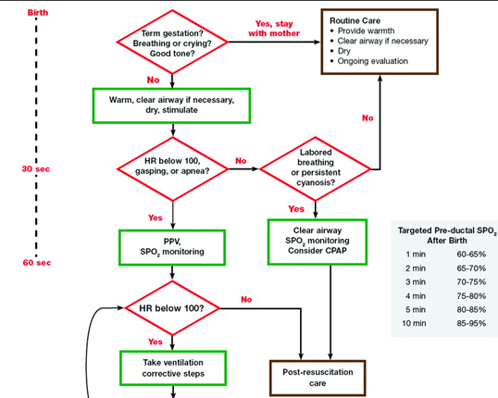

Slide 39
Laryngeal mask airways and PPV
Laryngeal mask airways that fit over the laryngeal inlet - effective for ventilating newborns
weighing more than 2000 g
delivered ≥34 weeks gestation
But recent NRP guidelines LMA sidelined !!

Slide 40
Endotracheal Tube Placement
Initial endotracheal suctioning of nonvigorous meconium-stained newborns
If bag-mask ventilation is ineffective or prolonged
When chest compressions are performed
For special resuscitation circumstances, such as congenital diaphragmatic hernia or extremely low birth weight

Slide 41
Discontinue resuscitation
In a newly born baby with no detectable heart rate, it is appropriate to consider stopping resuscitation if the heart rate remains undetectable for 10 minutes

Slide 42
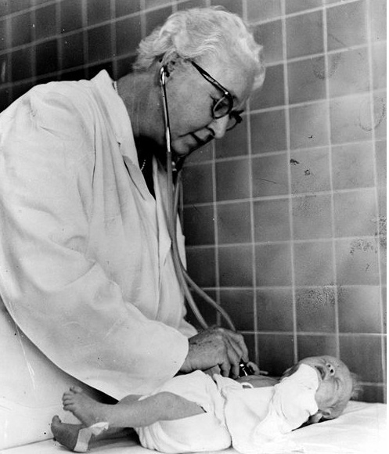
After reading neonatal resuscitation
What is shocking ??
NO APGAR score at all.

Slide 43
The Apgar score
Evaluate the newborn baby on five simple criteria on a scale from zero to two,
then summing up the five values thus obtained.
The resulting Apgar score ranges from 0 to 10.
The five criteria are summarized using words chosen to form a backronym
(Appearance, Pulse, Grimace, Activity, Respiration.)

Slide 44
SCORES
  0 1 2
Appearance - red peri. Blue total blue
Pulse ? < 100 > 100
Grimace stim.no mild active
Active tone less flexion good resist
Respir. Absent weak ,gasps active cry

Slide 45
APGAR score
Score of 10 ??
>7 ok
4 – 7 -- to act
1 min, 5 , 10, 15 minutes
What is first minute ( we receive the baby)
Score of 3 0r less persistent – neuro damage

Slide 46
Others
Fontanelles
Injuries
Eyes
Spines
Ryles tube
Fingers
Nipple
scrotum

Slide 47
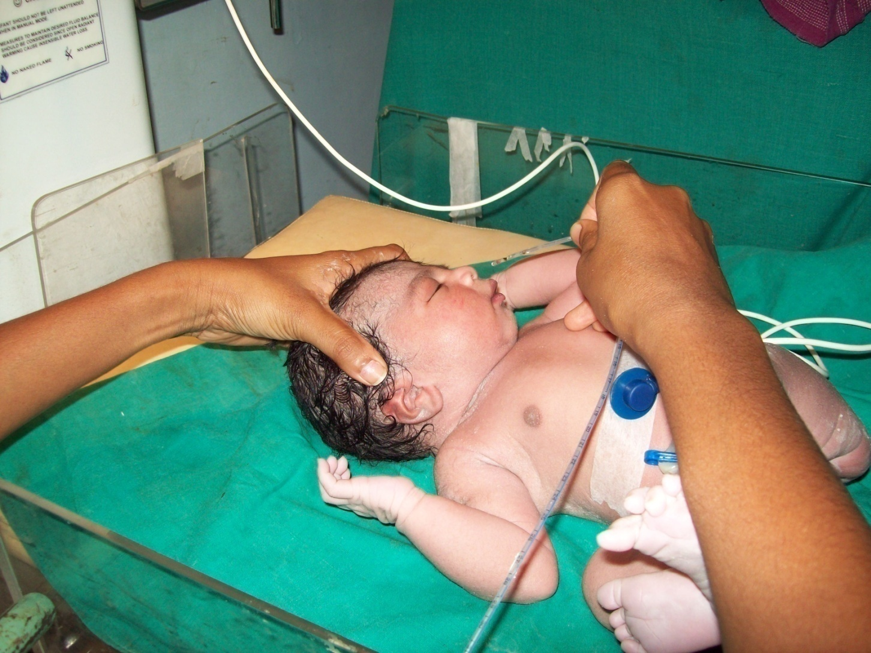
Ryles tube and aspiration

Slide 48
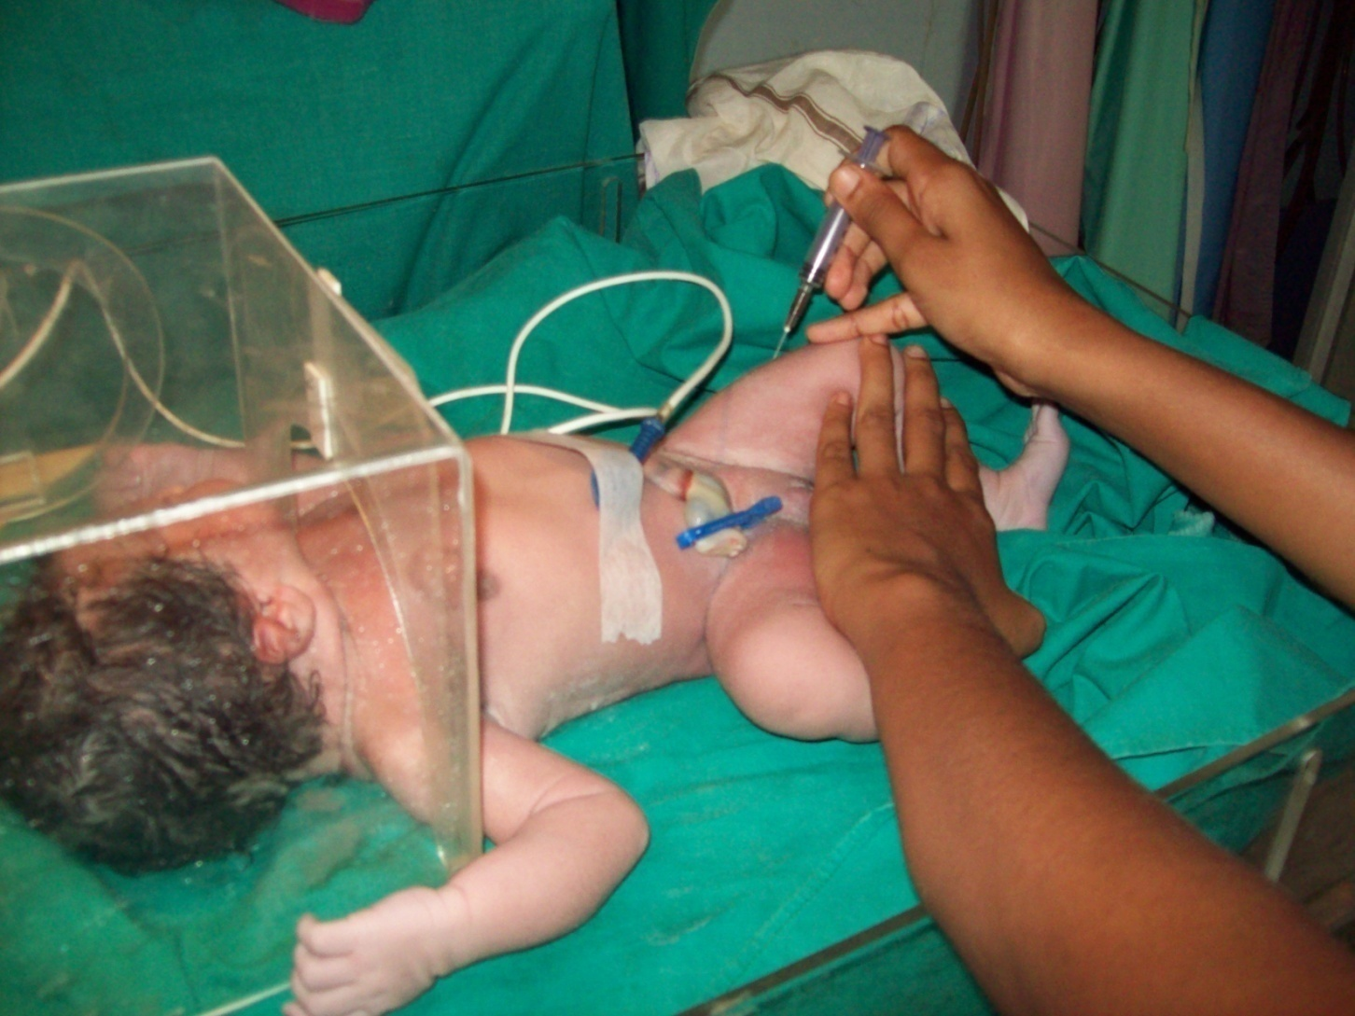
Inj. Vit. K , temperature monitoring with hood oxygen

Slide 49
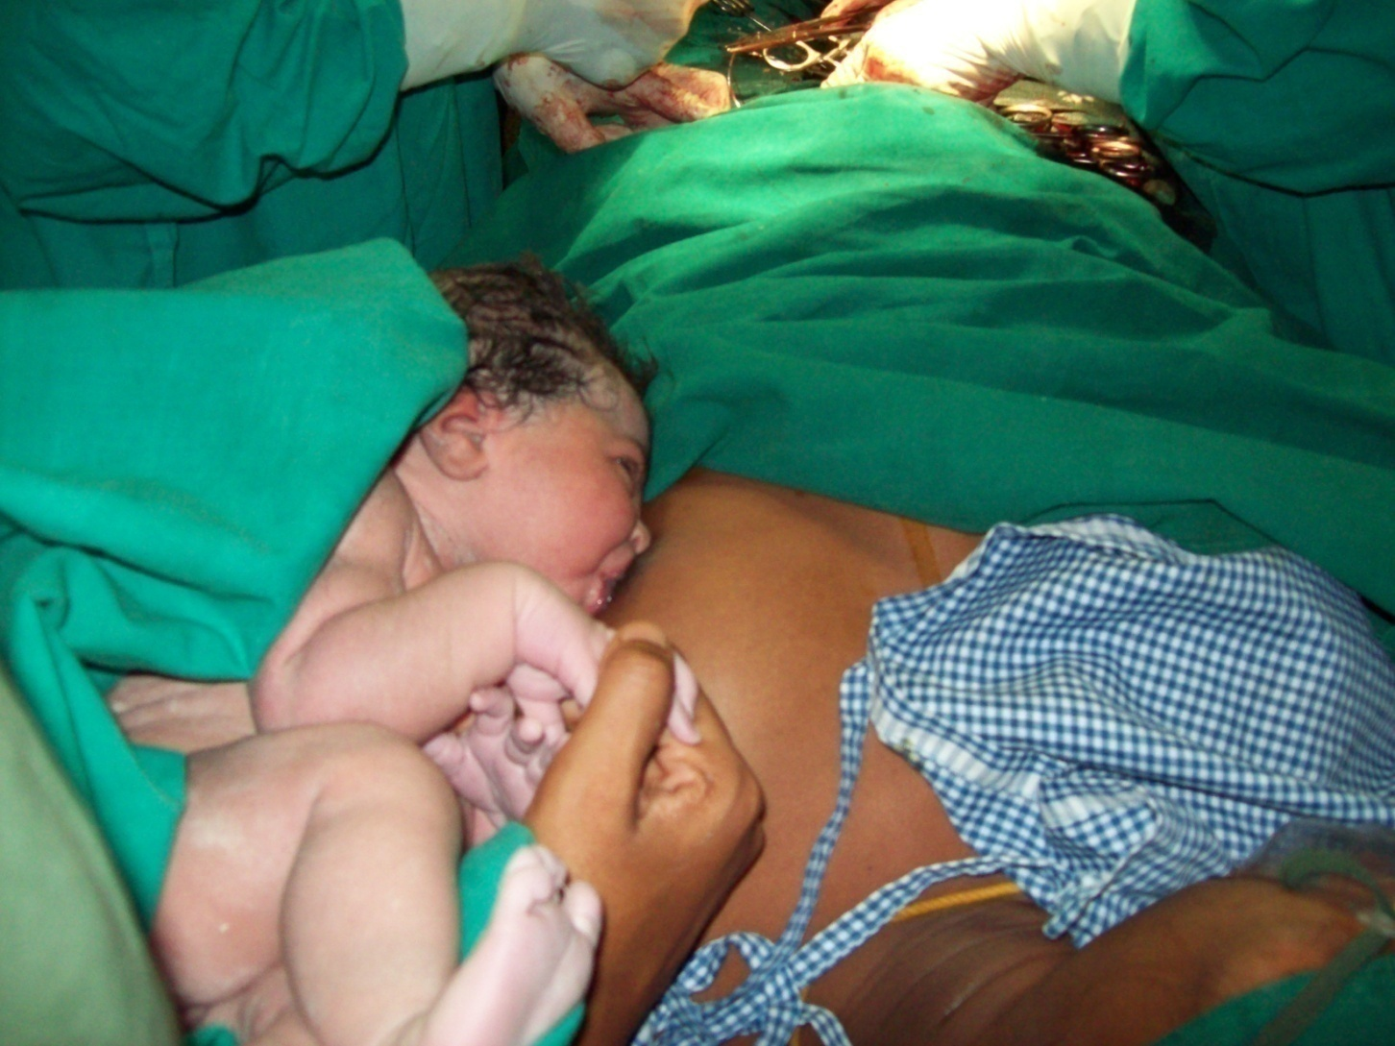
Breast feeds

Slide 50
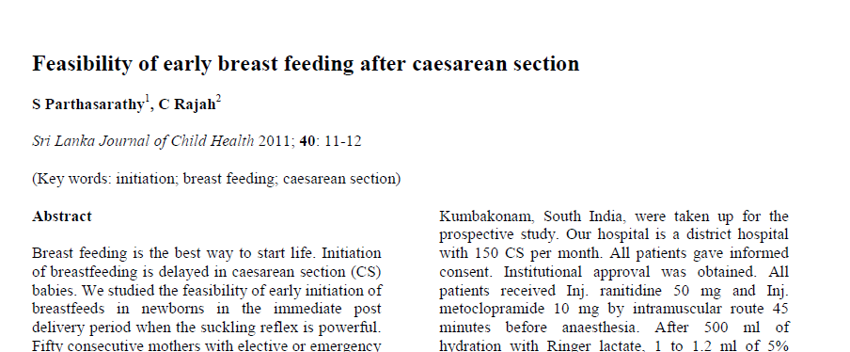

Slide 52
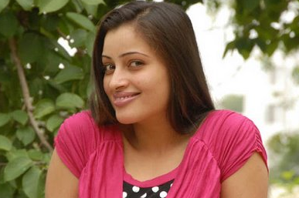
Thank you all

