Slide 1
Status asthmaticus coming for strangulated inguinal hernia
Dr. S. Parthasarathy
MD., DA., DNB,
Dip. Diab., DCA,
Dip. Software statistics-
PhD ( physiology) , IDRA, FICA

Slide 2
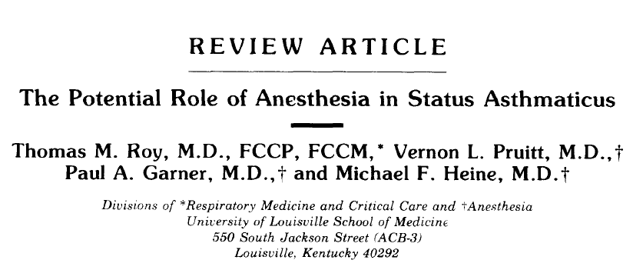

Slide 3
What do we mean by the two terms in the title ?

Slide 4
What is status asthmaticus ??
in a patient with bronchial asthma
condition of progressively worsening bronchospasm and respiratory dysfunction
unresponsive to standard conventional therapy
may progress to respiratory failure
may need for mechanical ventilation.
But

Slide 5
PCO2 of more than 50mmHg
decreased level of consciousness
A variation greater than 12 mmHg in systolic blood pressure between inspiration and expiration represents a sign of severity in asthmatic crisis. --- Sudden disappearance
DD - new-onset wheezing,
Four clinical entities like
asthma, pneumonia, foreign-body aspiration, and congestive heart failure
SA

Slide 6
Two types
Slow-onset attacks (>6 hours of deterioration) are most common (~90%)
(inadequate treatment, low compliance, inappropriate control, coexisting psychological factors)
Sudden-progression asthma attacks (<6 hours of deterioration) are less common (~10%).
(sudden exposure to a large amount of allergens

Slide 7
The essence
Humidified oxygen
parenteral or nebulized steroids
nebulized or parenteral beta agonists
Ventilation
Antibiotics, anticholinergics,
magnesium sulfate,( both nebulized and IV)
heliox, ketamine, inhalational agents, mucolytics

Slide 9
Hernia
normal hernia = Cough impulse + reducibility
Irreducible hernia = reducibility lost
Obstructed hernia = irreducibility + intestinal obstruction
Strangulated hernia = irreducibility + impairment of blood supply

Slide 10
The two extremes
a total dead gut with toxemia and septic shock in one end
the omental gangrene with a stable hemodynamics on the other,

Slide 11
Think twice before opinions ??
The incidence of strangulated inguinal hernia varies between 0.29 and 2.9 %.
The mortality rate also ranges between 2.6 to 9 %, but a delay of 12 h increased significantly intestinal resection rate

Slide 12
Preanesthetic evaluation stabilization
salbutamol – MDI -- 4- 15 puffs / hour
( 400- 600 mic) - can deliver ??
Nebulization 5 mg/ 2.5 ml is routine – can go up to 40 mg/ day
Duration of action is 6 hours but why second hourly ?
intravenously (2- 4 mg- load then 1 µg/kg/min. infusion.
Subcutaneously, 0.3–0.4 ml (1:1000) of epinephrine
administered every 20 min for three doses
Terbutaline subcutaneously (0.25 mg)

Slide 13
Side effects
Salmeterol and formoterol
vasodilatation,
skeletal muscle tremor,
uterine muscle relaxation,
hyperglycaemia, and hypokalaemia
Go for levo salbutamol ( 0.65 mg = 2.5 mg salb.)– may be less side effects
But effects – acute setting same

Slide 14
Steroids
IV steroids = methyl prednisolone 125 mg IV followed by 4 – 6 hrly top ups.
Duolin ??
Each 2.5 ml unit-dose vial contains:
Levosalbutamol sulphate……………….1.25 mg
Ipratropium bromide …………………… 500 mcg
IV monteleucast in acute setting ??
Nebulized budesonide ( 400 µg) useful but systemic √

Slide 15
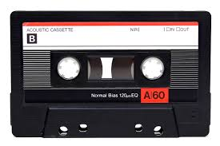
That’s the role of theophyllines
? Inflammatory action ??

Slide 16
When to ventilate ? Its an art and not science
Progressive exhaustion, respiratory arrest, decreased level of consciousness, persistent respiratory acidosis (pH<7.2) are clinical indications for endotracheal intubation and ventilation.
Ketamine !!
NO NIV
Enoximone 100 mg intravenous followed by 8 mg/ hour
Before intubation

Slide 17
Investigations
A chronic hypoxemia may show a polycythemia
gut gangrene with ongoing blood loss, the patient may be anemic
total count may show leucocytosis wherever the infection arises.

Slide 18
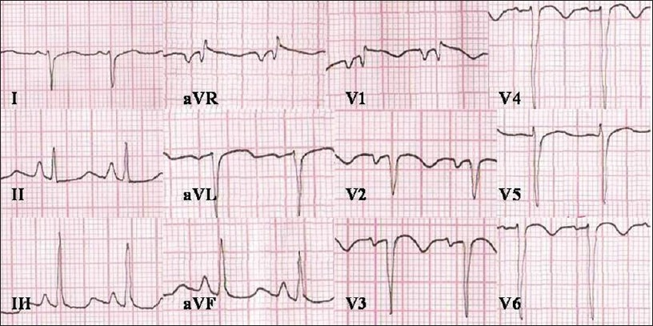
(RAD)², RBBB

Slide 19
Xray chest
Flattened diaphragm with hyperinflated lungs
But can rule out other disease

Slide 20
Investigations
Urea, creatinine
sugar, ( steroids and beta agonists )
Electrolytes (beta agonists)
Coagulation profile and platelets
CT abdomen

Slide 21
Arterial blood gases
Hypoxemia hyperventilation and hypocapnia with respiratory alkalosis
Hypoxemia with normocapnia with hypoxemia induced metabolic acidosis
Hypercapnia with respiratory acidosis
Gangrene gut induced metabolic acidosis

Slide 22
As simple as that
A PEFR of less than 150
FEV1 / FVC < 40 %

Slide 23
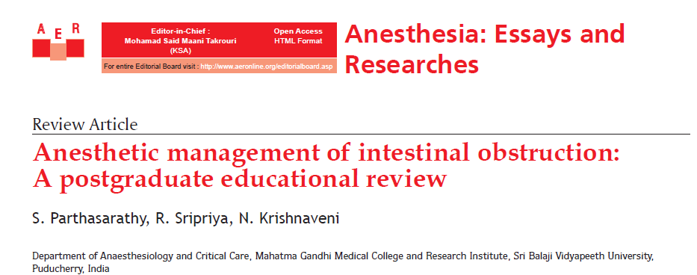
Possible fluid deficit in intestinal obstruction
mild: 1500 ml,
moderate: 3000 ml,
severe with shock: 6–8 L.
CVP measurement – guide fluid therapy ??
Intra thoracic pressure
Possible echo and IVC size
Arterial line –
sick septic patient on inotropes
– possible or blood gases
Crystalloids

Slide 24
we should always remember
a simple assessment of
tongue, eyes
urine.
pulse volume, capillary refill
respiratory rate,
blood pressure,
SaO2 can separate sick from the ordinary

Slide 25
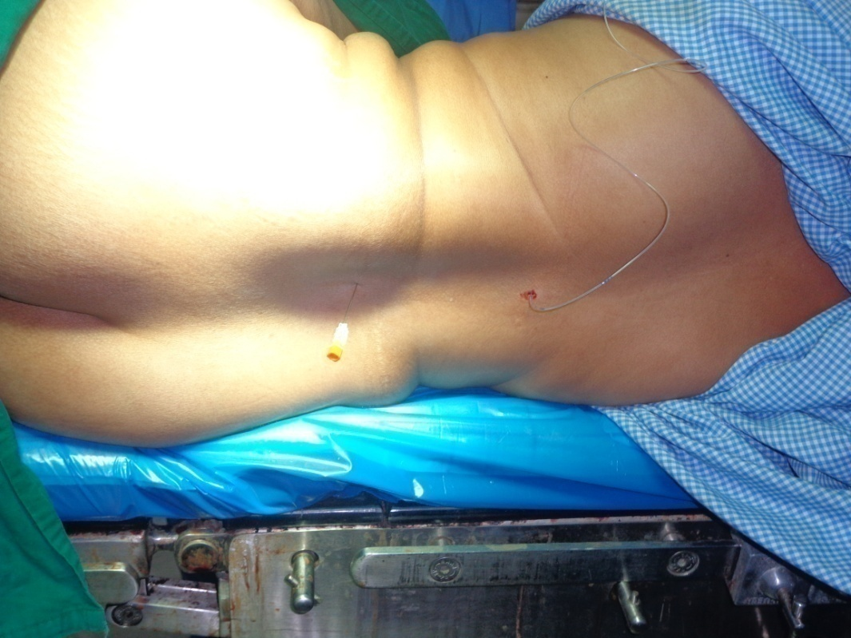
Anesthetic management
Controlled status
No sepsis
Coagulation profiles
normal
Possible CSEA – adjuvants like fentanyl
Drastic hypotension – gangrene inside !
Dopamine infusion ready
Difficult

Slide 26
Is it true ??
intestinal obstruction
Give spinal
Sympathetic blocked
Parasympathetic excess
constrict the gut
the surgeon and the patient
True ? clinical relevance ?

Slide 27
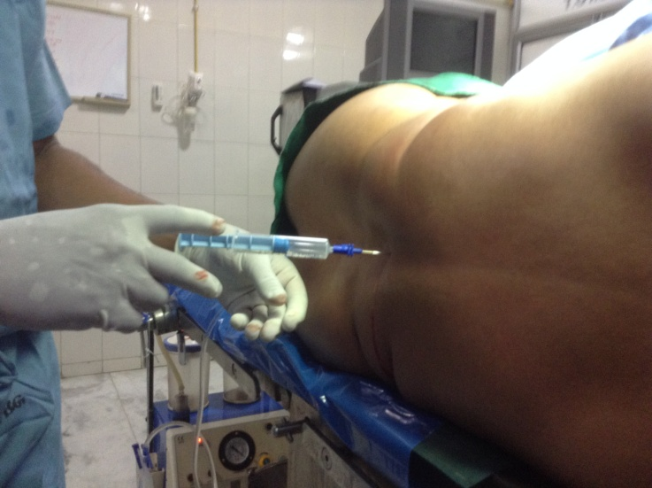
Controlled GA with RSI
Ketamine –
Bronchospasm + unstable hemodynamics
Glyco + benzodiazepines – add
No to Thio
Propofol is OK where BP fall is tolerable
Scoline OR rocuronium
Ryles tube aspiration
Proton pump inh
10 -15 ml/kg of IVF may be needed !!

Slide 28
Dexmedetomidine
Analgesia
Sympatholysis
Sedation
Mild antisialogogue action
Is there a drug?
Not established in status

Slide 29
Danger signs ?? !!
Bronchospasm can be provoked by laryngoscopy, tracheal intubation, airway suctioning, cold inspired gases, and tracheal extubation.
Airway tone is increased by vagal stimulation caused by peritoneal, or visceral stretch
Subcutaneous emphysema ??

Slide 30
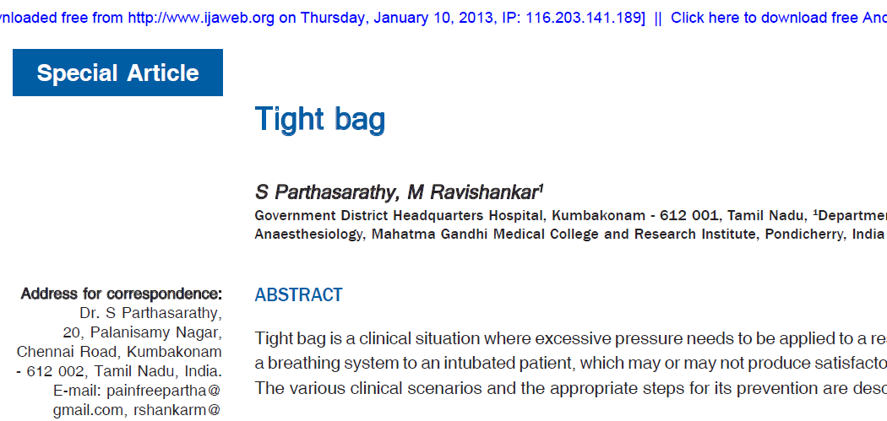
Beware of provokers –
like inadequate anesthesia, atracurium
Ketamine infusion
Less opioids ( prefer synthetic) – intra op TAP block
Agents More Agents ! more FiO2 ! but des ?
Local lignocaine into the trachea

Slide 31
Controlled Ventilation
Higher inspiratory flow rates and smaller tidal volumes than usual with less respiratory rates.
Inspiratory time is less , expiration time is high
100 % oxygen with no PEEP can be initiated and can slowly come down on FiO2.
Vigilant monitoring of dynamic hyperinflation by P. Plat. (should not be >40)
Pneumothorax vigilance .
Prepared for hypotension

Slide 32
Intraoperative scenes
Monitoring of pulse, blood pressure, CVP, ECG, EtCO2, urine output is routine
yet it is mandatory to monitor and maintain temperature, surgical field, NMJ, blood loss and blood gases.
Non latex gloves
Planning extubation ? Neostigmine - ??
6-8 puffs of MDI for intra operative bronchospasm – think of other causes also !

Slide 33
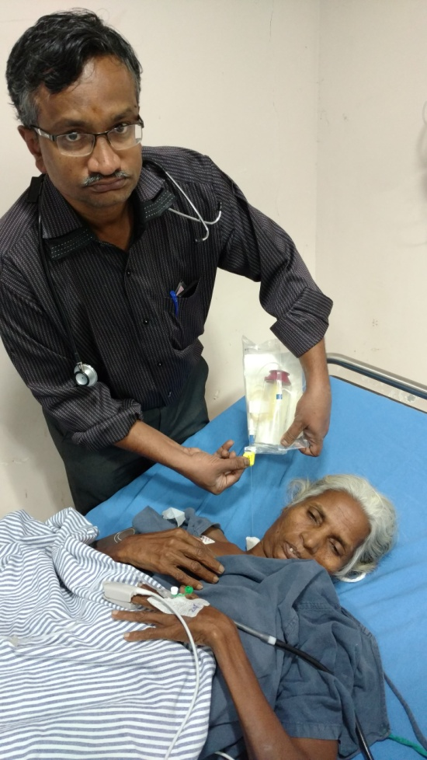
Postoperative period:
IV paracetomol , NO NSAIDs
Epidural or TAP block working ?
Continue aggressive beta agonists
and steroids
Steroids and myopathy, electrolytes
Stabilize blood gases and perfusion
Plan to extubate !

Slide 34
Summary
Supplemental oxygen, Inh./ IV beta2 agonists and systemic steroids – theophylline ??
initiation of mechanical ventilation in selected cases.-
Where do we stand in the two extremes?
Investigations?
CSEA or GA with EA or TAP block , intra op triggers
Paracetomol is OK – NSAIDs ?
Post operative aggressive bronchodilator and steroid therapy – continue epidural infusions

Slide 35
Message
Understand the patho physiology of the disease
Stabilize as far as possible
Think and institute the technique on case to case basis – but stick to basics
Anesthesia is not intra op –
Then --- we can anesthetize these patients

Slide 36
www.painfreepartha.com for free download of all academic material
Thank you all

