Slide 1
Upper limb blocks (Rescue)
Dr. S. Parthasarathy
MD., DA., DNB, MD (Acu), Dip. Diab. DCA, Dip. Software statistics-
PhD ( physiology),( IDRA)

Slide 2
What is it ?
Interscalene –
C8 T1 can escape
Axillary –
musculocutaneous can escape
Do something or some blocks to counter .. So its called rescue block

Slide 3
Why we need distal blocks ??
Lie away from critical, more central structures such as the pleura, subclavian or axillary artery and the phrenic nerve.
Preservation of proximal motor function
Along with GA
hasten block onset times and improve block consistency
Two surgeries – shoulder and wrist
Proximal– distal - motor and sensory – post op only sensory is possible

Slide 4
Potential Limitations
Tourniquet pain ?
Sensory supply of forearm
Musculo cutaneous and medial cut. N of forearm
Where to block distal or proximal ?
Multiple injections needed
No clear landmarks many times

Slide 5
Some examples

Slide 6
Suprascapular nerve
Superior cord
Under the trapezius crosses the suprascapular notch supplies --- SS and IS muscles
Shoulder joint and small surface area over the shoulder
Failed interscalene – rescue block

Slide 7
Suprascapular nerve block
Sit and lean forward
Spine to shoulder line
Vertical line from midpoint of the scapula spine
Upper outer quadrant
Hit the bone
Slid to get the notch – 10 ml and wait

Slide 8
USG guided
Probe
From the internet for closed academic purpose only

Slide 9
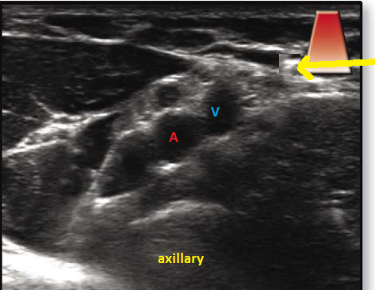
Intercosto brachial nerve
Medial to axillary vein sup. to deep fascia
Second thoracic nerve
Medial side of upper arm
Subcutaneous infiltration at the level of the axillary artery insertion of deltoid

Slide 10
Musculo cutaneous
Musculocutaneous

Slide 11
Axillary scan
Lateral root
Biceps and corocobrachialis
Brachialis
Elbow joint
Lateral cut. Nerve of forearm

Slide 12
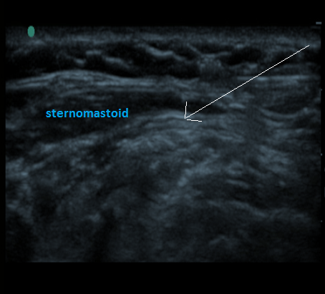
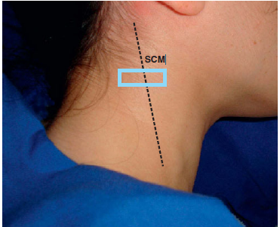
Supraclavicular nerves
Branches of cervical plexus
Supplies the shoulder
Upper posterior part

Slide 13
Radial Nerve Block
The radial nerve is a branch of the posterior cord of the brachial plexus. Wound round humerus
It provides motor innervation to the triceps extensor-supinator group of muscles.
The radial nerve branches all along its course,
Between two heads of triceps
posterior cutaneous branch of the forearm (sensory),
( 16 cm proximal to elbow)
anticubital fossa
1. deep radial nerve (motor),
2. superficial radial nerve (sensory).

Slide 14
Motor nerves of the forearm to be blocked – block above the elbow
Block below means – mainly sensory

Slide 15
Deep radial nerve
Distal to the lateral epicondyle –
Superficial radial nerve – middle third of fore arm accompanies the radial artery

Slide 16
Axillary region
Waterfall sign

Slide 17
Mid humeral

Slide 18
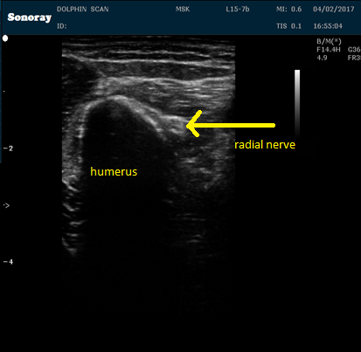
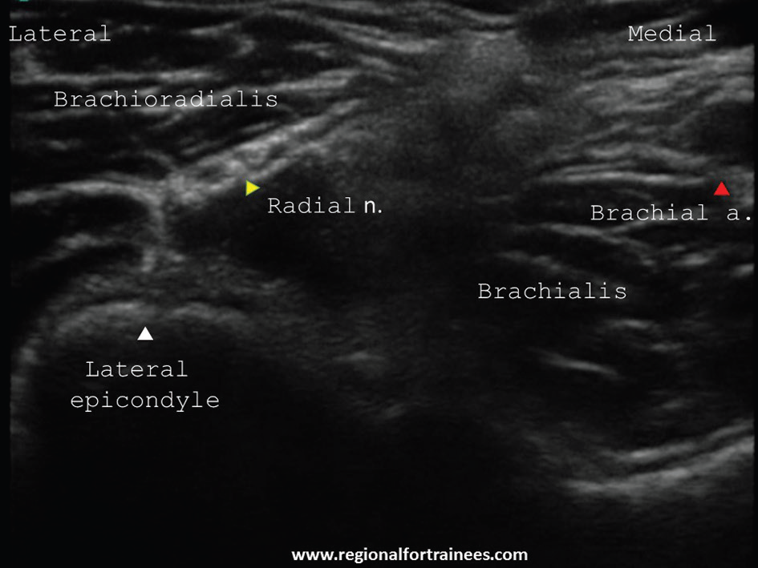
Slightly below

Slide 19
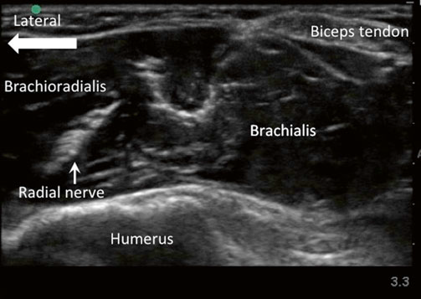
At the level of lateral epicondyle
Consistently between brachioradialis and brachialis

Slide 20
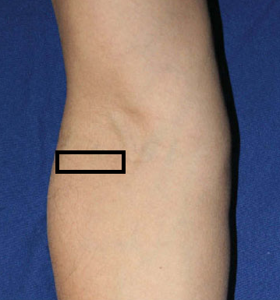
At the level of branching

Slide 21
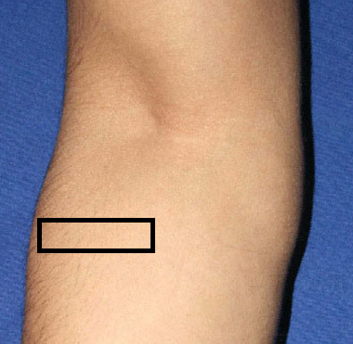
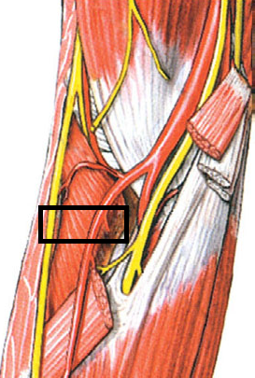
Fore arm- SUPERFICIAL BRANCH

Slide 22
RADIAL NERVE IN THE WRIST
Subcutaneous infiltration along the anatomical snuff box
Just lateral to the radial artery 1 cm proximal to the wrist – maximum 1 cm depth – inject and infiltrate

Slide 24
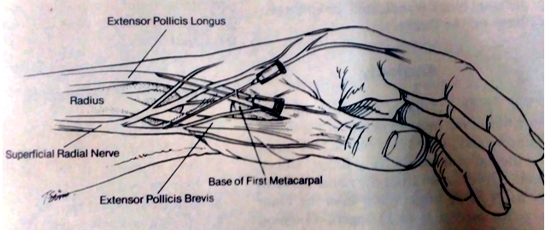

Slide 25
Median nerve
Lateral root + medial root
In the arm, it passes vertically downward lateral to the brachial artery. It crosses brachial artery anteriorly (or rarely posteriorly) to lie medial to it, just above the elbow joint. Here, it lies between biceps brachii and brachialis.
In the forearm, passes between the two heads of pronator teres and then travels between flexor digitorum superficialis and flexor digitorum profundus

Slide 26
Median nerve
Almost no work in the arm
Follows the artery in elbow ( FDP and FDS)
Divides later to anterior interosseus branch ( 5 cm distal to elbow) ( FDL and FDP)
The palmar cutaneous branch of the median nerve arises 5 cm proximal to the wrist crease on the radial side of the nerve

Slide 27
Median nerve

Slide 28
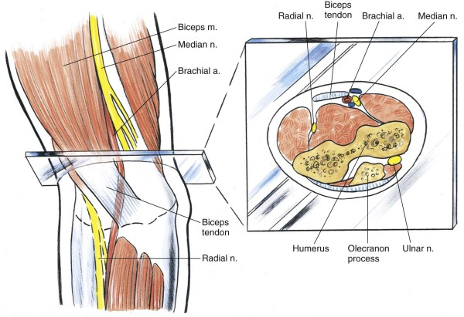

Slide 29
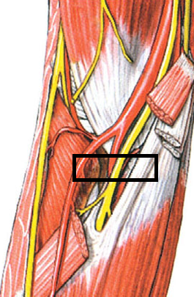
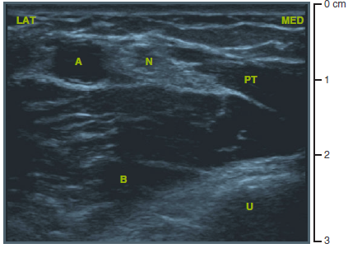
Median nerve

Slide 30
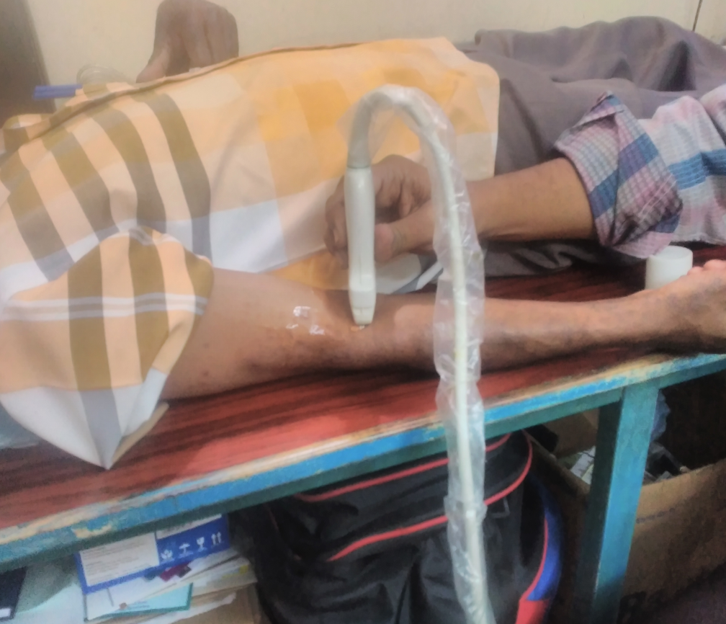
Median nerve

Slide 31
Usually midforearm is the target
Motor not affected
But sensory gone

Slide 32
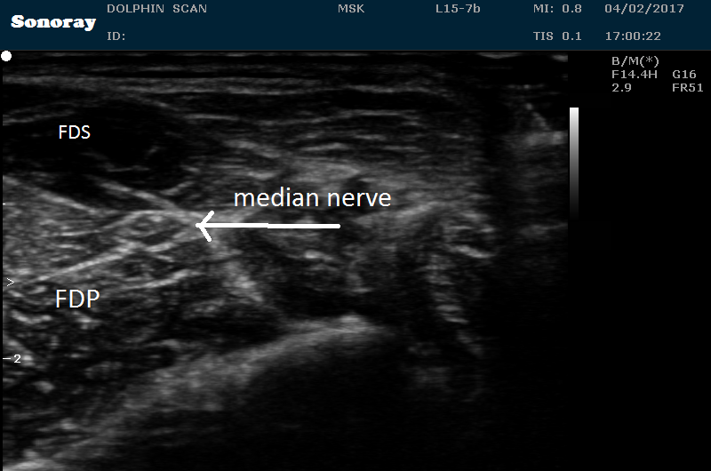

Slide 33
Persistent median artery

Slide 34
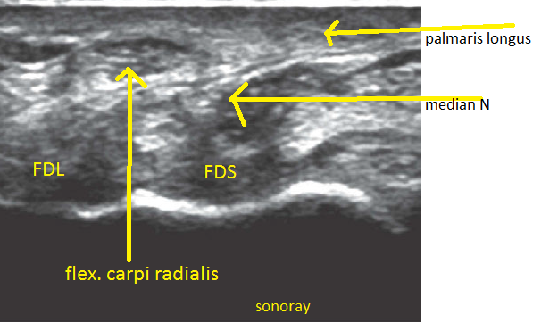
Keep the thumb and little finger touching and flex the wrist to make tendons prominent

Slide 35
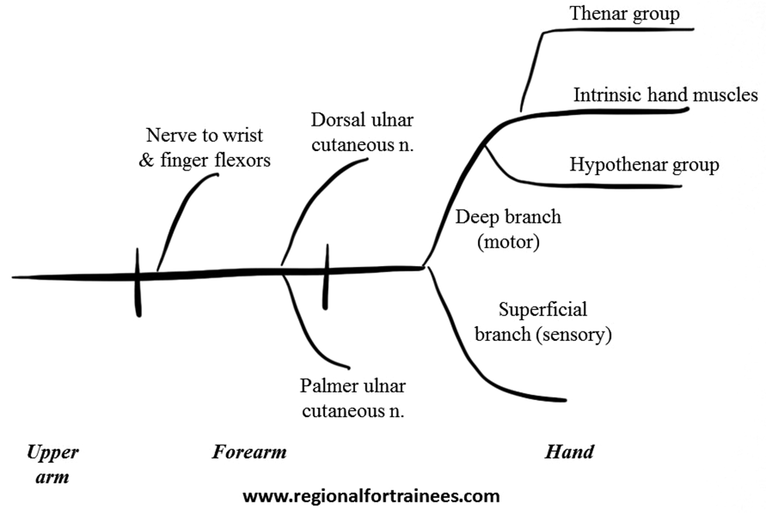
Ulnar nerve
Medial cord
Medial epicondyle close to the bone mostly travels subcutaneoulsly
Under flexor carpi ulnaris
Close to ulnar artery
Divides Sup & deep
Hand muscles
Sensation

Slide 36
Midhumeral – complete block
Any use ??

Slide 37
Medial epicondyle – dysesthesia ??
Funny bone

Slide 38
Forearm ulnar nerve

Slide 39
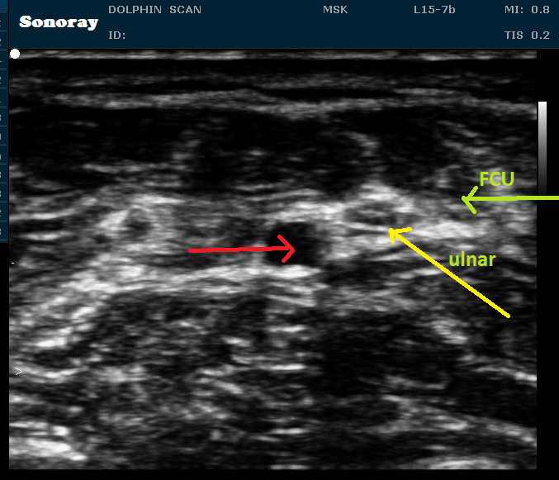
Wrist – ulnar
Left hand

Slide 40
Move the little finger

Slide 41
Median and the ulnar
FCR, PL
ulnar artery FCU

Slide 42
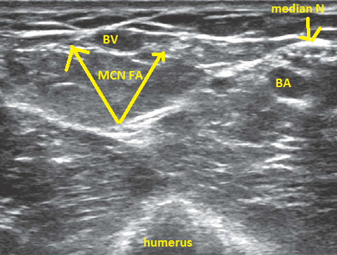
Medial CN FA

Slide 43
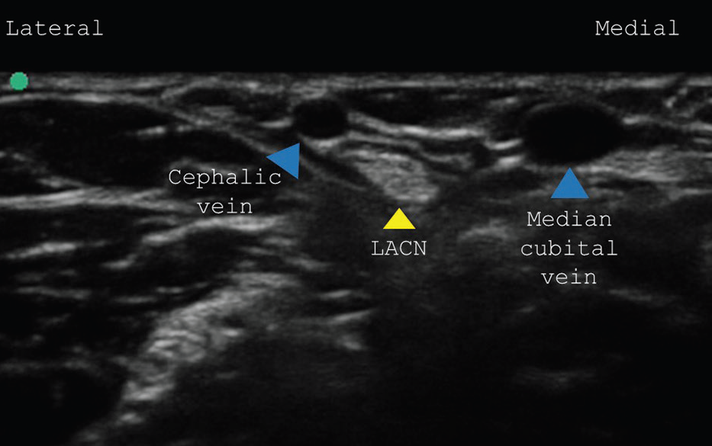
Lat cut nerve of FA

Slide 44
Forearm overall picture

Slide 45
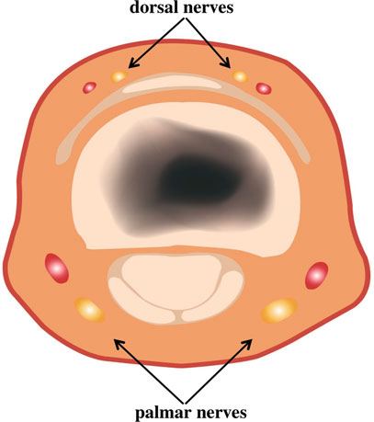
Digital blocks
Place in the dorsum where texture changes to smooth
Each side of the base of the digit
Both palmar and dorsal
Thumb and little finger
The other side
1 – 2 ml
No epinephrine
Neuropathy , ischemia
Leave some time to act – ten minutes at least

Slide 46
Blockade of major nerves at the elbow – really useful than at the fore arm ??

Slide 47
Why rescue blocks
Pros
Cons
Nerves
Techniques
Thank you all

