Slide 1
Choosing an IV agent
Dr. S. Parthasarathy
MD., DA., DNB, MD (Acu), Dip. Diab. DCA, Dip. Software statistics

Slide 2
What and how to choose
Thiopentone
Ketamine
Propofol
Etomidate
Methohexital

Slide 3
Some scenarios

Slide 4
Routine thyroid case
Induction (thio or propofol)
Thiopentone causes conversion of T3 to reverse T3, and that this can intensify the sick euthyroid Syndrome
Clinical significance ??

Slide 5
Anaesthesia for ECT
1. atropine
2. induction agent
3. Suxa
Mask ventilate and give it to them
With or without tourniquet
Methohexital

Slide 6
Laparotomy – porphyria
Induction thio ??
Relaxant
Gas , O2, agent
Propofol is safe

Slide 7
Perianal abscess
Intense analgesia needed
Ketamine with anti sialogogues and diazepam
But visceral pain – add opioid

Slide 8
IHD for GA
Etomidate
Induction
Propofol - no ( vasodilation more )
Etomidate -- vomiting, myoclonus and steroid suppression

Slide 9
Unmarried MTP
TIVA
Anti emesis with clear headed recovery
propofol

Slide 10
Child with Squint
Induction –
propofol – ok
but no to keta
No movement eyes and no nausea

Slide 11
Patients with pancreatitis
several reports of postoperative pancreatitis
in association with propofol - induced anesthesia

Slide 12
Laparotomy – ectopic
Pulse rate – 110 , BP of 94 systolic
Induction keta !!
Relaxant
Gas , O2, agent

Slide 13
Laparotomy patient on lithium and sertraline
Induction
Ketamine ??
Propofol ??
Thio is ok

Slide 14
Shoulder surgery and bronchial asthma
Induction
2.5 mg per kg of propofol per kg resulted in a significantly lower incidence of wheezing after tracheal intubation when compared 5 mg per kg of thiopental or with 1.75 mg per kg of methohexital per kg of body weight.
The incidence of wheezing was 0%, 45%, propofol. Thio
But in active wheezing – ketamine

Slide 15
Closed reduction ortho
Propofol – muscle tone decrease
Others ??
Especially ketamine ??

Slide 16
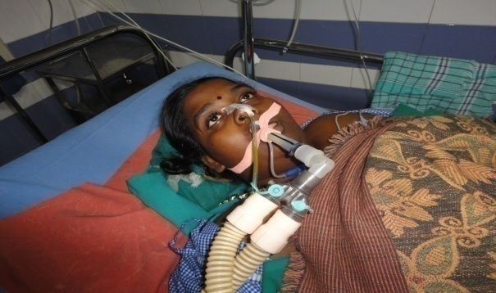
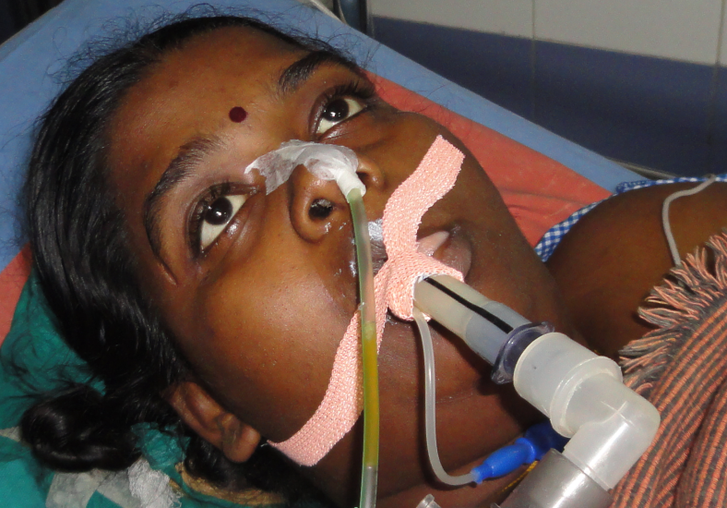
Prone for airway spasm
Thio - more sympathetic depression than parasympathetic
Propofol - both suppressed
Spasm less frequent with
propofol
LMA ventilation ??

Slide 17
Uncooperative child
Ketamine can be administered by multiple routes (intravenous, intramuscular, nasal, oral, rectal, epidural), thus making it a useful option for premedication in mentally challenged and uncooperative pediatric patients

Slide 18
Penetrating eye injury
Induction, propofol √
Ketamine , etomidate ???

Slide 19
Opioid addiction for GA
Induction – ketamine
NMDA antagonist

Slide 20
Thiopentone
rapid intravenous induction of anesthesia
treatment of increased ICP
to provide neuroprotection from focal cerebral ischemia

Slide 21
Fibroadenoma – LMA
Induction –
propofol
GA spont or controlled

Slide 22
Continuous infusion in small procedures
Propofol
Etomidate,
Ketamine
Context sensitive half life

Slide 23
thio
Blood
Propof
duration

Slide 24
critical illness, in particular in patients with septic shock,
GA
No etomidate WHY ??
incidence of adrenal insufficiency is high

Slide 25
FESS
Hypotensive anaesthesia
Propofol
Pain on injection - the problem with propofol

Slide 26
GA in a patient with liver disease
Induction
propofol extrahepatic metabolism 30 % through the lungs
Relaxant
Gas , O2, agent

Slide 27
GA with a patient with Atopy
Etomidate
is the induction agent of choice in atopic patients
comprise the safest combination of drugs for general anesthesia E, F, V
1 in 450000 or 1 in 50000 (pro) or 1 in 20000 (thio)

Slide 28
For scoliosis
Propofol better preserves cortical SSEP
Better hypnosis
Monitoring SSEP acceptable
Plan TCI – propofol

Slide 29
Others
Cost propofol higher
Reuse - no propofol
Endoscopy
Long term – infusion
propofol – ok
Sense of well-being noted after administration secondary to an increase in dopamine concentrations

Slide 30
Propofol
Subhypnotic dose can be used to treat pruritus induced by spinal opiates
Thiopental is stable for one week if refrigerated after reconstitution and methohexital is stable for up to six weeks.
But propofol - ??
Thiopental ideal for cerebral protection and status epilepticus

Slide 31
Pregnancy for GA
Propofol crosses the placenta and concentrations are higher
But thio, even though it crosses the placenta the relative concentrations are safer for the foetus

Slide 32
Others
Garlic taste in the mouth with IV induction
End point – loss of eyelash reflex ??
Loss of verbal contact – propofol ?

Slide 33
Combine two drugs
Less complications better effect
Propofol – ketamine
Thio – ketamine
Subanaesthetic doses of ketamine

Slide 34
1 + 1 = 2 is never correct in medicine
These are general implications and considerations
The anaesthesiologist should decide on each and every case

Slide 35
Thank you all

