Slide 1
Digoxin
Dr. S. Parthasarathy
MD., DA., DNB, MD (Acu), Dip. Diab. DCA, Dip. Software statistics-
PhD ( physiology), IDRA

Slide 2
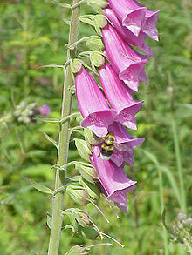
Started using in 1700s
Digitalis purpurea
Plant – so many
Alkaloids
Digoxin
Digitoxin
Oubain

Slide 3
Structure

Slide 4
Mechanism

Slide 5
Digoxin inhibits Na+,K+-ATPase
Increased cytosolic Na
Na + suppresses Na+-Ca2+ exchange
Increased cytosolic calcium
Actin myosin interaction
Inotropy

Slide 7
Other inotropes

Slide 8
Binding of glycosides to Na+K+ATPase pump is slow.
So the Ca2+ loading in SR occurs gradually
the inotropic effects of digitalis takes hours to develop even after IV administration
But adrenaline !!

Slide 9
Whats the other problem
Potassium depletion
Reason for toxicity
Supplementation partially reverses
Calcium entry and potassium depletion are inseparable – low therapeutic index

Slide 10
The autonomic nervous system effects of cardiac glycosides include increased parasympathetic nervous system activity due to sensitization of arterial baroreceptors (carotid sinus) and activation of vagal nuclei and the nodose ganglion in the central nervous system (CNS),

Slide 11
The Purkinje fibres and the other specialised automatic and conducting tissues in atria and ventricle are more sensitive to cardiac glycosides.
The resting membrane potential (RMP) of all these tissues is progressively reversed, i.e.
More towards automaticity

Slide 12
At therapeutic concentration, digoxin reduces the automaticity, increases the diastolic resting membrane potential, prolongs the effective refractory period and decreases the conduction velocity or time, predominantly of AV nodal tissues.
All these may be due to the increased vagal tone and decreased sympathetic nervous system activity

Slide 13
We don’t want much ??

Slide 14
GIST
No action on SA node
Blocks AV node
Irritates atria ( also tracts)
Irritates ventricles ( also tracts)

Slide 15
Wpw syndrome
The conduction through aberrant pathways are not slowed but that of AV node slowed.
So dangerous arrhythmias

Slide 16
At equilibrium, the concentration of cardiac glycosides in the heart is 15 to 30 times greater than those in the plasma.
Aglycon portion
attachment to cardiac muscle
Glycon portion
Inotropic action

Slide 18
Digitalisation- what is it ??
Oral slow digitalisation
0.25 mg oral once a day – after a week can increase to 0.375 mg / day -( week)
? Stopping
Oral rapid digitalisation
0.5 to 1 mg start, followed by 0.25 mg every 6 hours interval, with careful monitoring of toxicity (24 – 36 hours)
IV rapid digitalisation
0.25 mg IV stat, followed by 0.1 mg IV slowly
( 2- 6 hours )

Slide 19
Sometime you see movie for three hours but ??
Even after stopping the drug it remains in the heart for fifteen to twenty days

Slide 20
No IM injection

Slide 22
levels of digoxin in the blood, for CCF known as the therapeutic range, may be between 0.5 and 0.8 ng/mL.
If someone is taking digoxin for AF -- should have a blood level between 1 to 1.5
Above 2.5 ng/ ml – cautious

Slide 23
Downsloping ST depression with a characteristic “sagging” appearance Flattened, inverted, or biphasic T waves. Shortened QT interval. prolonged PR

Slide 24
Inverse tick sign

Slide 25
When to use ??
Sympathetic activation - beta blockers
Rennin angio activation – ACE inhibitors
Aldosterone activation - aldosterone , diuretics
When we cant get control – digoxin
Do we have oral inotrope for long term use ??
2- 3 months use – then withdraw ??
The other indication is – CCF with AF

Slide 26
Controversial
Mortality remained the same
Becomes less ??
Possible digitoxicity

Slide 27
Digoxin toxicity

Slide 28
Extracardiac effect
anorexia, nausea, vomiting,
fatigue, malaise,
mental confusions, restlessness,
disorientation, psychosis, visual disturbance

Slide 29
Cardiac effect
Almost all rhythm disturbances
pulsus bigeminus, ventricular extrasystole, ventricular fibrillation, ventricular tachycardia, AV junctional ectopic, partial to complete AV block, severe bradycardia,
Even atrial fibrillation

Slide 30
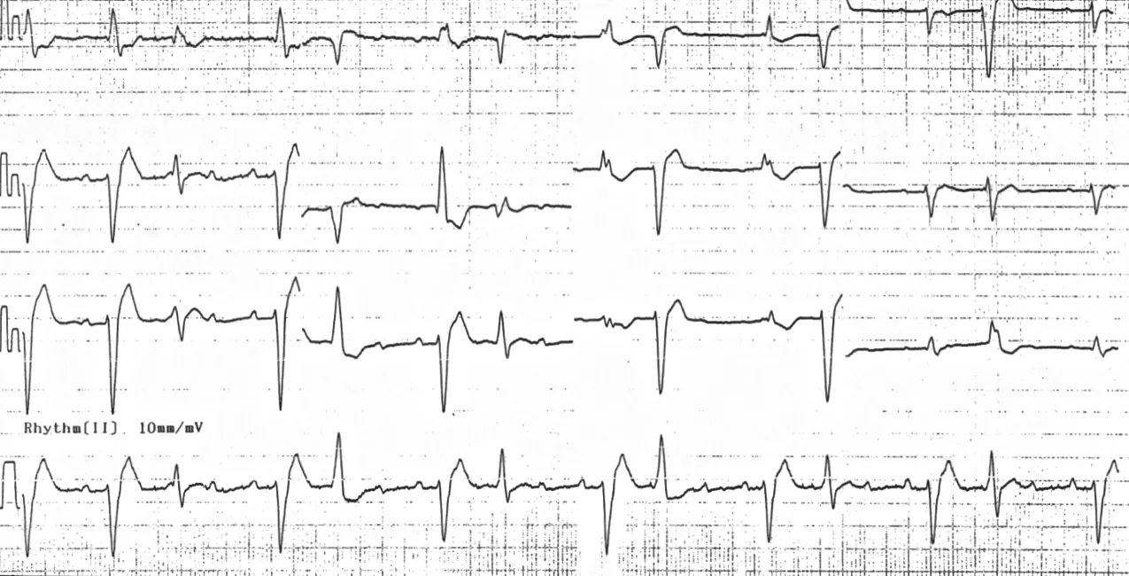
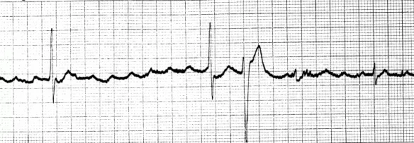
VPC, atrial tachycardia
Classical PAT with block
Net pictures for closed educational purpose only

Slide 31
Treatment
Sinus arrest, second or third degree AV block are usually treated by atropine IV injection
temporary ventricular pacing
Extracellular K+ promotes the dephosphorylation of Na+ K+ATPase enzyme
Fights with digoxin – so recommended even if no hypokalemia

Slide 32
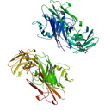
Lignocaine is used for the treatment of ventricular automaticity of digitalis toxicity which threaten haemodynamic compromise.
Electrical Cardioversion can induce unpredictable arrhythmias in patients taking digoxin
What is this ??

Slide 33
antidigoxin immunotherapy
Purified Fab (antigen binding fragment) from sheep antidigoxin antisera is an effective antidote for digoxin toxicity. The Fab fragment has been marketed in Europe as ‘digibend’ (40 mg/vial).
Digoxin ingestion more 10 mg
Children more than 4 mg
severe Digitoxic arrhythmias with potassium of more than 5

Slide 34
antidigoxin immunotherapy
It is non immunogenic.
Given by IV infusion ( with NS for 30 minutes )it markedly improved the survival of digitalis intoxicated patients.
digibend’ (40 mg/vial).
Each vial binds 0.5 mg digoxin – approx
The digoxin – Fab complex is rapidly excreted by kidney. However, it is very expensive. (600 US $)
Rarely potassium disturbances , edema dyspnea can occur

Slide 35
Summary
Cardiac glycosides structure
Mechanism
Effects , ECG
Uses
Toxicity
Treatment

Slide 36
Thank you all
Continue to read like this

