Slide 1
Opioids - UNIQUE FEATURES OF INDIVIDUAL AGENTS
Dr. S. Parthasarathy
MD., DA., DNB, MD (Acu), Dip. Diab. DCA, Dip. Software statistics-
PhD ( physiology), IDRA

Slide 2
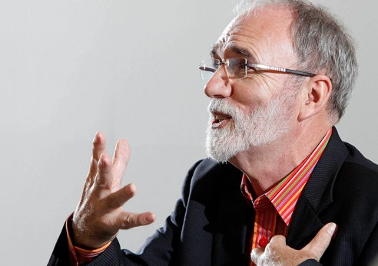
Just a simple notes but not a high profile lecture by a bearded scientist

Slide 3
Codeine
Greek word – for poppy head
Codeine is actually a prodrug that is metabolized in part by O-demethylation into morphine, a metabolic process.
Antitussive , antidiarheal , analgesic
Pharmaco genetic nuance ??

Slide 4
Codeine
Ethiopians

Slide 5
Morphine
Have we replaced morphine in effectiveness ??
Less lipopholic – slow onset – multiple doses toxicity
5 minutes after IV ??
Respiratory depression safety factor is there because of slow onset
Less lipophilic – late respiratory depression with morphine
Liver converts Morphine 3 G. and M6G – excreted by kidneys
Morphine 6G is active
Routes – oral , IM, SC, epidural, intrathecal, IV

Slide 6
Local injection – iliac crest grafting
M6G is potent than morphine ( 650 times )
Increases in renal failure
0.1 mg/kg dose IV
1-2 mg epidural
0.1 mg intrathecal
30 mic/ kg in paediatric
caudal
30 mg/ day tablets
Intraarticular – better ??

Slide 7
Fentanyl – with droperidol for neuroleptanalgesia
Innovar
2.5 mg of droperidol with 50 mic of fentanyl in one ml of innovar
Artificial hibernation, neurovegetation and ataralgesia

Slide 8
Fentanyl – contd.
Non ionized is only 10 % but high lipid solubility overcomes
1- 2 mic. Kg – Iv intra op analgesia
2 – 10 mic total for blunting intubation response
IV , PCA PCEA infusions epidural, intrathecal , TTS, OTFC, etc..
Faster onset less duration than morphine but infusions – stoppage does not reduce the risk of ventilatory depression

Slide 9
OTFC
Oral transmucosal fentanyl citrate (OTFC, ActiqÔ) is a solid formulation of fentanyl that resembles a lozenge on a handle.
rapid onset of analgesia, (fentanyl begins to cross the blood-brain barrier in as little as 3-5 minutes), peak effect at 20-40 minutes
Total duration of activity is 2 to 3 hours.
OTFC is available in 200, 400, 600, 800, 1200, & 1600 mcg dosage strengths.
Give 200 and wait 15 minutes and add
Breakthrough pain – cancer

Slide 10
TTS -- Fentanyl
This transdermal fentanyl patch is available in four sizes and provides sustained release of fentanyl at rates of approximately 25, 50, 75, and 100 µg/h for periods of 48-72 h.
The patch is attached to the skin by a contact adhesive, adjacent to which is a microporous membrane that controls the rate at which fentanyl is transferred from the drug reservoir to the skin
Nor fentanyl - No action

Slide 11
Alfentanil
Alfentanil was the first opioid to be administered almost exclusively by continuous infusion. Because of its relatively short terminal half-life, alfentanil was originally thought to be an opioid with a rapid offset of effect after termination of a continuous infusion.
Metabolism differs with single IV or infusion
- disuse for infusion

Slide 12
Alfentanil
The effect-site equilibration time for alfentanil is 1.4 minutes, compared with 6.8 and 6.2 minutes for fentanyl and sufentanil, respectively.
10 minutes
15 mic/ kg – intubation response – 90 seconds
150 mic/ kg unconsciousness in 45 seconds
Nor alfentanil – no action

Slide 13
Meperidine(Pethidine)
This substituted phenylpiperidine is significantly more lipid soluble than morphine, although its plasma pharmacokinetics is similar.
The onset of the analgesic effect is faster than morphine, and the duration is shorter (2-3 hours). 6 hours for morphine
1-2 mg / kg - IV – IM epidural, intrathecal use –OK
Intrathecal – use – alone – local anesthetic action

Slide 14
Pethidine
Tachy , hypertension
Norpethidine – epiletogenic
Don’t combine with phenobarb
Pethidine and antishivering action in lower doses – 12-20 mg -Possible α_{2b} agonism
Inhibition of serotonin reuptake and the potential dangerous interaction with MAOIs
serotoninergic crisis manifested as clonus, agitation, hyperreflexia, and hyperthermia.
Chlorpromazine with steroids

Slide 15
Sufentanil
Sufentanil’s distinguishing feature is that it is the most potent opioid commonly used in anesthesia practice.
This thienyl derivative of fentanyl is more potent and even more fat soluble.
Its high affinity and selectivity for μ opioid receptors have made it a common probe for μ effects in pharmacologic studies.
Because it is more intrinsically efficacious at the opioid receptor, the absolute doses used are much smaller compared to other less potent drugs

Slide 16
sufentanil
High doses – cardiac anesthesia –
The fat solubility of sufentanil allows it to be absorbed rapidly through intact skin and mucous membranes.
Although it has been used epidurally, its rapid absorption by spinal cord and vertebral plexus result in a very short duration.

Slide 17
Sufentanil
A single dose of sufentanil, 0.1 to 0.4 µg/kg IV, produces a longer period of analgesia and less depression of ventilation than does a comparable dose of fentanyl (1 to 4 µg/kg IV).
Onset – 1 – 4min. Duration – 30 -60m
Skeletal muscle rigidity
Bradycardia
Resp. depression remain

Slide 18
Pentazocine
Pentazocine is a synthetically-prepared prototypical mixed agonist–antagonist (opioid analgesic) drug of the benzomorphan class of opioids used to treat moderate to moderately severe pain
Talwin -- Ts as recreation
0.3 mg / kg IV available as 30 mg/ ml
Miosis and IOP – no effect
Psychotomimetic effects , tachycardia , hypertension

Slide 19
Buprenorphine
Buprenorphine appears to be a partial agonist at mu and K receptors;
to this extent it resembles the nalorphine-like drugs.
However, slow dissociation from mu receptors and an unusual"bell-shaped"dose-response curve give buprenorphine a unique pharmacologic profile.

Slide 20
Buprenorphine

Slide 21
nalbuphine
Agonist antagonist
10 mg iv bolus – 3 minutes – 3-6 hours
5 mg/ hour
Analgesia – acceptable – comparable with 5 mg morphine
No itching
Less nausea
Less spasm
Cardiac stability
“Buddy” – head injury cases OK !

Slide 22
Naloxone
Antagonist
Treatment of opioid depression of respiration
Sedation
Reverses analgesia also but neuraxial – no
0.4 – 2 mg – upto 10 mg – 2-3 hours – renarcotization
nausea, pruritus
Pruritus of cholestasis also

Slide 23
naloxone
For neonatal resuscitation, naloxone (0.1 mg/kg) is specifically indicated in infants with severe respiratory depression whose mothers received opioids within 4 hours of delivery
Pulmonary edema
Arrhythmias reported

Slide 24
Naloxone
Sepsis induced hypotension ? Use
A new use for naloxone, ultrarapid detoxification, involves administration of the drug to opioid-dependent patients under general anesthesia to provoke acute withdrawal. This process allows for controlled management of withdrawal symptoms, reduces patient discomfort, and avoids the need for a prolonged opioid wean.

Slide 25
Naloxone
shown to be useful in the reversal of CNS depression induced by overdoses of several non-opioid drugs, including ibuprofen, clonidine and valproic acid. It has been suggested that the mechanism for naloxone in treating valproic acid overdose may be antagonism of gamma-aminobutyric acid (GABA), as well as reversal of endogenous opioid effects

Slide 26
Clinical pearls
Slow onset – no problem about duration – post op ventilation-- cost ??
Morphine
Retrobulbar block – one shot for sedation –
alfentanil
FESS under IVA
remifentanil
Intraop cholangiogram
Nalbuphine
Opioid intrathecal –
fentanyl
Opioid in blocks –
buprenorphine
Penta, butodol, and bupre for IV use in small hospitals

Slide 27
Opioid uptake by the lung has a significant implication in opioid pharmacokinetics.
The time necessary to reach the peak concentration of an opioid is influenced by the degree of pulmonary uptake.
Pulmonary uptake of fentanyl is more extensive than the pulmonary uptake of alfentanil, which may be explained by the difference in sequestration into pulmonary endothelial cells

Slide 28
Age
Neonate – less doses – pharmacokinetic reason
Old age – low doses – pharmaco dynamic reason

Slide 29
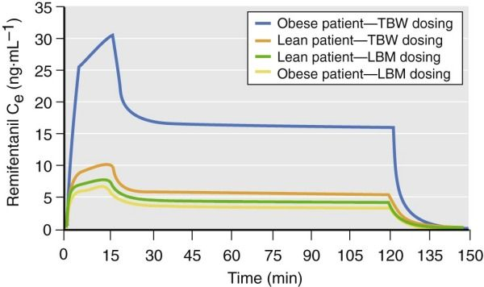
Obesity
Lean body mass
Ideal
For closed academic purpose only – figures from internet

Slide 30
Renal Failure
Renal failure has implications of major clinical importance with respect to morphine and meperidine
For the fentanyl congeners, the clinical importance of renal failure is less marked.
Why – ? think of metabolites

Slide 31
Liver
liver is the metabolic organ primarily responsible for opioid biotransformation, -- still
the degree of liver failure typically observed in perioperative patients, with the exception of patients undergoing liver transplantation, does not have a major impact on the pharmacokinetics of most opioids.
Morphine and pethidine – mild but others no

Slide 32
Others
Changes in pH influence the protein binding of fentanyl, sufentanil, and alfentanil such that protein binding increases with alkalosis and decreases with acidosis
It is common practice to administer reduced doses of opioids to patients suffering from hemorrhagic shock to minimize any adverse hemodynamic consequences and prevent prolonged opioid effect.

Slide 33
Pictures taken and modified from internet for closed academic purpose only

Slide 34
After four hour infusion – CSHL in minutes

Slide 35
Agonist (Low level)+ agonist Antagonist
Increased action
Agonist (high level)+ agonist Antagonist
Decreased action

Slide 36
அப்பா முடிஞ்சுதா ??

