Slide 1
Clonidine
Dr. S. Parthasarathy
MD., DA., DNB, MD (Acu), Dip. Diab. DCA, Dip. Software statistics-
PhD ( physiology), IDRA, FICA

Slide 2
History
Clonidine was first discovered serendipitously in 1962 when Dr. M. Wolf administered to himself and his secretary a few drops of a 0.3% solution (1-2 mg) of clonidine ? For decongestant properties.
But found its sedative, bradycardic, and hypotensive effects–
Antihypertensive !

Slide 3
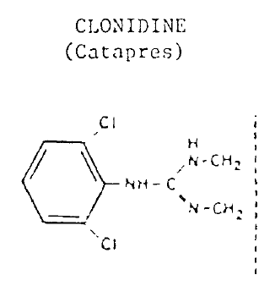
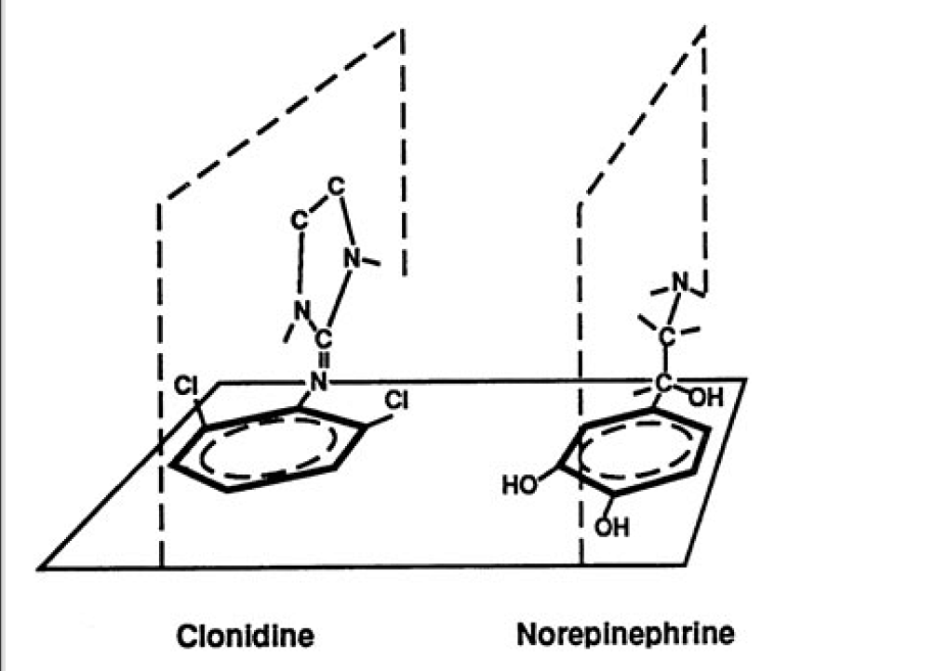
Imidazoline derivative similar to tolazoline
Alpha receptor agonism
Alpha 2 :1 = 200 :1
Similar shape !!

Slide 4
Adrenergic agonists
Dopamine
Dopamine
Phenyleph
Clonidine
Dobutamine
Oxymetazoline
Isoprenaline
Noradrenaline
Terbutalin
norad
Adrenaline
Alpha | Beta
Alpha 1 | Alpha 2
Beta 1 | Beta 2 | Beta 3
Ephedrine
Ephedrine

Slide 5
Understand ? Clear ?

Slide 6
Routes of administration
Oral initially used as an anti hypertensive
Good reduction of BP for 4- 6 hours excreted via urine predominantly after liver metabolism
Oral --
Intravenous
Intramuscular ??
Nebulised
Nerve blocks
Spinal
epidural
Transdermal clonidine provides a sustained therapeutic level of drug
The peak action occurs in 10 minutes and lasts for 3-7 hours after single intravenous dose.

Slide 7
Possible mechanisms of action
Alpha 2 stimulation
Decreased central sympathetic drive
decreasing noradrenaline release from both central and peripheral sympathetic nerve terminals-
Depression of upward thalamic transmission – sedation
Locus ceruleus hypotension
vagal nucleus bradycardic effects.
acts on the cholinergic, purinergic and serotonergic pain systems causing analgesia
Decreased PRA
Decreased aldosterone
I2 imidazoline receptor may interact with opioid receptors

Slide 8
Neuraxial clonidine – how it acts ?
Stimulation of α2-receptors in the dorsal horn diminishes pain transmission (mimics inhibitory descending bulbospinal neurons)
Increased ACh levels increases analgesia through cholinergic mechanisms (neostigmine)
Intrinsic blockade of Aδ and C fibers
Local vasoconstriction (? effective at clinically used doses)
suppresses the generation of action potentials in tonic-firing spinal dorsal horn neurones.
Potassium channels and hyperpolarization ?

Slide 9
In nerve blocks ! Is it alpha 2 ?
The peripheral effects of clonidine are through inhibition of the hyperpolarization-activated cation current (I_{h} current).
This current normally functions to restore nerves from a hyperpolarized state to resting potential for a subsequent action potential.
The effect appears to be more profound on C-fibers (pain fibers) than A∝-fibers (motor fibers),thereby making the effects potentially more sensory specific.

Slide 10
To the CVS !
In the supine position, clonidine reduces mean arterial pressure (MAP) (average 17%) ,
cardiac output (CO) (average 21 %) ,
heart rate (HR) (average 1O %),
stroke volume (SV) (average 15%)
with no consistent change in total peripheral resistance (TPR)
The decrease in systolic blood pressure produced by clonidine is more prominent than the decrease in diastolic blood pressure.
Alpha 1 and initial BP rise ?

Slide 11
Other actions
The α2-agonists have minimal depressant effects on ventilation, and these agonists do not potentiate ventilatory depressant effects of opioids.
Sodium and water retention
Dry mouth !

Slide 12
Clinical uses in anesthesia
Preanesthetic medication (5 µg/kg) orally blunts cardiovascular responses to sympathetic nervous system stimulation and decreases anesthetic requirements..
Intubation response
Decreased perioperative ischemia
Decreased anesthesia requirements

Slide 13
When does it occur ?
The maximum effect of intravenous clonidine occurs approximately 15 minutes after administration and is slow compared to other agents used for this purpose.
When to time the injection ?
Many times after intrathecal the fall in HR will be around 45 – 50 minutes – beware

Slide 14
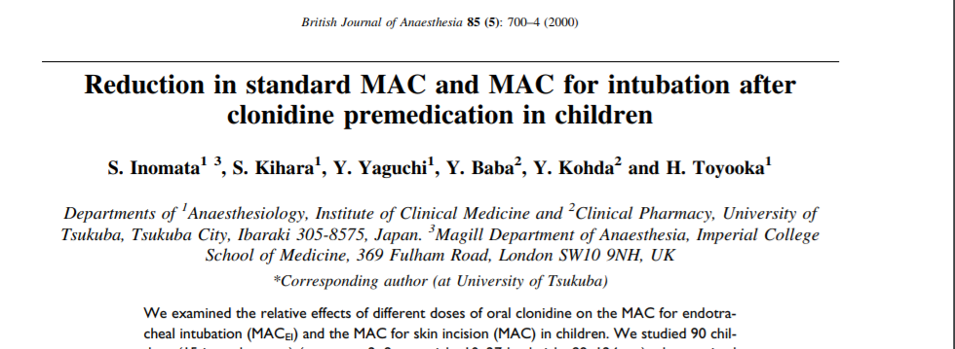
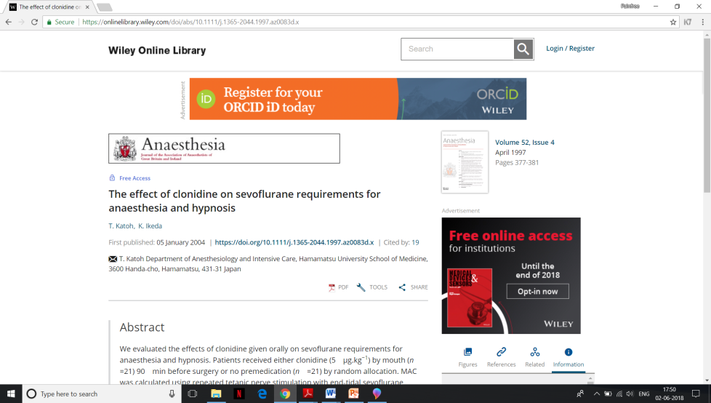
Probable reduction of MAC by 25 – 30 %
Propofol requirements are decreased by 20 %

Slide 15
Perioperative clonidine has some advantages over perioperative beta-blockers because it has less risk of bronchospasm in asthmatics and it comes in a transcutaneous form that can be used in patients who are not taking oral medications ('NPO').
Transdermal patch 0.1 mg/ 24 hours for seven days

Slide 16
Other uses in general anesthesia
Clonidine decreased anesthetic requirements but does not delay recovery
Clonidine decreased postoperative oxygen requirements
Preinduction clonidine decreased post operative shivering

Slide 17
Hypertensive emergencies
An initial oral dose of 0.1 to 0.2 mg of clonidine hydrochloride followed by hourly doses of 0.05 or 0.1 mg until goal blood pressure is attained that does not reduce perfusion to critical organs,
a total of 0.7 mg is given, will achieve a significant reduction in blood pressure in 93% of patients.

Slide 18
Neurosurgery
Oral clonidine premedication provides optimal hemodynamic stability and good neuro-surgical comprising heart rate, mean arterial pressure and dural tightness.
Anaesth Pain & Intensive Care 2015;19(3)233-239
Low dose oral clonidine for ophthal anesthesia

Slide 19
For deliberate hypotension
Intravenous clonidine as a part of balanced anaesthesia for controlled hypotension in functional endoscopic sinus surgery: A randomised controlled trial
3μg/kg ?? of clonidine intravenously, 30 min prior to induction of anaesthesia.

Slide 20
Regional anesthesia and clonidine
Acta Anaesthesiol Scand. 2003 Sep;47(8):1001-5.
Intravenous clonidine prolongs bupivacaine spinal anesthesia. both 30 mic and 60 mic are useful .. Not significant side effect change profile
Not prolonged this much

Slide 21
Subarachnoid additives
Even a small dose of 15 mic improves and increases blockade with spinal bupivacaine..
( couzon textbook of regional anesthesia)
High doses i.e 15 mg bupi -- prolongation may be upto one hour
Traditional dose 15 – 45 mic.
150 to a maximum of 300 mic used - Side effects are very high

Slide 22
Epidural
1 mic / kg – addition prolongs post op pain relief
3 mic / kg also used
Probable duration - 6 hours
1 mic/ kg/hour infusion also used
Variable results with side effects
Along with morphine or fentanyl – also given
Almost all studies are a decade ago
Careful in elderly

Slide 23
In plexus !!
Perineural Clonidine Reduces Mechanical Hypersensitivity and Cytokine Production in Established Nerve Injury–
Addition in BPB - 2 mic/ kg increases duration of analgesia –
Doubts in healthy volunteers
15 studies pro and 12 con for addition in blocks
Intraarticular clonidine – conflicting positive results

Slide 24
In ambulatory surgery – think
Orthostatic hypotension ? (Not like alpha 1 antagonists) and fainting are more serious adverse effects; they may delay ambulation.

Slide 25
ICU sedation
clonidine, the prototype of alpha 2 agonists has been used as an analgosedative in intensive care both in ventilated and spontaneously breathing patients..
Used in tetanus patients
100 mic/ hour
But hypo, late bradycardia and withdrawal rebound hypertension, arrival of dexmed - ? ? Sedative in ICU

Slide 26
Chronic pain
Intrathecal 150 mic clonidine decreases capsaicin induced hyperalgesia
Epidural 150 and 750 mic used With side effects
Useful in many chronic pain conditions where neuropathic component is predominant
Clonidine infusion through implantable pumps for cancer pain relief
Topical clonidine gel has been used with good success rate in painful diabetic neuropathy.

Slide 27
Possible uses of IV, epidural and intrathecal clonidine
Still lack good clinical trials to establish facts

Slide 28
Other uses
Migraine
Menopausal flushing
Shivering
Attention deficit disorder
Opioid addiction
Anxiety
Alcohol withdrawal
Diagnosis of pheochromocytoma; failure of the “clonidine suppression test” to ↓ catecholamine release suggests diagnosis

Slide 29
Clonidine in pediatrics

Slide 30
Premedication
Clonidine in doses of 4 mcg.kg-1 orally or intranasally and in doses of 5 mcg.kg-1 rectally provides adequate sedation
Atropine decreases side effects

Slide 31
Yes ! in nerve blocks
A continuous infusion of 0.2% ropivacaine 0.4 mg/kg/hour with clonidine 0.12 mcg/kg/hour through a sciatic nerve catheter offered complete pain relief in a three year old boy who had a subtotal amputation of his foot
2 – 4 mic / kg single dose

Slide 32
Pediatrics – continued
Decreased MAC,
Emergence agitation - decreased
Better recovery in CTVS surgery
Both oral and caudal clonidine has been reported to reduce the incidence of postoperative vomiting in children.
1.5 mkic/ kg for shivering control ? Prevention
Sedation in ICU

Slide 33
Hypovolemia,
A-V block,
prolonged P-R interval
spontaneous bradycardia
Cautious use

Slide 34
Clonidine overdosage
Gastric lavage, fluids, and vasopressors should be used in treatment of clonidine overdose.
Tolazoline, 10 mg intravenously every 30 min, is the treatment of choice and usually reverses the effects of clonidine overdose promptly

Slide 35
Mivazerol
Mivazerol, another intravenous α2-agonist that is administered by continuous infusion (α2-to-α1 receptor selectivity of 119:1), also has been studied for perioperative myocardial protection
3 mic/kg/hour – but found inferior to dexmed in hemodynamic stability

Slide 36
Summary
Structure , Routes
Mechanism
Effects
Uses – anesthesia ( general and regional)
Pain and ICU
Others
Side effects
Contraindications
Toxicity

