Slide 1
Hypertensive disorders in pregnancy
Dr. S. Parthasarathy
MD., DA., DNB, MD (Acu), Dip. Diab. DCA,
Dip. Software statistics, PhD(physiology)
Mahatma Gandhi Medical College and Research Institute, Puducherry, India

Slide 2
Classify hypertensive disorders in pregnancy

Slide 3
Hypertension is defined as:
• Systolic blood pressure: .140 mm Hg
or 30 mm Hg above baseline
• Diastolic blood pressure: .90 mm Hg
Or 15 mm Hg above baseline
Blood pressures should be measured at rest with left uterine displacement and should be reproducible at least 6 hours later

Slide 4
Left lateral position
Left and right arms
Correct sized cuff
White coat hypertension
Continuous ambulatory monitoring finds one third as white coat
NIBP better but phase V of korotkoff sounds ok

Slide 5
Beyond 12 weeks postpartum
> 300 mg/day

Slide 6
Severe preeclampsia
Systemic illness

Slide 7
Incidence
6% to 8% of all pregnancies are complicated by pre-eclampsia.
The disease affects multiple organ systems and is the second leading cause of maternal mortality in the United States for pregnancies that result in a live birth.

Slide 8
Who are at risk ??
Nulliparaous
Africo american ( INDIAN !!)
Age >40
Previous preeclampsia
HT , DM .
Multiple gestation ,
molar pregnancy ( in which week??)
Obesity
Chronic renal disease , SLE
7.1% with mortality 0.4%

Slide 9
If a woman becomes pregnant by a man who has already fathered a preeclamptic pregnancy in a different woman, her risk of developing preeclampsia is increased 1.8

Slide 10
How does it occur ??
Incomplete trophoblastic invasion ??

Slide 11
Placental ischemia – TX2 ↑
vasoconstriction,
platelet aggregation,
uterine irritability,
uteroplacental hypoperfusion

Slide 12
Edema
Proteinuria
HT

Slide 13
Diagnosis
Gestational HT + proteinuria + serum urate > 5.5
HELLP syndrome is a variant of pre-eclampsia in which hemolysis, elevated liver enzymes, and low platelets are present.
Women with pre-eclampsia who develop grand mal seizures have eclampsia.

Slide 14
Pregnancy with pheo
First manifestation

Slide 15
PRES
A particular complication that may be seen is the posterior reversible encephalopathy syndrome (PRES),
More seen with preeclampsia
It is characterised by headache, convulsions, confusion and visual loss,
MRI – hyperintensities in parieto occipital region
Wait and watch

Slide 16
Haemodynamic changes:
The normal expansion of blood volume that takes place in early pregnancy
fails to occur in pre-eclamptic women
they are relatively hypovolaemic + hypertensive

Slide 17
Hemodynamic changes
Albumin loss
Hypoalbuminemia
Colloid osmotic pressure less
Inappropriate fluid administration
Prone for pulmonary edema

Slide 18
Preeclamptic women have a low pulmonary capillary wedge pressure,
a high systemic vascular resistance,
a low cardiac index, and
an increased heart rate compared with normotensive pregnant controls

Slide 19
Renal plasma flow and glomerular filtration rate are markedly diminished, and blood urea nitrogen and creatinine concentrations are increased.
What happens to creatinine in normal pregnancy??
Hyperuricemia is usually present and tends to be an early sign of deteriorating renal function in preeclamptic women.

Slide 20
Fetal effects:
Chronic impairment of uteroplacental blood flow causes intrauterine growth retardation and this may be one of the first signs of pre-eclampsia.
There is an increased risk of prematurity.

Slide 21
Diagnosis
Urine dipstick testing for proteinuria, with quantitation by laboratory methods if >’1+’ (30mg/dL)
Full blood count
Urea, creatinine, electrolytes
Liver function tests
Ultrasound assessment of fetal growth, amniotic fluid volume and umbilical artery flow

Slide 22
If some organ damage ??
Urinalysis and microscopy on a carefully collected mid-stream urine sample.
If there is thrombocytopenia or a falling hemoglobin, investigations for disseminated intravascular coagulation (coagulation studies, blood film, LDH, fibrinogen).
What is the normal pregnancy coagulation status??

Slide 23
Drugs
Alpha 2 agonists – alpha methyl dopa
Combined alpha and beta blockers – labetolol
Vasodilators – hydralazine
Calcium channel blockers – nifedipine
Keep it lower than 140/ 90

Slide 24
Alpha dopa
Oral 250 – 500 mg three to four times a day
Orthostatic hypotension
Think of drug interactions in anaesthesia
Mild hypotension in babies in first 2 days of life
No obvious association with congenital abnormalities

Slide 25
Atenolol, pindolol metoprolol described and used
But the problem of PIH ?? – vaso constriction ??
Alpha blocker Prazocin
No obv. Congenital anomaly

Slide 26
Labetalol
Oral 50 -100 mg tds
5 – 10 mg IV shots
Alpha and beta blocker

Slide 27
Ca channel blockers
Nifedipine 10 mg tds
Amlodipine 2.5 to 5mg bd
Dilzem – NO

Slide 28
Diuretics
Chlorthiazide
Possible association with congenital abnormalities
Possible neonatal thrombocytopaenia
Frusemide -- ok but the hemodynamic change in preeclamsia is what ??
Hypovolumic ??

Slide 29
Vasodilators
Hydralazine oral /IV
25 mg tablets
Safe
Hypotension controlled ??

Slide 30
Magsulf
Magnesium sulphate has been shown to reduce the incidence of eclampsia in pre-eclampsia by approximately half, although whether it should be offered routinely to pre-eclamptics is controversial
Use when
Severe PE, eclampsia and HELLP syndrome

Slide 31
Steroids
High-dose dexamethasone (10 mg IV q12hr) may improve laboratory abnormalities and accelerate postpartum recovery in patients with HELLP syndrome.

Slide 32
HELLP SYNDROME

Slide 33
How to check later
daily many times for the first 2 days after birth
• at least once between day 3 and day 5 after birth
as clinically indicated if antihypertensive treatment is changed after birth.
No alpha dopa after two days
Shift to original drug after 2 weeks

Slide 35
Prevention of preeclampsia

Slide 36
Salt and calcium
Restriction in dietary salt intake during pregnancy with the aim of preventing the development of pre-eclampsia and its complications is not recommended
In areas where dietary calcium intake is low, calcium supplementation during pregnancy (at doses of 1.5–2.0 g elemental calcium/day) is recommended for the prevention of pre-eclampsia in all women

Slide 37
Restrict fluids ??
Even though preeclampsia is associated with sodium and water retention, fluid and sodium restriction are not necessary and, in fact, may further exacerbate the disease by increasing the production of renin–angiotensin and aldosterone.

Slide 38
No strict bed rest – even in severe preeclampsia
Vitamin D supplementation during pregnancy is not recommended to prevent the development of pre-eclampsia
Antioxidants ?
L arginine ??
Low-dose acetylsalicylic acid (aspirin, 75 mg/day) for the prevention of pre-eclampsia and its related complications should be initiated before 20 weeks of pregnancy

Slide 39
Recommendations
Do not use the following to prevent hypertensive disorders during pregnancy:
• nitric oxide donors
• progesterone
• diuretics
• low molecular weight heparin.

Slide 40
Danger signs
Headache
• Visual disturbance
• Epigastric pain / right upper quadrant pain
• Nausea / vomiting
• Increasing swelling of legs, fingers, face.

Slide 41
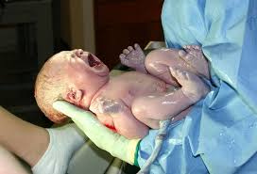
That’s the treatment at last

Slide 42
For vaginal delivery
epidural analgesia has the distinct advantage of relieving labor pain.
Epidural analgesia will decrease maternal blood pressure and can indirectly increase placental perfusion by decreasing circulating catecholamine levels.
CSEA is OK
may also improve both uteroplacental and renal blood flow.
Beware of clotting parameters

Slide 43
Dilute bupi and intervillous blood flow

Slide 44
Anaesthetic management

Slide 45
Preoperative
Volume status (urine output)
Airway edema
BP and drugs
Edema and spinal and IV access
Decision on monitoring
Lab values – platelet,1.5 lakh means she will maintain atleast 80000 through out labour. coagulation ,
LFT,RFT
ABG, XRay sos
Hypertension control is pharmacological but not with neuraxial techniques

Slide 46
Anaesthetic techniques
Spinal
epidural
CSEA
Controlled GA

Slide 47
Spinal
Previously thought as negative
But now yes-- Left uterine displacement
Hypotension corrected by ephedrine and IVF
Fentanyl addition
Phenylephrine ??
Severe preeclampsia – spinal ok but IVF beware think of CVP

Slide 48
2009 UK guidelines
Women with severe pre-eclampsia should be encouraged to have regional anaesthesia for caesarean section.
Convert an epidural if already in ….
Give spinal – bigger needle of epidural ??
Don’t worry about hypotension
They have high catecholamine secretion
Beware of vasopressors only

Slide 49
After spinal BP fall ??

Slide 50
HELLP syndrome

Slide 51
General anesthesia
the increased risk of difficult airway and intubation
marked pressor response at laryngoscopy, intubation and extubation resulting in dangerous surges in blood pressure
ICH dangers

Slide 52
Technique of GA ??
Acid aspiration prophylaxis
Thiopentone – higher doses
Suxa – RSI
Labetolol, lignocaine or some opioid to blunt response
Magsulf and NDPs
Iso + N2O +O2 (FiO2 of 50 %)- atracurium
After delivery – FiO2 change – iso cut- high dose opioids
No NSAIDs , continue monitoring BP and drugs
Cautious food intake

Slide 53
Hypertensive crisis
Labetolol 25 mg IV bolus
20 mg/ hour
Hydralazine 40 mg in 40 ml saline
5ml in 15 minutes followed by 5 ml / hour
NTG, magsulf reported
Start RL
Why ??

Slide 54
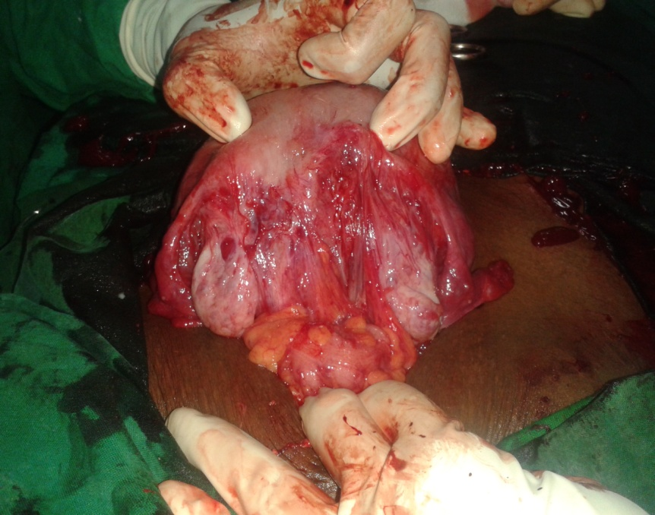
Uterus does not contract
Ergot alkaloids ??
Prostaglandins post op ??

Slide 55
Summary
Definition and types
Severe preeclampsia
Drugs
HELLP
analgesia
Anaesthetic technique
Post op pain and drugs

Slide 56
Thank you all

