Slide 1

Pharmacokinetics and pharmacodynamics of obstetric anesthesia
Dr SPS

Slide 2
Dr. S. Parthasarathy MD., DA., DNB,
MD (Acu), Dip. Diab. DCA,
Dip. Software statistics,
PhD (physiology) FICA
Mahatma Gandhi Medical College and Research Institute, Puducherry, India

Slide 3
The topic
Pharmacokinetics
What the body does the drug ??
Drug dose Vs drug concentration
Pharmacodynamics
What the drug does in the body
drug concentration Vs drug effect ??
What do we mean ??

Slide 4


Why should we know ?? 30 crores to 120 crores

Slide 5
A difficult topic ??
Pharmacokinetics and pharmacodynamics
Obstrtetic or obstetric or obstretic ??
Who is benefitted ?
Obviously the faculty – 75 %
May be the IMA branch 20%
Audience - ? 5%

Slide 6
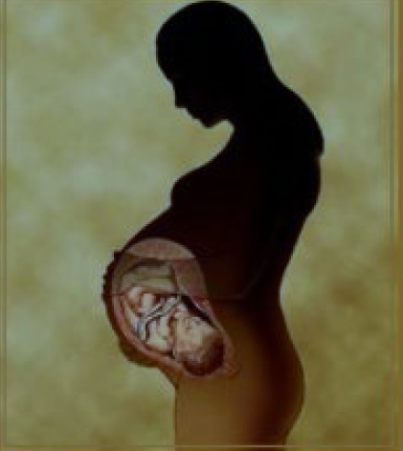
The pharmacodynamics and pharmacokinetics of many drugs change during pregnancy.
Pharmacokinetics
Absorption
Distribution
Metabolism
Elimination
Dr SPS

Slide 7
Absorption
absorption of enterally administered drugs may be affected by pregnancy-associated gastrointestinal upsets including vomiting.
Owing to the increased minute ventilation and cardiac output, absorption of inhalational
agents is more rapid.

Slide 8
Distribution of drug
Increased blood volume and body fluids
Decreased plasma proteins
Fetus is an additional compartment
Labour pain – pH changes – level changes

Slide 9
Metabolism
Liver route
no problem
Pseudocholinesterase
30 % reduction

Slide 10
Elimination
Since glomerular filtration rate is increased in pregnancy, clearance of many drugs is increased unless renal function is impaired
Big advantage – fetus over neonate –
It can get it back to the mother --

Slide 11
Plasma volume increase
Albumin decrease
GFR increase

Slide 12
Pharmacokinetic Principles
lipid solubility,
protein binding,
pKa of the drug,
pH of the fetal blood,
Blood flow.
Area

Slide 13
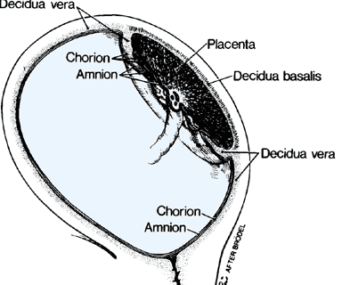
Placental transfer
dq/dt = k a (Cm–Cf) / d,
Transfer =
constant * area * conc gradient /thickness
lipid solubility,
protein binding,
pKa of the drug,

Slide 14

Is it clear ??

Slide 15
What is “ k “- also includes
molecular weight,
500 D – OK ..
Think of BBB , drugs those cross the brain – cross placenta also.
lipid solubility,
degree of ionization , pH and pKa
amount of protein binding.
Term increase – surface area increase
Thickness may decrease at term

Slide 16
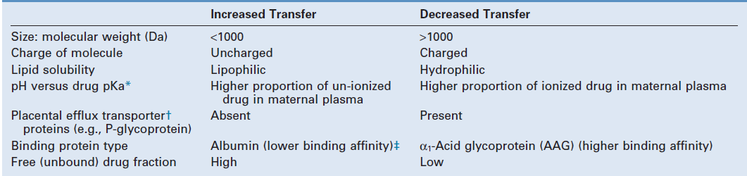
Placental depot

Slide 17
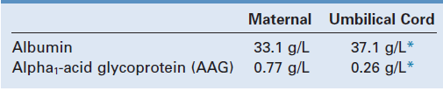
Albumin binding – OK – but AAG ??
Albumin binds primarily acidic and lipophilic compounds, whereas AAG binds
more basic compounds. ( LA and opioids )

Slide 18
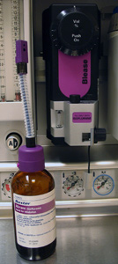
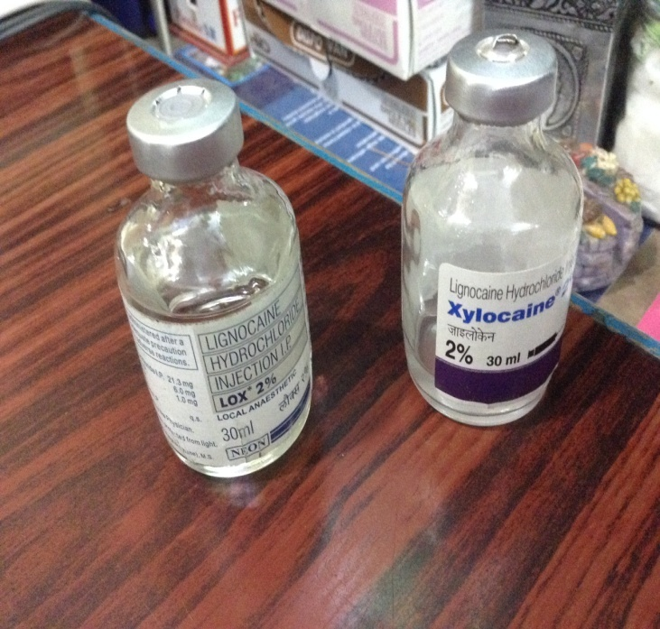
Pharmacodynamics
minimum alveolar concentration of inhalational agents is reduced as is the minimal blocking concentration of local anaesthetics

Slide 19

Lets move to individual drugs

Slide 20
Local anaesthetics
Increased progesterone levels
Increased abd. Pressure and epidural space
Pain, tachypnea and respiratory alkalosis causing a pH change in CSF and thereby increased unionized fraction of the drug

Slide 21
BUPIVACAINE
Bupivacaine is extensively bound to plasma proteins, so as the α1-acid glycoprotein levels decrease with pregnancy,
an increased percentage of the drug remains
unbound in the maternal serum compared to nonpregnant women.
Liver and kidney –same
Almost the same for lignocaine

Slide 22
pKa and protein binding
the higher the pKa, the more ion trapping can occur, so bupivacaine (pKa 8.1) is more susceptible than mepivicaine (pKa 7.7) on the basis of pKa.
However, the more protein bound, the less impact pH has on the local anesthetic, so bupivacaine is actually least affected by pH.

Slide 23
Local anesthetics
Molecular weight – 250 – 280
pKa – 7.7 to 8.1
Animal studies have shown that the transfer rate is slower for drugs that are extensively bound to maternal plasma proteins, such as bupivacaine

Slide 24
The ionized form of drugs will get trapped in the fetus since they will be unable to cross the placenta.
This phenomenon has been described as “ion trapping
7.32 – 7.38 in fetus
7.38 – 7.44 in mother

Slide 25
In the case of the acidotic fetus, a greater tendency for drug to exist in the ionized form, which cannot diffuse back across the placenta into the maternal plasma,
causes a larger total amount of drug to accumulate in the fetal plasma and tissues.
This is the mechanism for the phenomenon termed ion trapping

Slide 26
Ropivacaine
epidural use in cesarean delivery,
the free maternal plasma concentration of ropivacaine was almost twice as high as bupivacaine at delivery,
elimination half-life of ropivacaine was significantly shorter than bupivacaine by almost 3 hours
Blood levels – high, - goes out faster

Slide 27
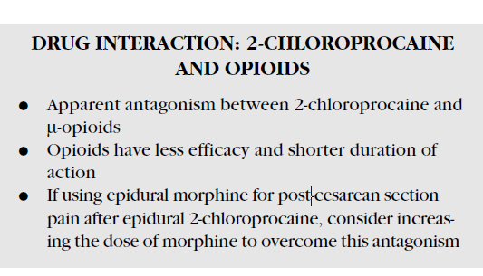

Slide 28
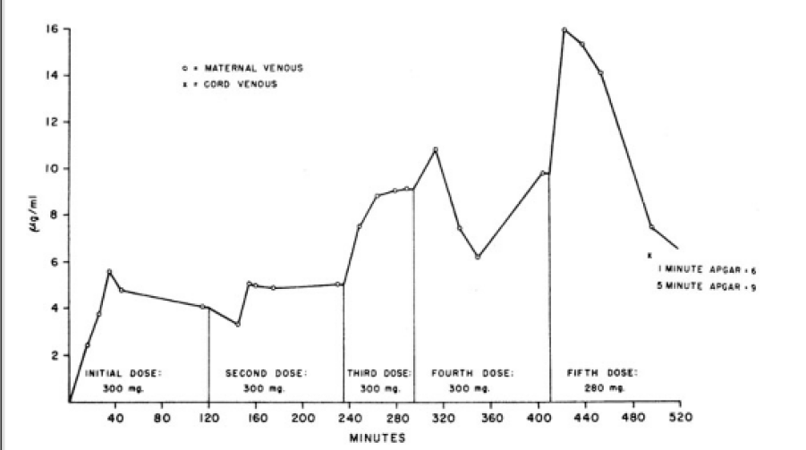
Accumulation of mepivacaine

Slide 29
Why should we decrease neuraxial local anaesthetics ??
(1) reduction of spinal CSF volume, which accompanies distention of the vertebral venous plexus;
(2) enhanced neural sensitivity to local anesthetics;
(3) increased rostral spread when injections are made with the patient in the lateral position;
(4) inward displacement of intervertebral foraminal soft tissue, resulting from increased abdominal pressure

Slide 30
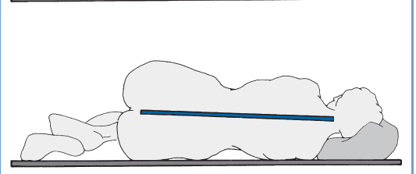
Pregnant back

Slide 31

Essence
Give 40 % less local anesthetic in pregnant patients for spinal or epidural

Slide 32
Drugs and route
Epidural epinephrine and clonidine – no effect on uterine flow but
IV may cause decreased UBF – proved only in animals
Dexmed F/M ratio of 0.2 only

Slide 33
Opioids
Labour pain
Intra op
Post op
SC, IV, IM, neuraxial opioids
Morphine , fentanyl, pethidine, pentazocine, butorphanol , buprenorphine

Slide 34
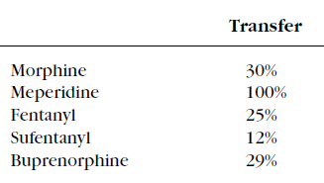
Lipid solubility and protein binding

Slide 35
Opioid likes ??
Butorphanol and nalbuphine rapidly cross the placenta, with mean F/M ratios of 0.84 and 0.74 to 0.97, respectively.
In one study, maternal administration of nalbuphine resulted in “flattening” of the fetal heart rate tracing in 54% of cases

Slide 36

Opioids - essence
Pethidine ?
All others – OK
Dose – same

Slide 37
General Anesthetics
Thiopentone less drug is needed
4 mg / kg – major problems - nil !!
Ketamine – may cause uterine hypertonicity
Etomidate – not studied much
But propofol pregnant and nonpregnant does not bother
Propofol, thiopentone -- √ √

Slide 38
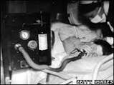
Inhalation Agents
Started from queen victoria

Slide 39
Agents – no difference ??
All agents are lipophilic and low molecular weight.
mixture of 50% nitrous oxide and 50% oxygen
Entonox
All agents decrease uterine tone
No agent – specific advantage

Slide 40
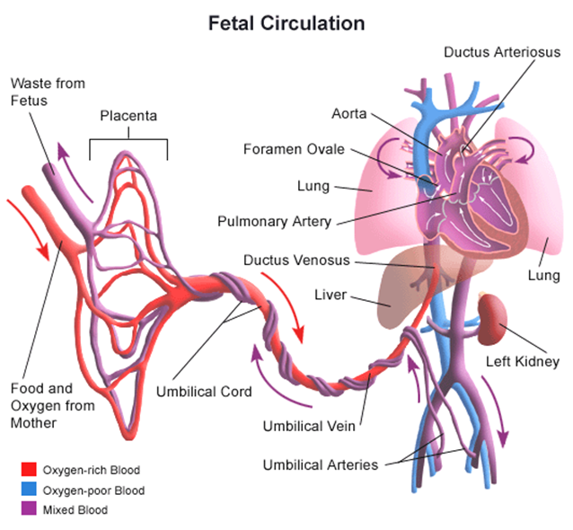
The liver is the first fetal organ perfused by umbilical vein blood, which carries drug to the fetus.
Substantial uptake by this organ has been demonstrated for a few drugs including, thiopental, lidocaine, and halothane

Slide 41

Essence
MAC decreased – 25 – 40 % -
progesterone effect
Endorphin ??

Slide 42
Benzodiazepines
They can be used for a hemodynamically stable induction of general anesthesia but cause significant neonatal side effects, often described as “floppy infant syndrome.”
Highly un-ionized, lipophilic, and 95% protein-bound diazepam is associated with an F/M ratio of 1 within.
lorazepam and midaz - -- fetal concentration less
We don’t want amnesia in pregnant patients.

Slide 43
Diazepam is a highly protein-bound drug.
Diazepam given intravenously after local
anesthetic administration will compete with protein binding and will thus increase the free local anesthetic concentration.
Avoid BZD

Slide 44
In humans, dexmedetomidine, an α2-adrenergic agonist, has an F/M ratio of 0.12, with evidence of significant placental tissue binding due to high lipophilicity.
Clonidine – less lipophilic

Slide 45
Steroids
Dexamethasone and betamethasone, that are often given to accelerate fetal lung maturity, increase ABCB1 gene expression fourfold.
ABCB1 is an efflux transporter protein; hence increased gene expression may increase fetal-maternal transfer of substrate molecules
Significance ??

Slide 46
Muscle relaxants
Scoline – pseudocholinesterase
No prolongation due to apparent volume of distribution increase.
In postpartum pseudo remains but Vd decrease
So prolongation stands

Slide 47
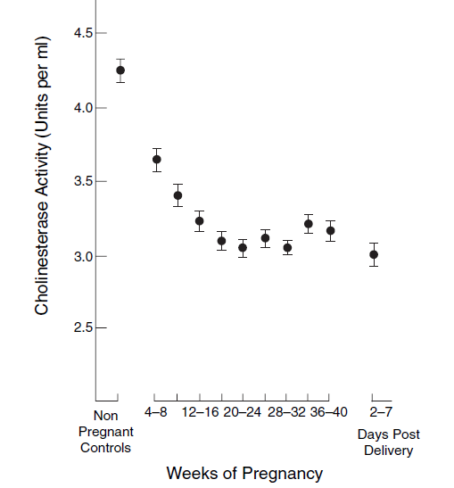
Scoline

Slide 48

Vecuronium
Faster onset
Less dose
Less duration ( faster clearance )
Atracurium – no change
Prefer atracurium

Slide 49
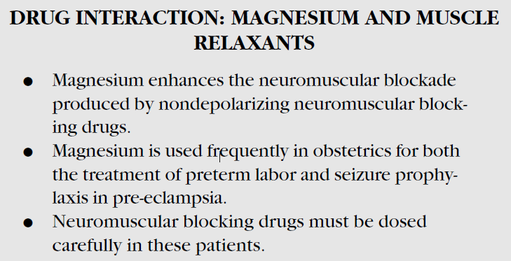

Slide 50
Vasopressors
Ephedrine does not cause uterine artery constriction
But phenylephrine does
Ephedrine crosses placenta but Ph ??
Newer concepts Ph. √ --- hypo ??

Slide 51
Both depolarizers and NDPs don’t cross placenta
But NDPS IN LARGE DOSES..
intubate with scoline !!

Slide 52
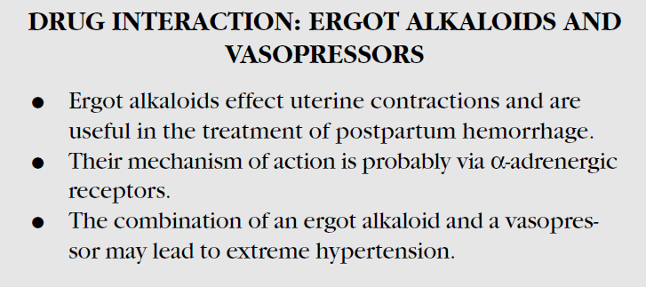

Slide 53
Antihypertensives
Animal studies have shown that nifedipine decreases uteroplacental blood flow and worsens the fetal condition, whereas human studies have shown either no change in uteroplacental blood flow or vascular resistance or a decrease in vascular resistance
Potentiate agents

Slide 54

Mahamaham
We don’t want any more catastrophes
Beware of combination of nifidipine and magnesium

Slide 55
Antihypertensives
Magsulf – better uterine blood flow
But NTG increase UBF – placental perfusion ??
Labetalol, the most commonly used antihypertensive during pregnancy, has a low F/M ratio of 0.38 with long term oral administration, despite reports of mild neonatal bradycardia
Esmolol – fetal brady and decreased UBF – NO
NO ACE inhibitors

Slide 56
UBF and placental flow
The uteroplacental circulation is a dilated, low resistance vascular bed with limited ability for
autoregulation
UBF may not match placental flow

Slide 57
Vagolytics
Intravenous glycopyrrolate (0.005 mg/kg) and intravenous atropine (0.01 mg/kg) administered to laboring parturients have equal effects on maternal heart rate and blood pressure.
Scopolamine, used in the past for “twilight sleep” in labor, has a similarly rapid intramuscular absorption rate with an elimination half-life during pregnancy of 1 hour
Glyco crosses placenta ??
Glyco – OK

Slide 58
Inotropes
Mother profile otherwise
No specific advantages

Slide 59
Methyl xanthines
Methylxanthines are associated with the release of endogenous catecholamines;
hence halothane can induce dysrhythmias.
This problem can be exaggerated if the parturient receives ephedrine.
Deriphyllin antagonizes pancuronium - ? Mechanism

Slide 60
Anti aspiration drugs
Nonparticulate antacid √
Ranitidine √
Omeprazole √
Metoclopramide √
Ondansetron √
Droperidol

Slide 61
Gestational age may alter placental transfer, although the direction of the alteration requires further evaluation.
Although traditional belief holds that placentas from younger fetuses are more likely to transfer substances, one study has demonstrated that methadone transfer is 30% lower in human preterm placentas than in term placentas.

Slide 62
Heparin and protamine don’t cross at all

Slide 63
WHY ??
During a contraction – can we inject epidural drug
During a contraction can we give IV injection
NO
YES

Slide 64
Summary
Pharmacokinetics and pharmacodynamics
Placental transfer formula
Factors – for K
Drugs
LA, opioids, induction, inhalation ,
Magsulf , antihypertensives
Vagolytics
Relaxants, heparin,glyco,phenpress- don’t cross
droperidol ??

Slide 65


Sheep placenta – equate with human ??

Slide 66

We should know the nuances – yet
Which are more problematic
Hypotension ,
Hypoxia
Hypercarbia
Acidosis
Think – drug necessary – then administer

Slide 67

Thank you all

