Slide 1
Anaesthesia for Patients Undergoing Hip Fracture Surgery
Dr. S. Parthasarathy
MD., DA., DNB, MD (Acu), Dip. Diab. DCA,
Dip. Software statistics, PhD(physiology)
Mahatma Gandhi Medical College and Research Institute, Puducherry, India

Slide 2
What is common for both??

Slide 3
77 000 new hip fractures in one year in UK
In MGMC alone ,
Almost 400 cases/year are conducted
In kumbakonam – private hospitals. 10 / week
Consider the Indian statistics !!

Slide 4
Approximately 98% of hip fractures are managed surgically,
WHY ??
fixation provides the best analgesia
chance of rehabilitation
reduces the risk of complications such as pneumonia and pulmonary embolism.

Slide 5
Age old problem !!
36 hours from admission – anaesthesia
52% of all hip fracture patients are ASA 3,
10% are ASA 4

Slide 6
Preoperative management

Slide 7
The three key features
analgesia,
resuscitation
optimization of pre-existing medical conditions.

Slide 8
analgesia,
Epidurals
Parenteral pethidine
IV paracetomol
Fascia iliaca block

Slide 9
Indications of fascia iliaca block
Perioperative analgesia for patients with fractured neck or shaft of the femur
· Adjuvant analgesia for hip surgery depending on the surgical approach
· Analgesia for above knee amputation
· Analgesia for plaster applications in children with femoral fracture
· Analgesia for knee surgery (in combination with sciatic nerve block)
· Analgesia for lower leg tourniquet pain during awake surgery

Slide 11
The Fascia Iliaca Compartment is a potential space
· Anteriorly: the posterior surface of the fascia iliaca,
· Posteriorly: the anterior surface of the iliacus muscle and the psoas major muscle.
Medially: the vertebral column
cranially laterally the inner lip of the iliac crest.
Cranio medially: it is continuous with the space between the quadratus lumborum muscle and its
fascia.

Slide 13
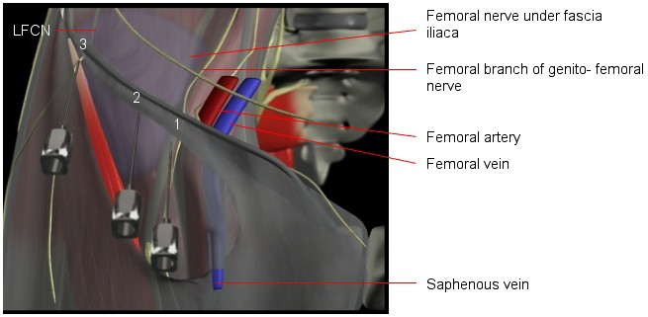

Slide 14
Technique
Infiltrate
Cranially 60 degrees
Two pops
Down to 30 degree
Aspirate 5 ml increments .. 40 ml of 0.2 % bupivacaine
No pain, paresthesia , resistance
Press finger down
Flow up to block nerves

Slide 16
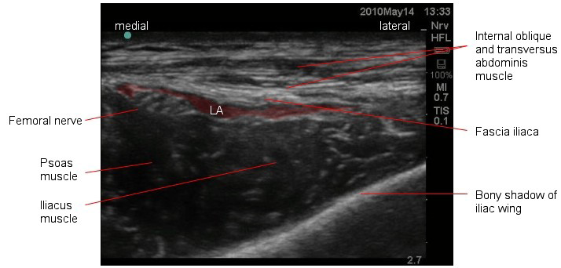
Move the probe cranially

Slide 17
Large volume dilute solutions
Cranial spread
analgesia only
No nerve injuries
Not near vascular structures
Dynamic Vs static analgesia
Epidural??

Slide 18
Other RA options
Three in one blocks
Psoas compartment blocks described

Slide 19
Which is the best analgesic??

Slide 20
Resuscitation
IV access and fluids immediate
Intra capsular fractures bleed less
Liberal transfusion policy of 10 gm% as transfusion trigger
The amount of blood lost at surgery also varies, with intramedullary nails and hip screws losing more blood than hemi-arthroplasties
Keep it around 10 for better walks
Catheterize !!

Slide 21
Oxygen
Preop
Intra op
Post op

Slide 22
Optimisation

Slide 23
Can be postponed ??
Anaemia (haemoglobin <9.0 g.dl−1)
Dehydration or acute uraemia
Severe electrolyte imbalance (sodium <120 or >150 mmol.l−1, potassium <2.8 or >6.0 mmol.l−1)
Uncontrolled diabetes
Uncontrolled heart failure
Correctable cardiac arrhythmia

Slide 24
Co morbid conditions

Slide 25
The incidence of hyponatremia was 4%, and it was associated with a sevenfold increase in hospital mortality.
Hb value ??
After fluid administration … Hb original !!

Slide 26
Antiplatelet drugs
Aspirin no problem.. go ahead
Clopidogrel stop – assess patients needs ;;;;
Proceed with GA with caution for blood loss.
With good surgeons – loss found similar
Thromboembolic prophylaxis – definite
fixation needs priority

Slide 27
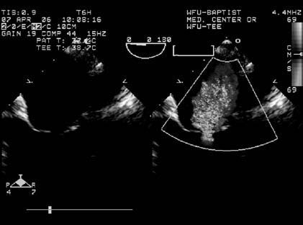
The heart murmur
Can we postpone?
No
Many have some aortic stenosis
Some fall due to it.
Many tolerate RA with AS (studies)

Slide 28
The timing of surgery
24 – 48 hours
Optimize and operate √
Optimize and wait

Slide 29
More than 48 hours
delay to surgery beyond 48 h is associated with increased 30 day postoperative mortality, complications, and length of inpatient stay.
2,75,000 patient meta analyses study !!

Slide 30
Anaesthetic implications

Slide 31
L1 to L4 and some S2,3

Slide 32
Opioids
Opioids are associated with increased postoperative confusion, which prolongs inpatient stay through delayed mobilization
40% of hip fracture patients have at least moderate chronic renal impairment (estimated glomerular filtration rate ,60 ml min1.73 m2), -- relatively higher risk for opioid toxicity.
NSAIDs further reduce renal function, and increase the risk of gastrointestinal haemorrhage.
Regularly administered paracetamol is very effective, but codeine and tramadol should be avoided.

Slide 33
meta-analysis of anaesthetic practice have failed to show any great difference in outcome between general and regional (spinal) anaesthesia
-------------------------------------------------------------
acute postoperative confusion
reduction in 30 day mortality
Pnemonia, hypoxia
RA

Slide 34
The SIGN guidelines
suggested that ‘Spinal/epidural anaesthesia should be considered for all patients undergoing hip fracture repair, unless contraindicated’.
The Scottish Intercollegiate Guidelines
Network (SIGN)
Technique varies with setup, institution and anaesthesiologist

Slide 35
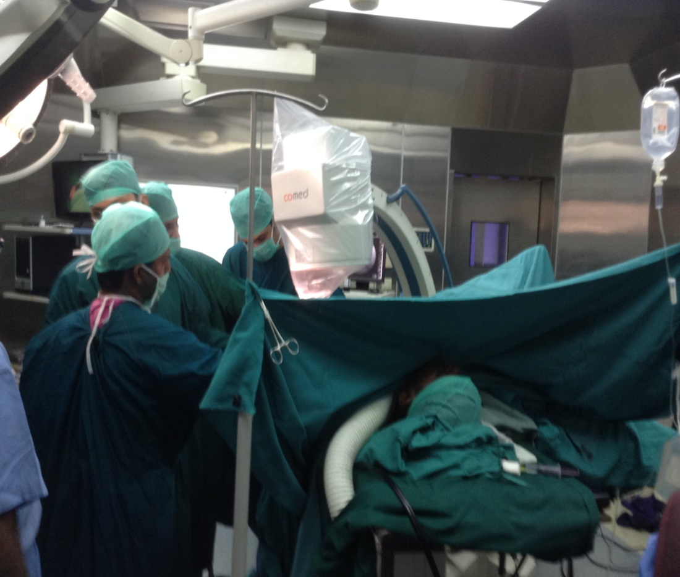
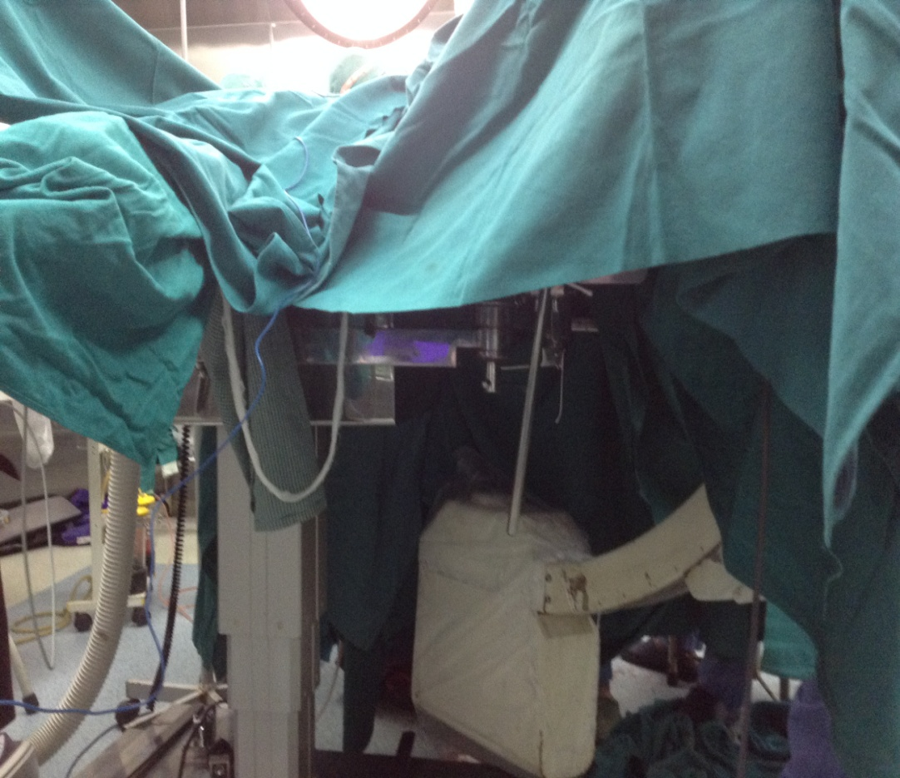
Position
Temperature
IV access ??
Oxygen
BP apparatus
Catheter

Slide 36
Intrathecal opioids
No to morphine
PONV
Fentanyl is OK

Slide 37
An anaesthetist experience
Take a 10-ml syringe, draw up 4 ml of levobupivacaine 0.5%, fentanyl 100 μg and make this up to 10 ml with normal saline.
I use 2 to 3 ml of this solution for the spinal injection,
I also perform a femoral 3-in-1 block after the spinal.
In some cases,
I perform the block before positioning the patient for the spinal.
Hypotension is rare, but if the patients have been adequately resuscitated, the incidence should be low.

Slide 38
The surgery should be completed in about 45 minutes for this technique to work!

Slide 39
Orthopedician is better OT assistant for holding position
No sedatives
No worry about cognitive dysfunction

Slide 40
Type of anaesthesia
(GA/GA with block/ GA with spinal/GA intubated/GA supraglottic device/GA inhalation/ GA TCI, etc.) (spinal/spinal with sedation/‘plain’ spinal/‘heavy’spinal/use of adjuncts, etc.)
CSEA
Can we have meta analyses ??

Slide 41
Mortality is high- 1.4% to 12%. – 1 year 25%
> 85 years
Two co morbid conditions
Cognition ?
Anemia
Previous malignancy
cardiac failure and myocardial infarction,
2 days,
pulmonary embolism, second week
bronchopneumonia, which accounts for the majority of late deaths
.

Slide 42
Bone cement implantation syndrome
BCIS is characterized by hypoxia, hypotension or both and/or unexpected loss of consciousness occurring around the time of cementation, prosthesis insertion, reduction of the joint or, occasionally, limb tourniquet deflation in a patient undergoing cemented bone surgery.

Slide 43
BCIS
Grade 1: moderate hypoxia (SpO₂<94%) or hypotension [fall in systolic blood pressure (SBP) >20%].
Grade 2: severe hypoxia (SpO₂<88%) or hypotension (fall in SBP >40%) or unexpected loss of consciousness.
Grade 3: cardiovascular collapse requiring CPR
Micro emboli and mediator release - histamine ??

Slide 44
Treatment
Aggressive oxygen
Fluid resuscitation
Vasopressors
Ventilation

Slide 45
Post op pain !!
Different types of surgical fixation have different analgesic requirements, and this should be borne in mind when postoperative analgesic regimens are considered.
Hemi-arthroplasty and total hip replacements for hip fracture are less painful than dynamic hip screws and nails.

Slide 46
Psoas compartment block
The use of a continuous regional anaesthetic technique for PCB is extremely effective, resulting in mean visual analogue scores (VAS) of 10 mm (rest) and 15–30 mm (movement) during the first 48 h postoperative after total hip arthroplasty (THA)

Slide 47
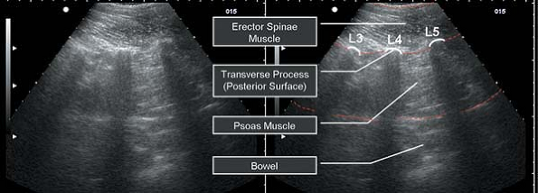
PNS is better than USG ??

Slide 48
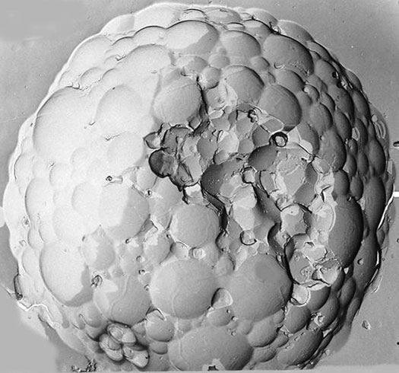
Depofoam
A new approach to postoperative analgesia hip replacement is the use of extended-release epidural morphine sulfate.
This technology is based on liposomal products into which doses of morphine 10–20 mg are incorporated.
No catheter , no worry about anticoagulation

Slide 49
Even in RA !!
far greater consideration be given to invasive arterial pressure monitoring and use of cardiac output (e.g. Doppler, CO) and
cerebral function (e.g. bispectral index, cerebral oxygen saturation) monitors
Major cases , (revision ) + cardiac disease !!

Slide 50
As a gist !!
Analgesia , resuscitation , comorbid illness
Hemoglobin values, creatinine
Blood ready – revision surgeries
Thrombo prophylaxis
Assess cardiac status ??
Other injuries ??
Pre and intra op positioning
Reaming
Temperature maintenance

Slide 51
A 75 year old female with hip # for DHS with HB of 8 gm
BP of 180/106.
RBS of 130 and normal electrolytes
Serum creatinine – 2
Echo normal

Slide 52
Criticize
Early fascia iliaca block –
check BP and drugs to continue
Preop and intra op blood
Central line for monitoring preload
Catheterize and monitor
No premed ??
Oxygen
CSEA – spinal bupi 2 ml with fentanyl 25 mic
IV para , monitor blood chemistry
Continue epidural with LA and fentanyl

Slide 53
Thank you all

