Slide 1
Sedation in regional anesthesia
Dr S. Parthasarathy MD DA DNB PhD FICA , Dip software based statistics

Slide 2
Why regional ?
For the anaesthetist,
cardiovascular and respiratory stability, rapid postoperative recovery,
preservation of protective airway reﬂexes
Use in systemic illness.
Difficult airway
Stress reduction

Slide 3
Some draw- backs
linked with regional anesthesia techniques:
pain at the puncture site,
fear of needles,
recall of the procedure.
These factors stress the importance of sedation during RA

Slide 4
If we ask a patient preop ??
Do you want a needle in the neck
Do you want a sleeping drug to make you unconscious ??
Which you will prefer ?

Slide 5
Keep sedated ??
What are the ways ??
What is the level of depression of consciousness ??

Slide 6
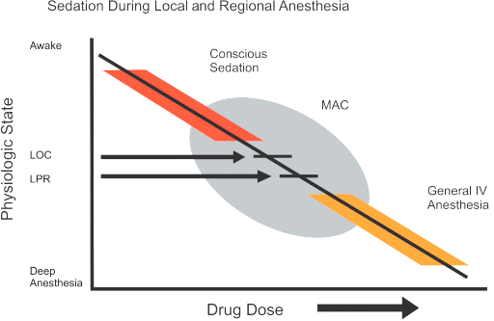

Slide 7
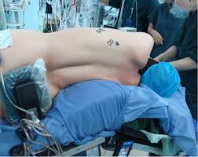
Abnormal positions
Long duration
At last 5 – 10 % of blocks are not completely foolproof – need some drugs to supplement
But no controlled studies
There are few words in Miller “ blocks work by parenteral narcotics”

Slide 8
Techniques
Non pharmacological
Pharmacological

Slide 9
Nonpharmacological
Vocal = talk but talk relevant
MUSIC : their choice , closed or open to all
Their own sets also
Decreased need for sedatives and analgesics when music is added
Closed TV circuits – in holding areas
Hypnosis and TENS also

Slide 10
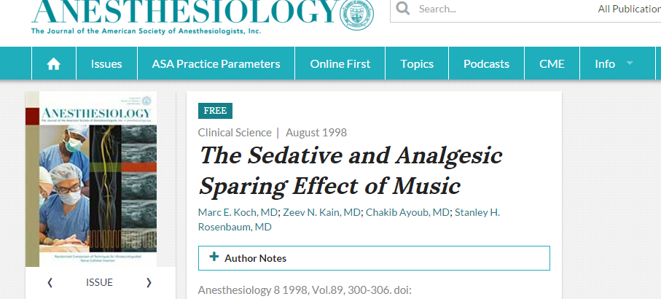

Slide 11
Pharmacological
Intravenous
Benzodiazepines,opioids, anesthetics, alpha agonists ,
NSAIDs, gabapentin, pregabalin, magnesium
Inhalational agents

Slide 12
We cant look here and there
Vigilant monitoring is a must

Slide 13
Vigilant monitoring is required because patients may rapidly progress from a "light" level of sedation to "deep" sedation and ultimately,
risk for airway obstruction, oxygen desaturation, and even aspiration.
supplemental oxygen, end-expiratory CO₂ monitoring for assessing ventilatory rate, presence of airway obstruction, and apnea.
cerebral monitoring (eg, electro encephalographic [EEG] bispectral index [BIS]) described

Slide 14
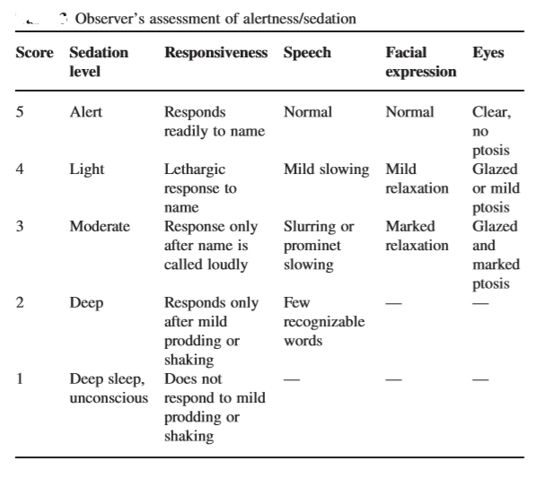
OAA/S

Slide 15
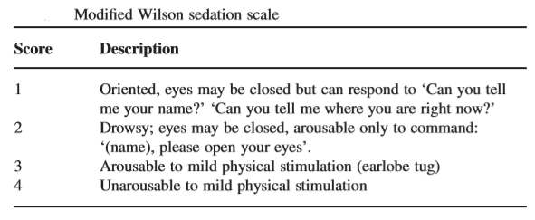

Slide 16
VAS 10
0 = totally alert
deeply unconscious = 10

Slide 17
What do we expect
Rapid onset, easy titration, and high clearance.
Amnesia !!
Analgesia , sedation, anxiolysis
No to
haemodynamic impairment, respiratory depression, and thermoregulatory interference
Already spinal ??

Slide 18
Benzodiazepines
Midazolam preferred – better recovery
produces good sedation,
excellent amnesia, anxiolysis
Flumazenil available

Slide 19
Midazolam
1 – 2 mg slow IV
Followed by 0.5 mg / hour
1 -2 µg / kg /minute
depresses respiration and arterial pressure and has no speciﬁc analgesic properties.

Slide 20
Alpha agonists - clonidine
15 – 25 µg slow IV
A dosage of 1.5 µg / kg / h was found to be clinically effective without signiﬁcant haemo dynamic impairment.
Sedation, analgesia amnesia – OK
Hypotension bradycardia , slow onset and offset ??

Slide 21
Dexmeditomidine
Fast offset
1 µg/kg – slow IV
Followed by 0.2 to 0.5 µg/kg/minute
BP fall & brady remains
Nausea and vomiting
Thermoregulation and shivering control for both

Slide 22
Propofol
Best drug – so far – universally used
25 to 100 mg slow IV
25µg/kg/minute
Good sedation , rapid recovery, amnesia
Antiemesis
But pain , BP fall, apnea remains

Slide 23
Propofol + ketamine
Infusion in the ratio of 10:1
9 MG / ML + 0.9 mg / ml
0.2 ml / minute
Analgesia + BP maintenance
Ketamine with midaz at the rate 0.5 mg /kg /hour

Slide 24
Opioids
Analgesia
Sedation
Naloxone
But nausea, respiratory depression , itching and other side effects
No anxiolysis

Slide 25
Morphine , fentanyl – described
But remifentanil at the dose of 0.1µg/kg/minute
But midaz addition – more hypoxemic episodes
Midaz + fentanyl
Midaz + alfentanil
Propofol with fentanyl regimens described

Slide 26
Inhalational agents
Adding nitrous preferably below 25%
Low dose agents alone or with IVS
Isoflurane 0.7 %
Sedation level ? POCD ?

Slide 27
Mask ,LMA
But theatre pollution remains
Sevoflurane ok but postop excitement

Slide 28
Others
NSAIDs –sedation or post op pain ?
Gabapentin – 300 to 1200 mg oral one hour prior
Pregabalin 75 – 150 mg oral one hour prior
Local capsaicin ??
Magnesium

Slide 29
Magnesium
Usual regimens of magnesium sulfate administration were a loading dose of 30-50 mg/kg followed by a maintenance dose of 6-20 mg/kg/h (continuous infusion) until the end of surgery.

Slide 30
patient-controlled sedation
(PCS), the patient has a button which is linked to the pump which gives a bolus of a sedative drug and allows the patient to titrate the sedation according to their need.
To avoid over sedation, most PCS protocols have a lock-out period of 1–3 min.
Both propofol and midazolam used

Slide 31
PCS
Satisfaction better
Amnesia better
No extra side effects
Studies successfully using PCS for cataract surgery = published

Slide 32
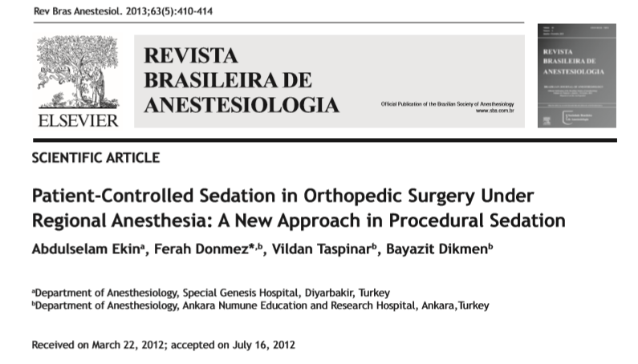

Slide 33
What is PMS ??
Patient maintained sedation
TCI system is equipped with a demand button giving patients the option to increase the target concentration to their needs
Experimental

Slide 34
Summary
Why regional
Why sedation
Non and pharm
IV and inhalational
Oral
PCS and PMS

Slide 35
Thank you all

