Slide 1
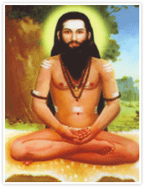
Retrograde intubation
Dr. S. Parthasarathy
MD., DA., DNB, MD (Acu),
Dip. Diab. DCA, Dip. Software statistics
PhD (physio)
Mahatma Gandhi Medical college and research institute , puducherry , India

Slide 2
Mostly it is like this??

Slide 3
But sometimes??

Slide 4
History
The first reported case of retrograde intubation (RI) was by Butler and Cirillo in 1960.
The technique involved passing a red rubber catheter cephalad through the patient's previously existing tracheostomy. When the catheter exited the oral cavity, it was tied to the endotracheal tube (ET), allowing it to be pulled into the trachea.

Slide 5
History
Waters, a British anesthesiologist in Nigeria
cancrum oris
Cricothyroid puncture
Touhy needle
Epidural catheter
Hook
Catheter through nares
Nasotracheal intubation

Slide 6
Misnomer
Translaryngeal guided endotracheal intubation
But the name remains
FOL
1993 ASA difficult airway Task Force

Slide 7
Indications
Cervical Spinal cord injury, Ankylosing spondylitis, Rheumatoid arthritis,
Cancrum oris, Mandibular or maxillary fracture, Mandibular prognathia, Perimandibular abscess,
Ankylosis of temporomandibular joint, Microstomia, Macroglossia,
Cancer of tongue, Oral myxoma, Lingual tonsil, Hypopharyngeal tumors,
Laryngeal cancer, Pharyngeal abscess,
Epiglottitis, Pharyngeal edema, Laryngeal edema after burn,

Slide 8
Coronary artery bypass grafting
Sitting or supine position
Even reports of double lumen tubes with retrograde intubation done

Slide 9
Fibreoptic laryngoscope redefines criteria

Slide 10
CONTRAINDICATIONS
UNFAVORABLE ANATOMY
LARYNGOTRACHEAL DISEASE
COAGULOPATHY
INFECTION

Slide 11
Anatomy
The cricoid cartilage and CTM should be identified preoperatively in every patient
Cartilage and membrane, vascular structures, and the thyroid gland are relevant.

Slide 16
Technique - PREPARATION
The ideal position for RI is the supine sniffing position with the neck hyperextended
trachea and cricoid cartilage pushed anteriorly
the strap muscles of the neck laterally
Sitting and neutral are described
Skin preparation

Slide 17
Technique follows

Slide 18
Local anaesthesia
an awake RI can be performed with translaryngeal anesthesia (4 mL 2% lidocaine)
with topicalization (nebulized or sprayed local anesthetics) of the pharynx and hypopharynx
Beware of needle breakage

Slide 19
Crico thyroid and cricotracheal
Cricothyroid – less chance of esophageal injury but also less chance of successful intubation

Slide 20
Entry site – crico thyroid or cricotracheal

Slide 21
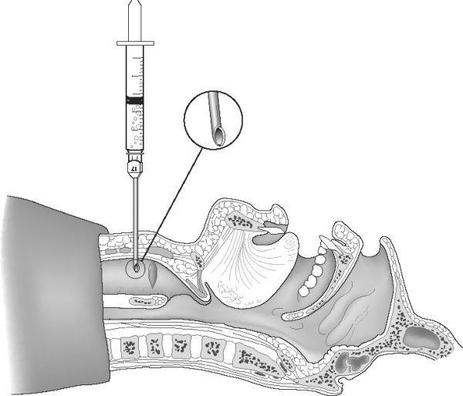
Incision
Puncture with needle - slow
Huber tip above
Air

Slide 22
Angle cephalad

Slide 27
Murphy eye

Slide 36
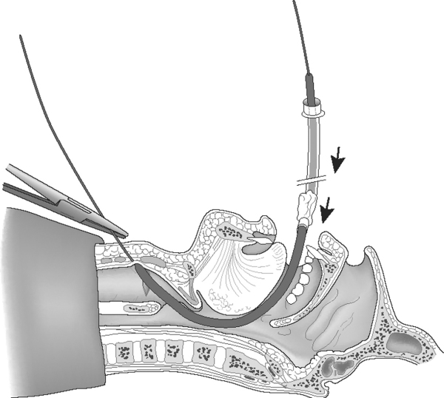
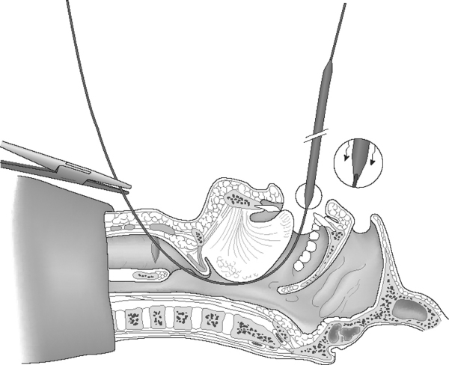
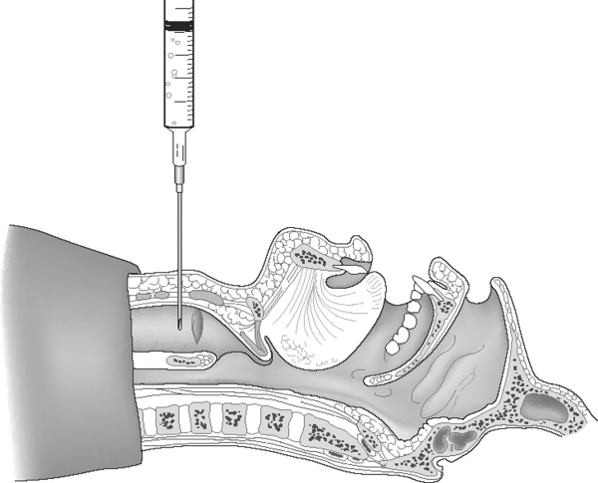
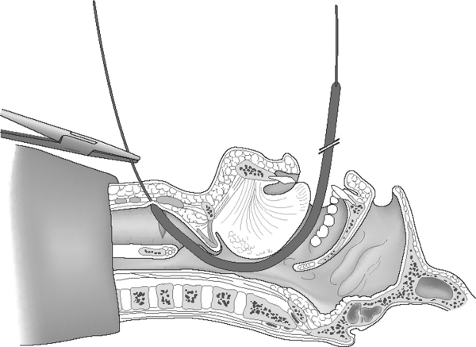
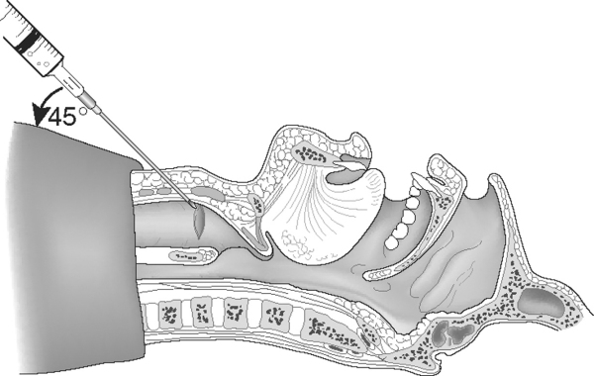
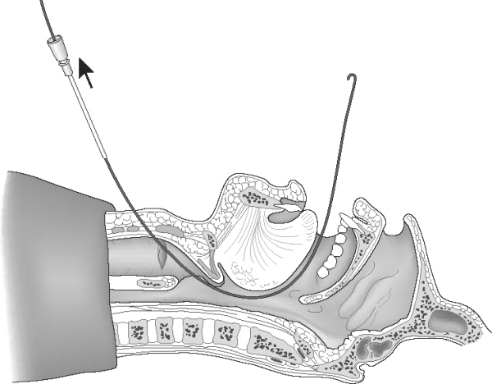
Angiocath – guidewire- catheter

Slide 37
Cook retrograde kit
An atraumatic “J” guidewire is the preferred retrograde device.
These guidewires are typically 0.032 to 0.038 inches in diameter, being able to pass though an 18-gauge intravenous catheter.
The typical length is between 110 and 120 cm. The only requirement for length is that the wire be more than twice as long as the tracheal tube to be used.

Slide 38
FIBEROPTIC TECHNIQUE
FOB and RI has limitations.
In some cases, the combination of two techniques can be successful when previously either technique alone has failed. The outer diameter of the guidewire and the internal diameter of the suction port of the FOB form a tight fit that prevents railroading between both cylinders, allowing the FOB to follow a straight path through the vocal cords without being caught on anatomic structures.

Slide 39
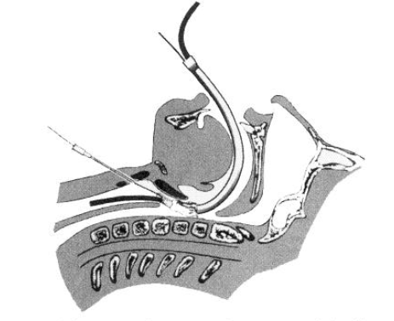
A Modification of Retrograde Wire-Guided, Fiberoptic-Assisted Endotracheal Intubation in a Patient with Ankylosing Spondylitis
.

Slide 40
Alternative retrograde techniques
Alternative retrograde techniques utilize infracricoid puncture, a bronchoscope, a light wand or a multilumen catheter over the guide
Retrograde intubation with epidural catheter and Cook airway exchange catheter

Slide 41
The silk technique
employs the principles and equipment of the classical technique, with the addition of a length of silk suture (3-0 nylon monofilament may also be used).
Once the epidural is out of either the oral or nasal cavity , the silk suture is tied to the cephalad end of the catheter

Slide 43
Silk can be kept for reintubation !!

Slide 44
Epidural and ureteral catheter
Retrograde nasal

Slide 45
Railroading

Slide 46
Disadvantages
It is invasive
advancement of the tracheal tube is blind

Slide 47
Physiology
Sympathetic stress responses (increased heart rate, blood pressure, intraocular pressure, and intracranial pressure and elevated catecholamine levels) have been reported.
RI, performed skillfully, is not more stimulating than any other technique for managing the airway.

Slide 48
Physiology – OK

Slide 49
Paediatrics

Slide 50
pediatric patients
problems of small anatomic structures that are difficult to palpate,
immature anatomic structures such as anterior larynx and narrow cricoid cartilage, congenital anomalies,
pathologic disorders that intimately affect the airway

Slide 51
Pediatrics
combination of fiberoptic with retrograde guidewire intubation, used
1. Higher success rate
2. Faster intubation
3. Ability to insufflate oxygen through the suction port of the FOB
4. No hanging up of the ET in the glottis
5. No need to rely on anatomic landmarks to guide the FOB into the trachea
6. Less requirement for experience to manage the FOB

Slide 52
Complications
Looks dangerous
But complications are less
Bleeding and subcutaneous emphysema
Pneumomediastinum,
Breath holding,
Catheter traveling caudad,

Slide 53
Complications
1. failure
2. Guidewire fracture, in which wire had to be surgically removed
3. Loss of hook (the type that was originally used by Waters and is no longer used)
4. Pneumothorax, which necessitated a chest tube
5. Pretracheal abscess in diabetic patients after multiple punctures at the CTM requiring incision and drainage

Slide 55
When there is bleed !!
1. Avoid RI in patients with bleeding diathesis.
2. Apply pressure to the puncture site for 5 minutes.
3. Apply pressure dressing to the puncture site for 24 hours.
4. Maintain patient in the supine position for 3 to 4 hours after puncture

Slide 56
What Barasch tells !!
Preferably, it should be learned on a simulator/mannequin model before being attempted in a patient.
In addition, unless is practiced often, it may be time-consuming.
For this reason, may be a poor choice for rescue of an acutely compromised airway.

Slide 57
Sometimes we see people like this

Slide 58
Sometimes we see people like this

Slide 59
Thank you all

