Slide 1
Intrathecal adjuvants
Dr. S. Parthasarathy
MD., DA., DNB, MD (Acu),
Dip. Diab. DCA, Dip. Software statistics PhD (physio),
FICA

Slide 2
Usually local anesthetics
Other than LA some other drug is added in less quantities
Adjuvant

Slide 3
Why we should add ??
Latency i.e. time of onset of LA block
Duration of analgesia i.e. duration of sensory and motor block
Quality
Less side effects
Postoperatively
Analgesic gap elevated
Quality of analgesia i.e. patient satisfaction, care providers’ impression of pain relief
Side effects i.e. reduction of untoward effects of LA drugs
Also for chronic pain

Slide 4
Some adjuvants
Morphine
Diamorphine
Buprenorphine
Pethidine
Tramadol
Fentanyl
Pentazocine
Sufentanil
Others
Opioids
Midazolam
Neostigmine
Alpha agonist
Epinephrine
Ketamine
Adenosine
Somatostatins
Ketoroloc
magnesium

Slide 5
Opioids
Intrathecal opioids bind to a family of G-protein-linked pre- and postsynaptic opioid receptors in Laminae I and II of the dorsal horn. Receptor activation leads to G-proteinmediated potassium channel opening (mu and delta) and calcium channel closure (kappa), with an overall reduction in intracellular calcium. Less glutamate

Slide 6
Intrathecal opioids
Stimulates Dorsal horn opioid receptors
G protein linked K + channel opening and Ca + channel closure
Decreased glutamate and substance P from C fibres
Decreased nociception
Others
Local anaes properties – pethidine , fentanyl
Modify descending pathways
Increased CSF adenosine – may be one cause

Slide 7
Chemistry
High lipophilicity – more potent – less duration – less cephalic spread
More hydrophilic – less potent – more duration – more cephalic spread
Fentanyl
Morphine

Slide 8

See that !!
fentanyl is only four times more potent than morphine when administered intrathecally
but 100 times more potent after systemic administration
Cant equate !!

Slide 9
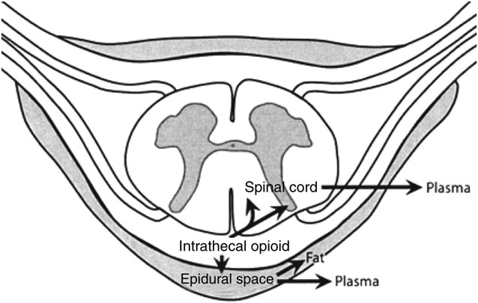

Slide 10
Cephalad spread
1. Bulk flow of drug in a caudal-cephalad direction.
2. Fluctuating pressure changes within the thorax as a result of respiration, facilitating cephalad flow of CSF.
3. Expansion and relaxation of the brain, occurring as a result of the cardiac cycle. This helps to create a backward and a forward motion of CSF with a net transfer of opioid in a cephalad direction

Slide 11
Morphine
Octanol partition coefficient – 1.8 (lipophilicity)
Less lipophilic
More cephalad spread
100 microgram dose – usual
Can go upto 0.3 mg , Or 10 - 20 mic. Kg
Spinal, OBG , ortho , general surgeries
Very effective analgesia – decreased VAS, decreased PCA etc..

Slide 12

Side effects
sedation,
sweating,
delayed gastric emptying,
urinary retention,
pruritus,
nausea and vomiting,
respiratory depression

Slide 13
Respiratory depression –( 0.3 – 7 % )
The risk factors
increasing age,
the concomitant use of long-acting sedatives,
positive pressure ventilation,
co-existing respiratory disease.
Cautious Parenteral use of opioids

Slide 14
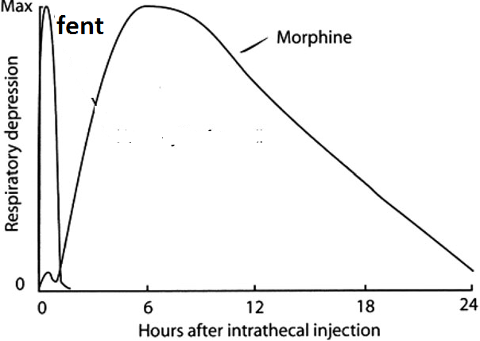
Early and late

Slide 15
Pruritus
Incidence – 1 – 100 % !! 70 – morphine, 10 – fent
Special itch C fibres
Pregnant females – more- in the face and thorax – manifest – cephalad spread to nerve 5
No histamine release – no AH
Ondan ,diclo propofol – decreases itch
naloxone (2 micg/ kg/ h)
naltrexone (6–9 mg)
release itch maintain pain relief

Slide 16
No neuro toxicity
There is no evidence that single, repeated, or continuous administration of the commonly used opioids such as morphine and fentanyl produce deleterious changes in the spinal cord of humans or monkeys
High dose morphine IT 10 -20 mg hyperalgesia !!
Probably through substance P

Slide 17
Nausea and vomiting
The incidence of nausea and vomiting associated with neuraxial opioids is 20-50%.
It is more common in females and with intrathecal morphine.
It is thought to be mediated by cephalad migration of the opioid to the chemoreceptor trigger zone
Transit time and hypomotility !!??
Naloxone !!

Slide 18
Urinary retention
The incidence of urinary retention is approximately 30-40%.
more common in young men and with intrathecal morphine.
It is mediated by opioid receptors in the sacral spinal cord.
This inhibits sacral parasympathetic outflow that leads to detrusor relaxation.

Slide 19
Fentanyl
10 -25 mic can intensify block
Decrease the need of LA
Decreased hemodynamic changes
Prolonged post op analgesia
Duration – less !!

Slide 20
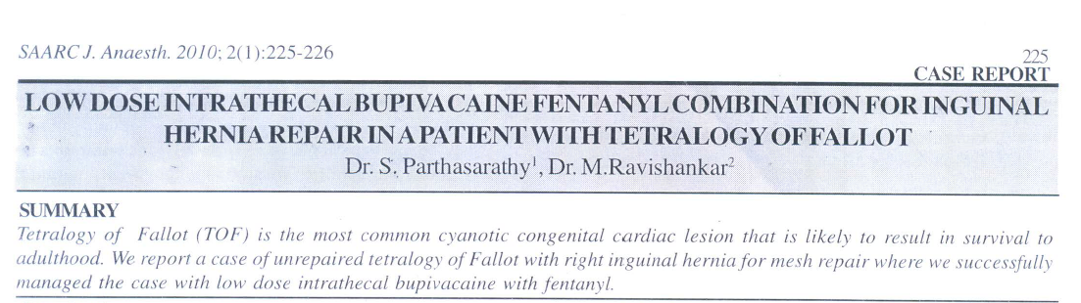

Slide 21
tramadol & sufentanil
Sufentanil
Doses of 2. 5 mic to 7.5 mic
Mainly used for labour analgesia
Similar to fentanyl
LSCS with low dose bupivacaine
Tramadol – 10 – 50 mg
Mu and monoaminergic actions
Analgesia
But nausea and vomiting with higher doses more than 10 mg

Slide 22
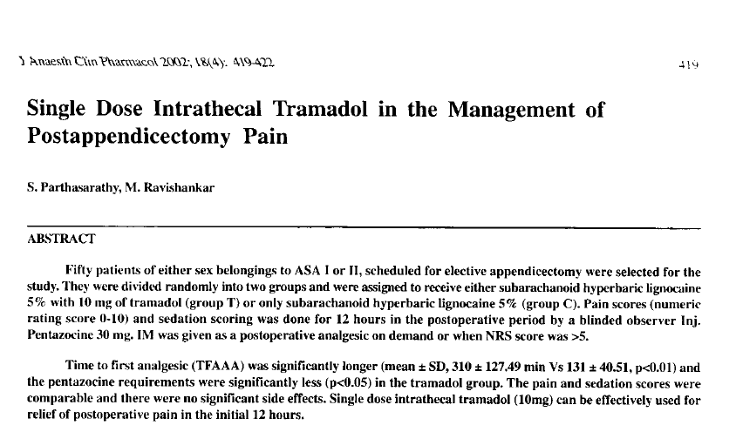

Slide 23
Diamorphine
Diamorphine is a lipid soluble pro drug
Oct. Water PC – 180
Esterase metabolism
Morphine derivatives
Pharmacokinetics unpredictable
Out of use

Slide 24
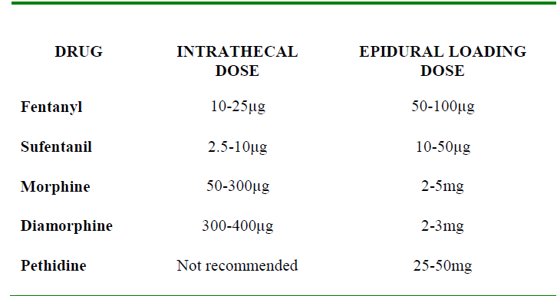
5min. - 1-4 hours
5 min – 2-4 hrs
30 min. 18-24 hrs
.
.

Slide 25
Mixtures
Morphine + fentanyl
buprenorphine + fentanyl
Morphine + sufentanil

Slide 26
Epinephrine
0.2 - 0.3 mg prolongs lignocaine and tetracaine anesthesia
But may have no effect on bupivacaine
No proved neurotoxicity
No to ambulatory anaesthesia
limits LA absorption,
increases neuronal exposure,
enhances duration of action,
enhances the quality of block,
limits toxicity of LA drugs
Phenylephrine
2-5 mg

Slide 27
Alpha 2 agonists
Clonidine
Dexmedetomidine

Slide 28
Clonidine
activating post junctional α2-adrenoceptors in the dorsal horn of the spinal cord.(also central)
Basic is sympatholysis
15 to 150 μg have been used
Synergy with opioids
increased duration of anesthesia, analgesia and motor blockade.
Sedation, brady, hypotension
Unlike opioids

Slide 29
Clonidine
Decreased narcotic requirement by 30 %
Can be added with narcotics
Decreased pain in chronic cancer pain even if refractory to opioids

Slide 30
Dexmed
5 µg dexmedetomidine seems to be an attractive alternative as an adjuvant to spinal ropivacaine in surgical procedures, especially those requiring long time.
It has excellent quality of postoperative analgesia with minimal side effects.

Slide 31
Dexmed
3 mcg of intrathecal dexmedetomidine was found to be equipotent with 30 mcg of clonidine
Intrathecal dexmedetomidine 5 mcg and fentanyl 25 mcg were compared for vaginal surgeries with bupivacaine anesthesia.
Dexmedetomidine caused significantly longer sensory and motor blockade whereas peak effect and onset time were not different

Slide 32
Benzodiazepines - Midazolam
GABA 2 receptors in dorsal horn
Also delta receptors
1 -2 mg – motor block , early post op analgesia
? Prolongation of anaesthesia
12 mg / day – chronic pain
Can be combined with opioids and clonidine
Early - neuro toxicity - ? Possibly addition of 10 % HCl in preparation – now proved as nil

Slide 33
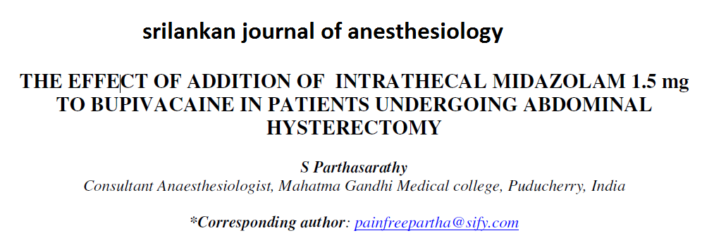

Slide 34
Ketoroloc
COX is released at the spinal level in response to acute pain and inflammation, contributing to central sensitization.
Can COX inhibitors do anything ??
In animals 2 mg intrathecal ketoroloc – decreased allodynia but usefulness ??

Slide 35
magnesium
The addition of magnesium sulfate 50 mg to bupivacaine for sub-arachnoid block in patients with mild preeclampsia undergoing elective cesarean section prolongs the duration of analgesia and reduces postoperative analgesic requirements without additional side effects and adverse neonatal outcomes

Slide 36
Gaba Receptor Agonist – baclofen ( GABA b agonist)
Intrathecal baclofen - used for spasticity and dystonia due to various conditions such as cerebral palsy and spastic post traumatic spinal cord injury
25mcg-200mcg/day is administered with programmable intrathecal pump.
Common side effects include sedation, drowsiness, headache, nausea, and weakness.
Rare - rhabdomyolysis and multiple organ failure have also been reported.

Slide 37
Neostigmine
Neostigmine administered spinally inhibits nociception in a dose dependent manner by increasing endogenous acetylcholine.
The addition of neostigmine 6.25 - 50 mcg prolonged duration of sensory and motor block .
produced a high incidence of side effects, especially nausea and vomiting- transient weakness
Unpopular

Slide 38
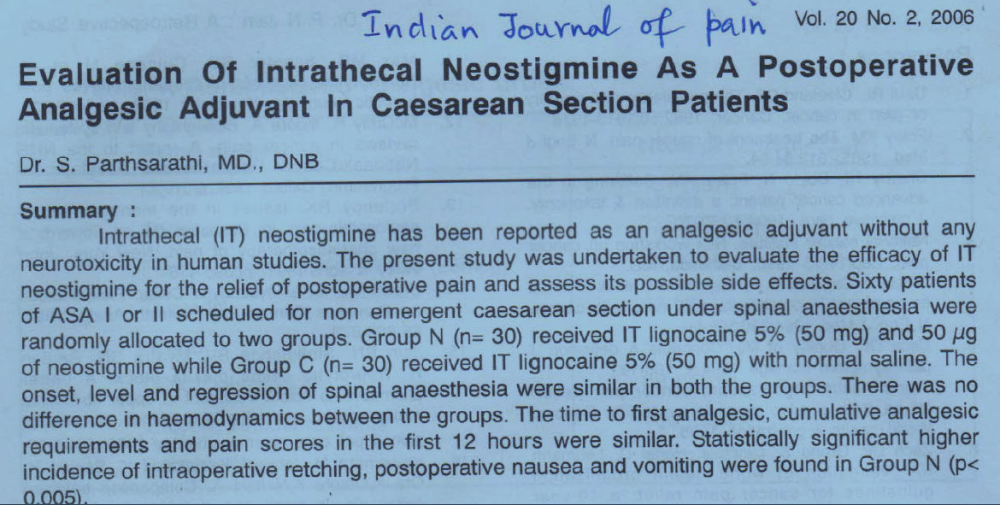

Slide 39

Calcitonin
100 μg IT decreased pain
Independent of bony actions
But nausea and vomiting are high

Slide 40
Ketamine
Ketamine is a non-competitive NMDA receptor antagonist.
antagonising NMDA receptors located on secondary afferent neurons in the dorsal horn of the spinal cord.
reduces the transmission of nociceptive information in the spinal cord
important role in preventing central sensitisation, windup and long term potentiation which are all involved in chronic pain.

Slide 41
Ketamine
0.5 mg/kg
Can combine with opioids
Sedation + headache reported
But no vomiting
Hemodynamic stability – yes
Alone used or with minimal LA !!

Slide 42
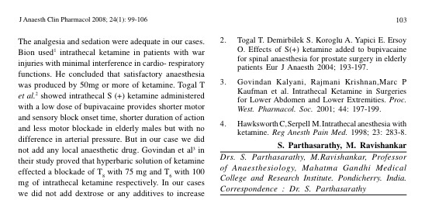
JOACP 2008; 24(1)102-103. Use of intrathecal ketamine in two difficult cases.

Slide 43

Adenosine
Intrathecal adenosine ( about 1 mg) does not inhibit acute pain but rather is more effective in treating allodynia and hyperalgesia.
neuropathic pain
A1 receptors
Less side effects
Delayed onset after 6- 10 hours
Promising

Slide 44
Calcium channel blocker
Ziconotide is a highly selective reversible blocker of N type voltage dependent calcium channels which are active in the dorsal horn of the spinal cord, cerebral cortex, and neurohyophysis .
Ziconotide is effective for the treatment of both nociceptive and neuropathic pain
2 – 3 μg / day - twice a week – but nystagmus, ataxia, sedation remains

Slide 45
Newer drugs
Resiniferatoxin
Resiniferatoxin is an investigational drug that desensitizes dorsal root ganglion neurons.
20 μg of octreotide – cancer pain
P-Saporin
P-Saporin is a neurotoxin which destroys cells of NK1 receptors and inhibit pain signal transmission

Slide 46
Intrathecal implantable pumps
Intrathecal pumps deliver small doses of medication directly to the spinal fluid.
It consists of a small battery-powered, programmable pump that is implanted under the subcutaneous tissue of the abdomen and connected to a small catheter tunneled to the site of spinal entry
Opioids, clonidine, ketamine

Slide 47

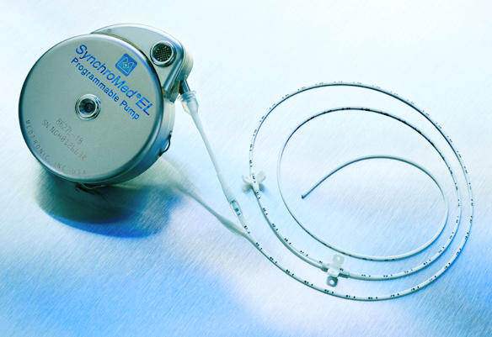
Pump and the catheter

Slide 48
Two types
Preprogrammed
Drug reservoir Into the subcutaneous tissue
Remote outside to change the dosing
Total asepsis
Morphine (pain) baclofen (spastic child)
6-9 months
5 lakhs
Asepsis
Routine epidural cath
Tunneled
All drugs
Maximum 2 weeks

Slide 49
Summary
Opioids and mixtures
Doses , effects side effects
Benzodiazepines
NSAIDs , ketamine
Alpha 2 agonists
Magnesium , calcium antagonists
Somatostatins, adenosine , baclofen
Pumps

Slide 50

Thank you all

