Slide 1
Disseminated intravascular coagulation
Dr. S. Parthasarathy
MD., DA., DNB, MD (Acu), Dip. Diab. DCA, Dip. Software statistics, PhD(physiology)
Mahatma Gandhi Medical College and Research Institute, Puducherry, India

Slide 2
Definition
Disseminated intravascular coagulation (DIC) is a clinicopathologic syndrome in which widespread intravascular coagulation is induced by procoagulants that are introduced into or produced in the blood secondary to 1 or more underlying condition(s)

Slide 3
Normal hemostasis

Slide 4
The process -- stage 1
Injury → platelet adhere (vWF),
subsequent platelet activation and aggregation
(vWf, serotonin, ADP)
↓
The platelet glycoprotein (Gp) IIb/IIIa (_{IIb3}) complex
occlusive platelet thrombus. (plug)

Slide 5
The process – stage 2
Plasma coagulation proteins (clotting factors) normally circulate in plasma in their inactive forms
extrinsic and intrinsic pathways – Active forms
Endothelial tissue factor + platelet factors
Clotting – fibrin plug ( THROMBUS )

Slide 6
Stage 3
Fibrinolytics

Slide 7
Platelet plug
Fibrin clot
Fibrinolysis +anticoagulation

Slide 8
Back to DIC

Slide 9
DIC never occurs alone
DIC is presently recognized as a deviation from the normal physiologic balance between the processes of thrombus formation and fibrinolysis.

Slide 10
Types as clinical - earlier described
Acute-
Large material , overwhelming process
Bad
Chronic –
slow process – body compensates

Slide 11
Incidence
1.5 % of in hospital patients
25 % of trauma
30 % of sepsis patients
Not uncommon

Slide 12
Causes
Infection
Trauma
Malignancy
Obstetrics
Toxic
Burns
Pancreatitis
obstructive jaundice

Slide 13
The basis
excessive generation and circulation of thrombin
impairment of the natural anticoagulant pathway
suppression of fibrinolysis

Slide 14
Pathogenesis
Malignant cells, sepsis, crush injuries
Tissue factor activated
TF + Factor VII
Activated factor IX and X
Thrombin

Slide 15
OK – now thrombin formed
There are a lot of natural anticoagulants
Should there be a problem ??

Slide 16
There are 3 most common Anticoagulants in the body:
Antithrombin,
Active Protein C
Tissue factor pathway inhibitor (TFPI).
In DIC:
↓Antithrombin
↓Active Protein C

Slide 17
Anticoagulation
Normal
DIC

Slide 18
Cascade continues

Slide 19
Fibrinolysis
Fibrinolysis is a process in which plasmin, an active form of plasminogen, cleaves fibrin and fibrinogen to restore vessel patency following hemostasis
Fibrin to FDPs √

Slide 20
Process proceeds -----

Slide 21
Malignancy – tissue factor
Sepsis – inflammatory cytokines

Slide 22
How does it present ??
Obs, bleeding
Leukemia, obs
Pre DIC
Sepsis

Slide 23
What is common ??
Acute --- bleeding manifestations
Chronic --- thrombotic manifestations
Setting of a DIC !!
Sepsis – acute
Malignancy– chronic

Slide 24
Bleeding
Bleeding is a more common clinical presentation in patients with acute, fulminant DIC.
Petechiae, ecchymoses, epistaxis, gingival/ mucosal bleeding, hematuria, and bleeding from wounds and puncture sites

Slide 25
Thrombosis- organs affected and symptoms
More chances
Less chances
Brain
Heart
Kidney
Adrenals
Spleen
Lungs
Liver

Slide 26
Lab diagnosis
Thrombocytopenia is the hallmark of DIC, and its presence should prompt consideration of DIC. (platelet count <50 · 10⁹/l)
A low platelet count on initial testing and, in particular, a progressive drop in the platelet count are sensitive signs of DIC
Thrombin induced platelet aggregation
Schistocytes on peripheral smear

Slide 27
Lab diagnosis
FDP consists of both fibrin and fibrin degradation products.
Elevated levels of FDP reflect accelerated fibrinolysis due to plasmin and are found in 85% to 100% of patients with DIC
OC pills, infarction, renal diseases ?? Test validity ??
Soluble fibrin monomer (SF) measurements offer theoretical advantages in DIC

Slide 28
Lab diagnosis
D-dimer levels are elevated in almost all cases of DIC, but it may be falsely high in infection, inflammation, pregnancy, and other conditions involving thrombosis.
PT is prolonged in 50% to 75% of DIC cases
aPTT is prolonged in 50% to 60% of patients
Fibrinogen level is low 100– both PT and apTT prolonged – acute phase reactant !!

Slide 29
Exclude heparin contamination

Slide 30
Diagnosis – in order !!
Platelets ↓
FDPs - ↑
Prothrombin time ↓
aPTT ↓
Fibrinogen ↓
In a setting

Slide 31
D dimer with fragmented red cells in a peripheral film
In a chronic setting
Normal PT and apTT
May suggest DIC

Slide 32
TEG
abnormal in septic patients, their diagnostic sensitivity/specificity for DIC is unclear
atypical light transmittance profile on the aPTT has been associated with DIC-
biphasic wave forms

Slide 33
A lot of such scores like that

Slide 34
DIC is dynamic

Slide 35
Management

Slide 36
1.Treatment of the cause
2.Blood component therapy – stop the cycle
3. Anticoagulation

Slide 37
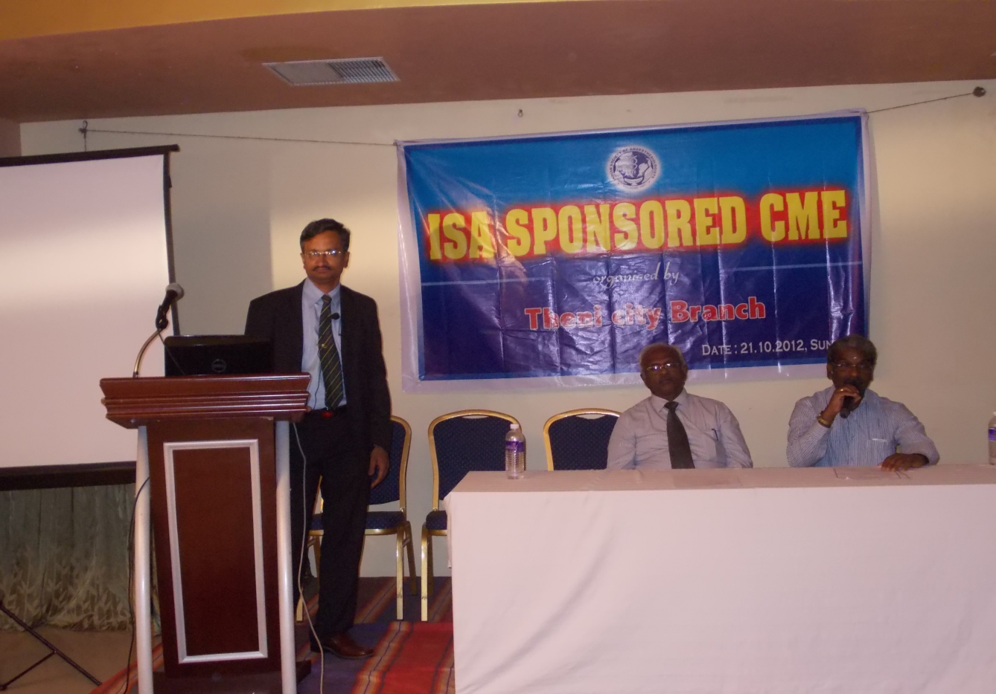
1.Treatment of the cause
Sepsis
OBG
Trauma
Malignancy?

Slide 38
Blood –
Recommended in bleeding type of DIC

Slide 40
No role for prophylaxis

Slide 41
Anticoagulation
There is no strong evidence to support the use of heparin in DIC
Shows a worse outcome in DIC patients who are treated with heparin.
Despite this controversy, it is commonly accepted to use heparin in cases where thrombosis seems to predominate (eg, purpura fulminans, solid tumors, hemangiomas, dead fetus syndrome).
5 units / kg /hour ??

Slide 42
Presently, with the exception of Trousseau syndrome (occurrence of thrombophlebitis migrans with visceral cancer), anticoagulation is not recommended as a treatment for DIC.

Slide 43
Anticoagulation
successful use of recombinant factor VIIa in patients with DIC and life-threatening bleeding.
However, the efficacy and safety of this treatment in DIC is unknown
Antithrombin concentrate – labs better but patients ??

Slide 44
Anticoagulation
Consider treating patients with severe sepsis and DIC with recombinant human activated protein C (continuous infusion, 24 mic.g/kg/h for 4 d)
Risk of bleeds
Aptt prolonged

Slide 45
Others
Synthetic protease inhibitors, such as Gabexate mesilate®and nafamostat®, exhibit multiple-functions, including antagonistic effects on the kinin/kallikrein system, fibrinolysis, complement system, and coagulation system.

Slide 46
Tx – no role
Patients with DIC that is characterized by a primary hyperfibrinolytic state and who present with severe bleeding could be treated with lysine analogues, such as tranexamic acid (e.g. 1 g every 8 h)
Possible promyelocytic leukemia

Slide 47
Comes for surgery
Perioperative goals include maintaining the platelet count in the range of 25,000–50,000/μL and the fibrinogen level greater than 50 mg/dL.

Slide 48
Summary
What is DIC ??
Causes
Clinical features
Lab diagnosis
Treatment

Slide 49
What does DIC mean
DIC = “Death is Coming

